Slide 1
Data Mining: Introduction to Statistics

Slide 2
Statistics – Introduction
2

Slide 3
Statistics – How Does it Work?
How Statistics Works
Formulate a Hypothesis
- “Smoking causes cancer”
Make Observations
- Get data regarding smoking habits and medical history
Analyze Data and Make Conclusions
- Accept or reject hypothesis
3

Slide 4
Statistics – Basic Statistical Measurements

Slide 5
Central Tendency Measures – Mean, Mode, Median

Slide 6
Central Tendency Measures – Calculation
Given the following dataset, let’s calculate the mean, median and
mode.
65 | 54 | 89 | 56 | 35 | 14 | 56 | 55 | 87 | 45 | 92
Mean
( 65 + 54 + 89 + 56 + 35 + 14 + 56 + 55 + 87 + 45 +92 ) / 11 = 58.9
Median
56
14 | 35 | 45 | 54 | 55 | 56 | 56 | 65 | 87 | 89 | 92
mode
Given that 56 is the only repeated value, it's clearly also the mode.

Slide 7
Central Tendency Measures – Mean
If you use a mean to analyze your data, you will notice that it is quite sensitive to outliers. Outliers can affect the value of the mean. When utilizing a mean, you can limit the effects of outlier data by trimming and winorizing the mean.
Let's use this data and see how the mean changes between a normal mean, trimmed mean, and winsorized mean.
Data: 1, 2, 2, 3, 3, 4, 4, 4, 5, 20
You will notice that this data has an outlier of 20, which is much larger than the rest of the data.

Slide 8
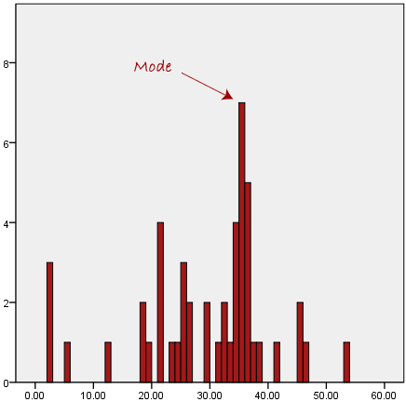
Central Tendency Measures – Mode for Categorical Data
The mode is typically used with qualitative information to identify the most frequent class, as shown below.

Slide 9
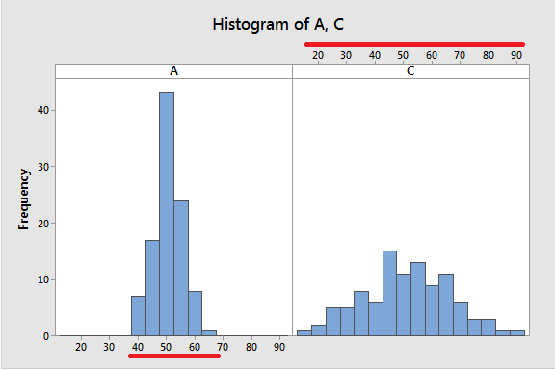
Measures of Variability – Range
Range = Highest value – Lowest value

Slide 10
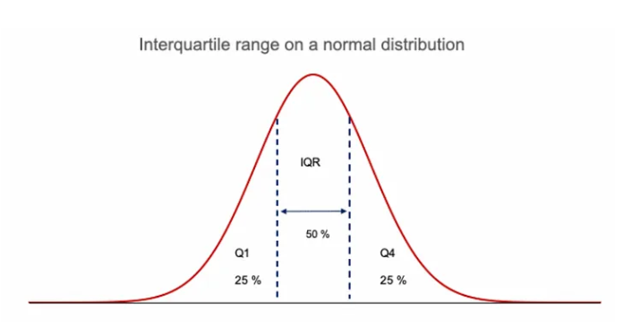
Measures of Variability – Interquartile Range
Range
Interquartile Range

Slide 11
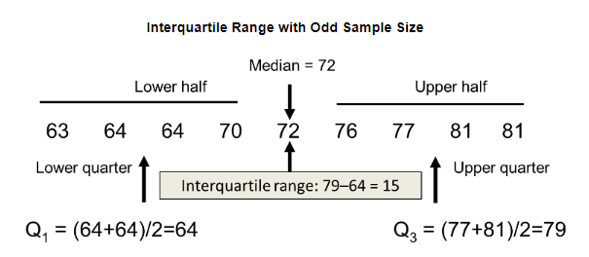
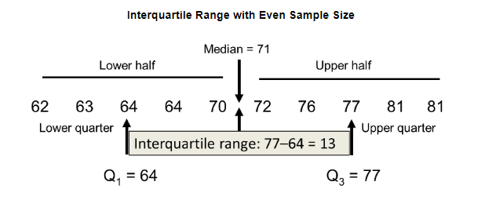
Measures of Variability – Interquartile Range
Since the interquartile range is defined using quartiles, it is a preferred measure of variation when the median is used as a measure of centre (i.e. in case of skewed distribution, where the distribution is not normal).

Slide 12
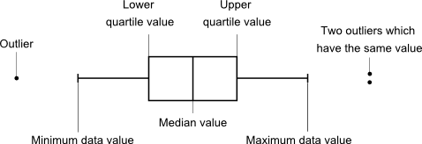
Measures of Variability – Box Plot Interpretation
Interpreting a boxplot can be done once you understand what the different lines mean on a box and whisker diagram.
The line splitting the box in two represents the median value. This shows that 50% of the data lies on the left hand side of the median value and 50% lies on the right hand side.
The left edge of the box represents the lower quartile; it shows the value at which the first 25% of the data falls up to.
The right edge of the box shows the upper quartile; it shows that 25% of the data lies to the right of the upper quartile value.
The values at which the horizontal lines stop at are the values of the upper and lower values of the data.
The single points on the diagram show the outliers.
Most of the distribution of data falls between the whiskers.

Slide 13
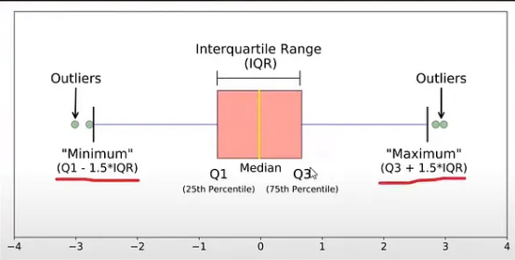
Measures of Variability – Outliers

Slide 14
Measures of Variability – Outliers Example

Slide 15
Measures of Distribution
Distribution
Histogram
Skewness
Kurtosis
Normal Distribution

Slide 16
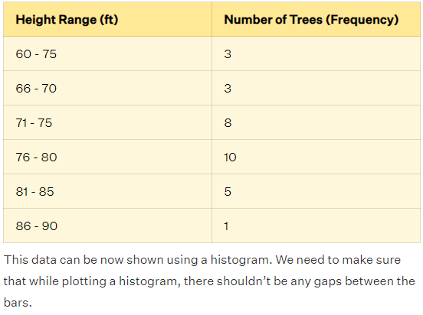
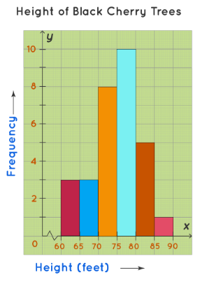
Measures of Distribution – Histograms
Uncle Bruno owns a garden with 30 black cherry trees. Each tree is of a different height. The height of the trees (in inches): 61, 63, 64, 66, 68, 69, 71, 71.5, 72, 72.5, 73, 73.5, 74, 74.5, 76, 76.2, 76.5, 77, 77.5, 78, 78.5, 79, 79.2, 80, 81, 82, 83, 84, 85, 87. We can group the data as follows in a frequency distribution table by setting a range:

Slide 17
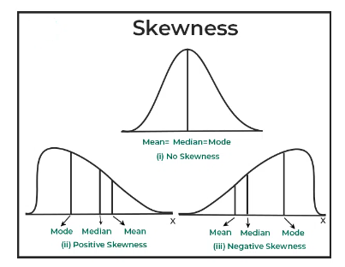
Measures of Distribution – Skewness

Slide 18
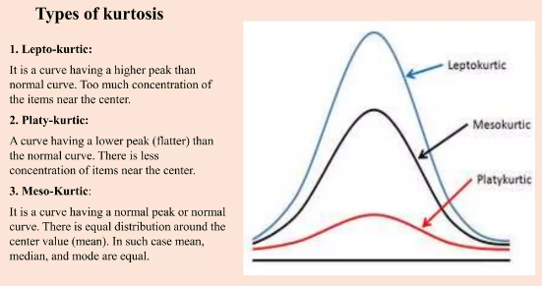
Measures of Distribution – Kurtosis

Slide 19
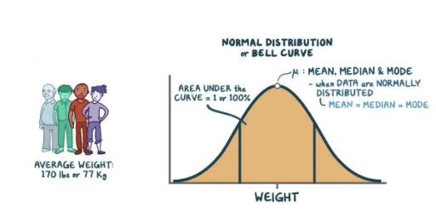
Measures of Distribution – Normal Distribution

