Slide 1
Data Mining: Introduction
Lecture Notes for Chapter 1
Introduction to Data Mining, 2nd Edition
by
Tan, Steinbach, Karpatne, Kumar

Slide 2


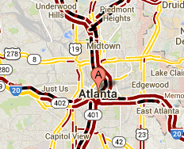
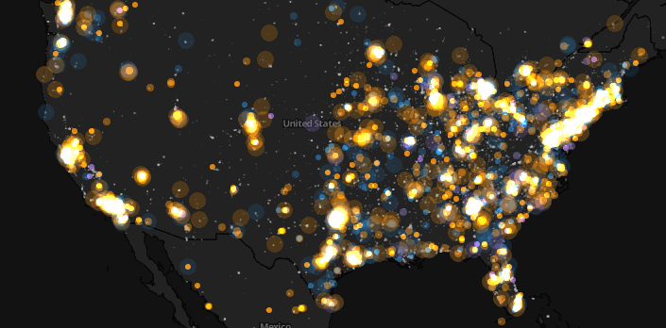
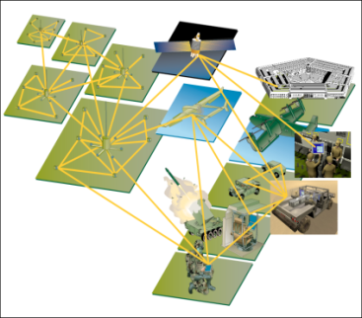
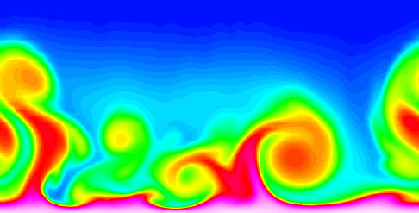
Large-scale Data is Everywhere!
There has been enormous data growth in both commercial and scientific databases due to advances in data generation and collection technologies
New mantra
  Gather whatever data you can whenever and wherever possible.
Expectations
  Gathered data will have value either for the purpose collected or for a purpose not envisioned.
E-Commerce
Cyber Security
Traffic Patterns
Social Networking: Twitter
Sensor Networks
Computational Simulations
Notes:
2

Slide 3




Why Data Mining? Commercial Viewpoint
Lots of data is being collected
and warehoused
  Web data
    Google has Peta Bytes of web data
    Facebook has billions of active users
  purchases at department/
  grocery stores, e-commerce
    Amazon handles millions of visits/day
  Bank/Credit Card transactions
Computers have become cheaper and more powerful
Competitive Pressure is Strong
  Provide better, customized services for an edge (e.g. in Customer Relationship Management)
Notes:
3

Slide 4
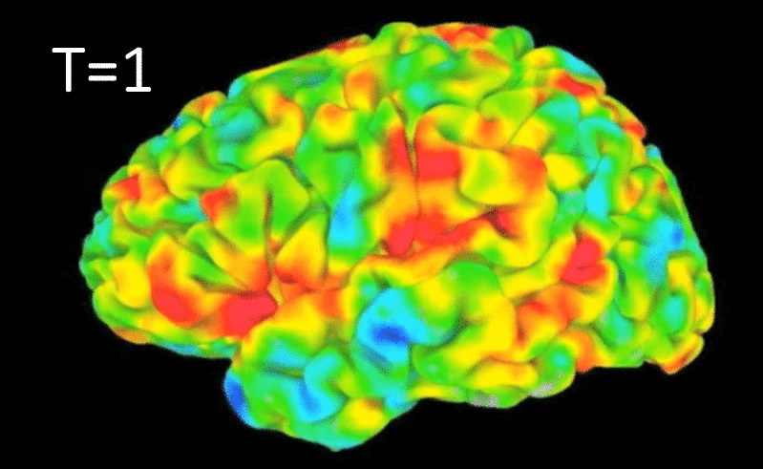
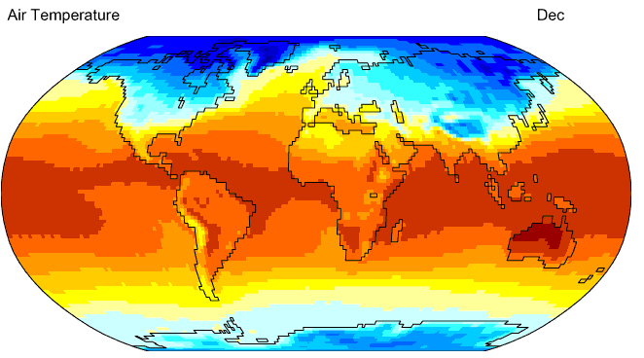
Why Data Mining? Scientific Viewpoint
Data collected and stored at
enormous speeds
  remote sensors on a satellite
    NASA EOSDIS archives over
    petabytes of earth science data / year
  telescopes scanning the skies
    Sky survey data
  High-throughput biological data
  scientific simulations
    terabytes of data generated in a few hours
Data mining helps scientists
  in automated analysis of massive datasets
  In hypothesis formation
fMRI Data from Brain
Sky Survey Data
Gene Expression Data
Surface Temperature of Earth
Notes:
4

Slide 5
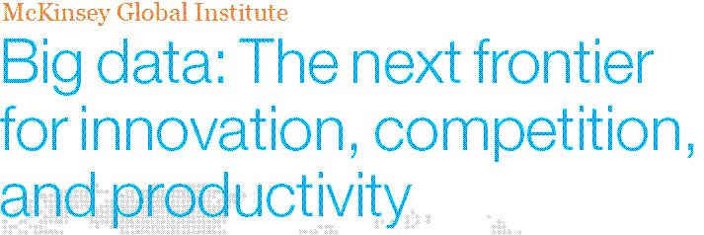
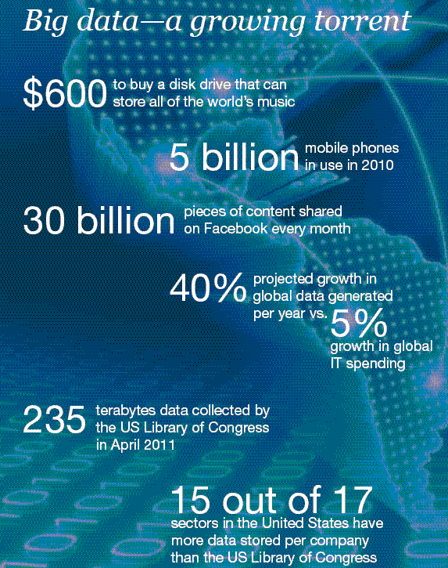
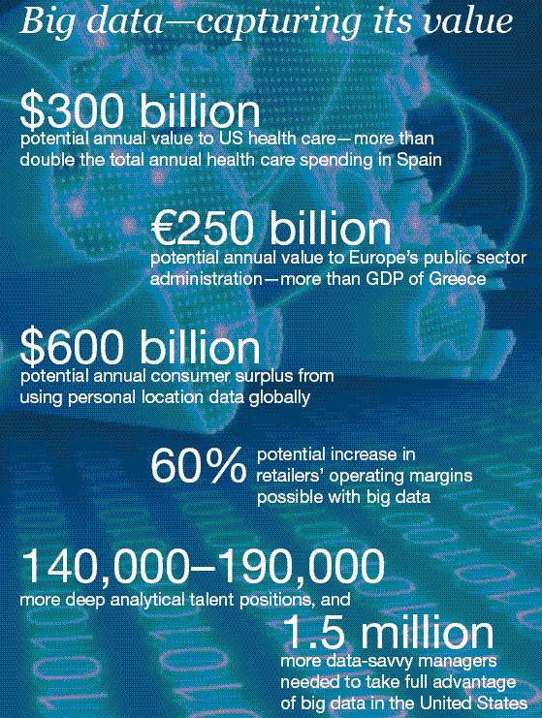
Great opportunities to improve productivity in all walks of life

Slide 6
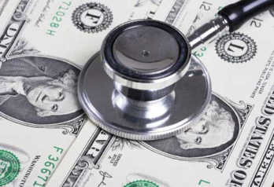
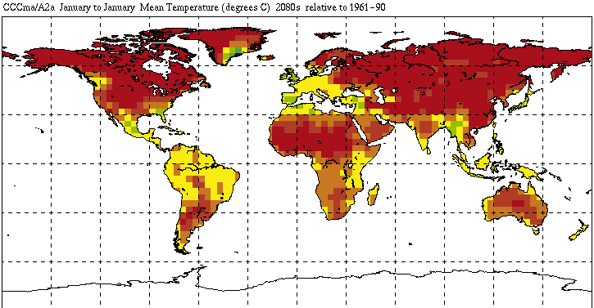


Great Opportunities to Solve Society’s Major Problems
Improving health care and reducing costs
Predicting the impact of climate change
Finding alternative/ green energy sources
Reducing hunger and poverty by
increasing agriculture production

Slide 7
What is Data Mining?
Many Definitions
  Non-trivial extraction of implicit, previously unknown and potentially useful information from data
  Exploration & analysis, by automatic or semi-automatic means, of large quantities of data in order to discover
  meaningful patterns

Slide 8
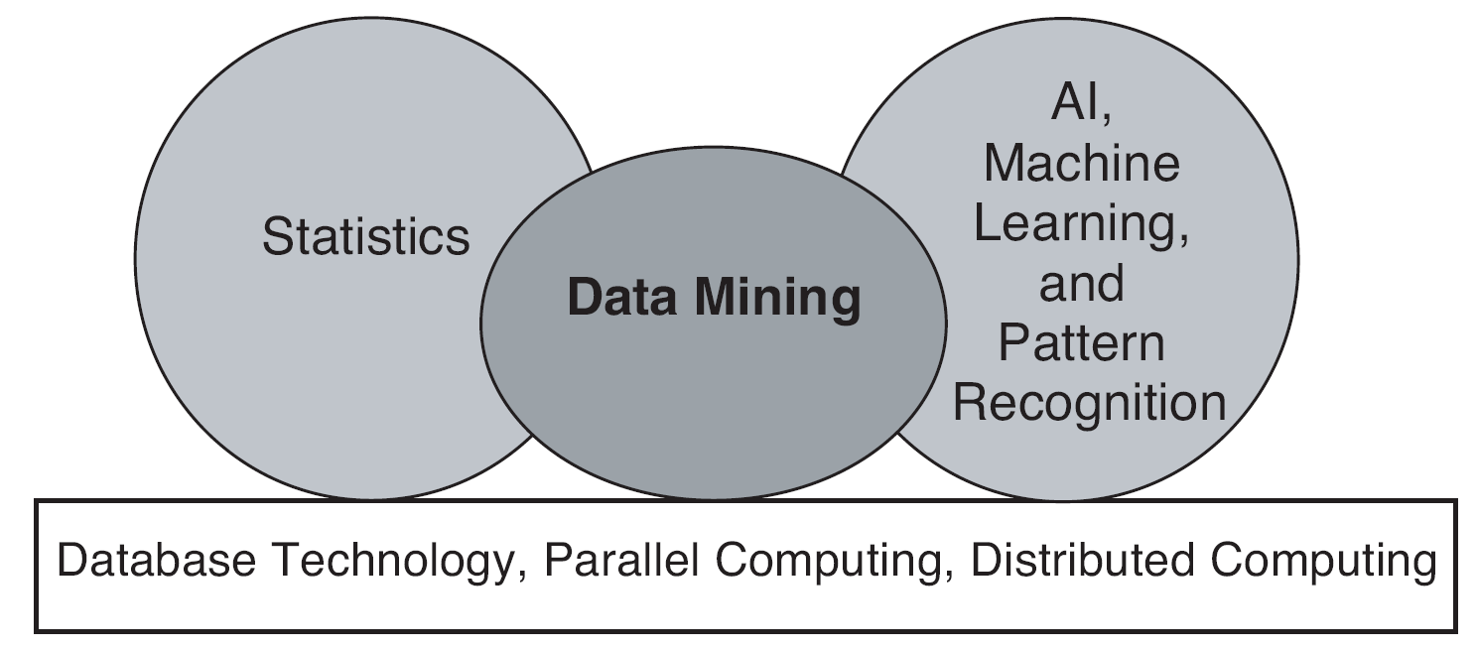
Origins of Data Mining
Draws ideas from machine learning/AI, pattern recognition, statistics, and database systems
Traditional techniques may be unsuitable due to data that is
  Large-scale
  High dimensional
  Heterogeneous
  Complex
  Distributed
A key component of the emerging field of data science and data-driven discovery

Slide 9
Data Mining Tasks
Prediction Methods
  Use some variables to predict unknown or future values of other variables.
Description Methods
  Find human-interpretable patterns that describe the data.
From [Fayyad, et.al.] Advances in Knowledge Discovery and Data Mining, 1996

Slide 10
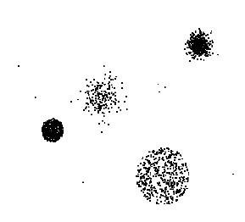

Data Mining Tasks …
Data
Clustering
Predictive Modeling
Association
Rules
Anomaly
Detection
Milk

Slide 11
Predictive Modeling: Classification
Find a model for class attribute as a function of the values of other attributes
Model for predicting credit worthiness
Class

Slide 12
Classification Example
categorical
categorical
quantitative
class
Test
Set
Learn
Classifier
Training
Set
Model

Slide 13
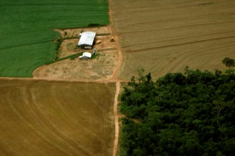
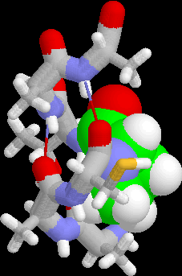
Examples of Classification Task
Classifying credit card transactions
as legitimate or fraudulent
Classifying land covers (water bodies, urban areas, forests, etc.) using satellite data
Categorizing news stories as finance,
weather, entertainment, sports, etc
Identifying intruders in the cyberspace
Predicting tumor cells as benign or malignant
Classifying secondary structures of protein
as alpha-helix, beta-sheet, or random coil

Slide 14
Classification: Application 1
Fraud Detection
  Goal: Predict fraudulent cases in credit card transactions.
  Approach:
    Use credit card transactions and the information on its account-holder as attributes.
      When does a customer buy, what does he buy, how often he pays on time, etc
    Label past transactions as fraud or fair transactions. This forms the class attribute.
    Learn a model for the class of the transactions.
    Use this model to detect fraud by observing credit card transactions on an account.

Slide 15
Classification: Application 2
Churn prediction for telephone customers
  Goal: To predict whether a customer is likely to be lost to a competitor.
  Approach:
    Use detailed record of transactions with each of the past and present customers, to find attributes.
      How often the customer calls, where he calls, what time-of-the day he calls most, his financial status, marital status, etc.
    Label the customers as loyal or disloyal.
    Find a model for loyalty.
From [Berry & Linoff] Data Mining Techniques, 1997

Slide 16
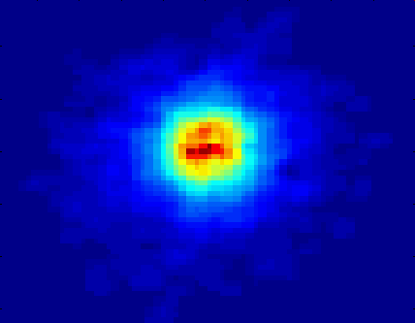
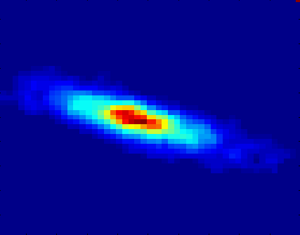
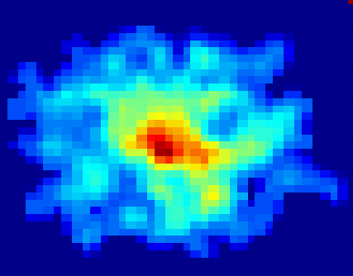
Classifying Galaxies
Courtesy: http://aps.umn.edu
Early
Class:
Stages of Formation
Attributes:
Image features,
Characteristics of light waves received, etc.
Intermediate
Late
Data Size:
72 million stars, 20 million galaxies
Object Catalog: 9 GB
Image Database: 150 GB

Slide 17
Regression
Predict a value of a given continuous valued variable based on the values of other variables, assuming a linear or nonlinear model of dependency.
Extensively studied in statistics, neural network fields.
Examples:
  Predicting sales amounts of new product based on advetising expenditure.
  Predicting wind velocities as a function of temperature, humidity, air pressure, etc.
  Time series prediction of stock market indices.

Slide 18
Clustering
Finding groups of objects such that the objects in a group will be similar (or related) to one another and different from (or unrelated to) the objects in other groups
Inter-cluster distances are maximized
Intra-cluster distances are minimized

Slide 19
Clustering: Application 1
Market Segmentation:
  Goal: subdivide a market into distinct subsets of customers where any subset may conceivably be selected as a market target to be reached with a distinct marketing mix.
  Approach:
    Collect different attributes of customers based on their geographical and lifestyle related information.
    Find clusters of similar customers.
    Measure the clustering quality by observing buying patterns of customers in same cluster vs. those from different clusters.

Slide 20
Association Rule Discovery: Definition
Given a set of records each of which contain some number of items from a given collection
  Produce dependency rules which will predict occurrence of an item based on occurrences of other items.
Rules Discovered:
{Milk} --> {Coke}
{Diaper, Milk} --> {Beer}

Slide 21
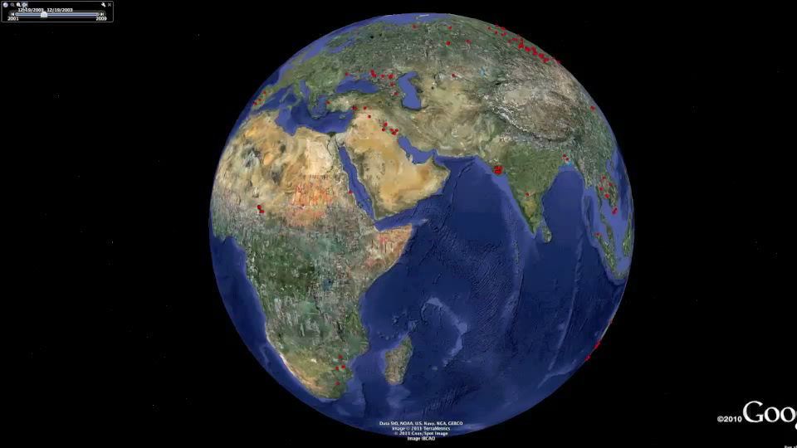
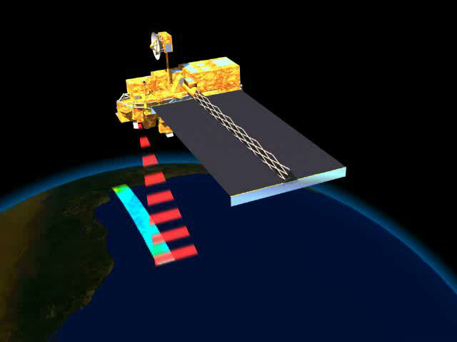
Deviation/Anomaly/Change Detection
Detect significant deviations from normal behavior
Applications:
  Credit Card Fraud Detection
  Network Intrusion
  Detection
  Identify anomalous behavior from sensor networks for monitoring and surveillance.
  Detecting changes in the global forest cover.

Slide 22
Motivating Challenges
Scalability
High Dimensionality
Heterogeneous and Complex Data
Data Ownership and Distribution
Non-traditional Analysis

