Slide 1
Data Mining: Data
Lecture Notes for Chapter 2
Introduction to Data Mining , 2nd Edition
by
Tan, Steinbach, Kumar

Slide 2
Outline
Attributes and Objects
Types of Data
Data Quality
Similarity and Distance
Data Preprocessing

Slide 3
What is Data?
Collection of data objects and their attributes
An attribute is a property or characteristic of an object
  Examples: eye color of a person, temperature, etc.
  Attribute is also known as variable, field, characteristic, dimension, or feature
A collection of attributes describe an object
  Object is also known as record, point, case, sample, entity, or instance
Attributes
Objects

Slide 4
A More Complete View of Data
Data may have parts
Attributes (objects) may have relationships with other attributes (objects)
More generally, data may have structure
Data can be incomplete
We will discuss this in more detail later

Slide 5
Types of Attributes
There are different types of attributes
  Nominal
    Examples: ID numbers, eye color, zip codes
  Ordinal
    Examples: rankings (e.g., taste of potato chips on a scale from 1-10), grades, height {tall, medium, short}
  Interval
    Examples: calendar dates, temperatures in Celsius or Fahrenheit.
  Ratio
    Examples: length, time, weight, money, age

Slide 6
Properties of Attribute Values
The type of an attribute depends on which of the following properties/operations it possesses:
  Distinctness: = ≠
  Order: < >
  Differences are + -
  meaningful :
  Ratios are * /
  meaningful
  Nominal attribute: distinctness
  Ordinal attribute: distinctness & order
  Interval attribute: distinctness, order & meaningful differences
  Ratio attribute: all 4 properties/operations

Slide 7
Discrete and Continuous Attributes
Discrete Attribute
  Has only a finite or countably infinite set of values
  Examples: zip codes, counts, or the set of words in a collection of documents
  Often represented as integer variables.
  Note: binary attributes are a special case of discrete attributes
Continuous Attribute
  Has real numbers as attribute values
  Examples: temperature, height, or weight.
  Practically, real values can only be measured and represented using a finite number of digits.
  Continuous attributes are typically represented as floating-point variables.

Slide 8
Types of data sets
Record
  Data Matrix
  Document Data
  Transaction Data
Graph
  World Wide Web
  Molecular Structures

Slide 9
Important Characteristics of Data
  Dimensionality (number of attributes)
    High dimensional data brings a number of challenges
  Sparsity
    Only presence counts
  Size
    Type of analysis may depend on size of data

Slide 10
Record Data
Data that consists of a collection of records, each of which consists of a fixed set of attributes

Slide 11
Data Matrix
If data objects have the same fixed set of numeric attributes, then the data objects can be thought of as points in a multi-dimensional space, where each dimension represents a distinct attribute
Such a data set can be represented by an m by n matrix, where there are m rows, one for each object, and n columns, one for each attribute

Slide 12
Document Data
Each document becomes a ‘term’ vector
  Each term is a component (attribute) of the vector
  The value of each component is the number of times the corresponding term occurs in the document.

Slide 13
Transaction Data
A special type of data, where
  Each transaction involves a set of items.
  For example, consider a grocery store. The set of products purchased by a customer during one shopping trip constitute a transaction, while the individual products that were purchased are the items.
  Can represent transaction data as record data

Slide 14
Graph Data
Examples: Generic graph, a molecule, and webpages
Benzene Molecule: C6H6

Slide 15
Data Quality
Poor data quality negatively affects many data processing efforts
“The most important point is that poor data quality is an unfolding disaster.
  Poor data quality costs the typical company at least ten percent (10%) of revenue; twenty percent (20%) is probably a better estimate.”
Thomas C. Redman, DM Review, August 2004

Slide 16
Data Quality …
What kinds of data quality problems?
How can we detect problems with the data?
What can we do about these problems?
Examples of data quality problems:
  Noise and outliers
  Missing values
  Duplicate data
  Wrong data
  Fake data

Slide 17
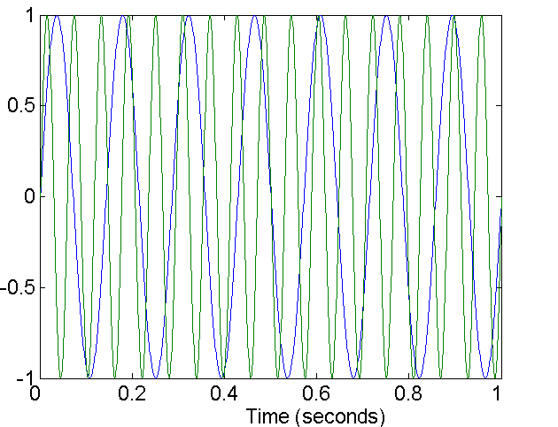
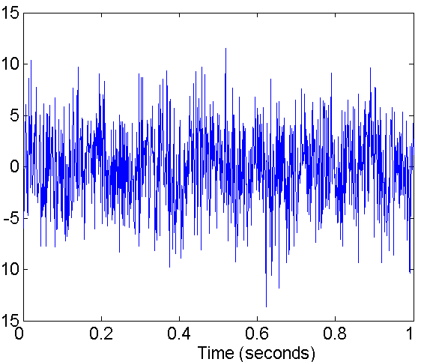
Noise
For objects, noise is an extraneous object
For attributes, noise refers to modification of original values
  Examples: distortion of a person’s voice when talking on a poor phone
Two Sine Waves
Two Sine Waves + Noise

Slide 18
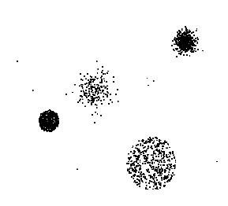
Outliers
Outliers are data objects with characteristics that are considerably different than most of the other data objects in the data set
  Case 1: Outliers are
  noise that interferes
  with data analysis
  Case 2: Outliers are
  the goal of our analysis
    Credit card fraud
    Intrusion detection
Causes?

Slide 19
Missing Values
Reasons for missing values
  Information is not collected
  (e.g., people decline to give their age and weight)
  Attributes may not be applicable to all cases
  (e.g., annual income is not applicable to children)
Handling missing values
  Eliminate data objects or variables
  Estimate missing values
    Example: time series of temperature
    Example: census results
  Ignore the missing value during analysis

Slide 20
Duplicate Data
Data set may include data objects that are duplicates, or almost duplicates of one another
  Major issue when merging data from heterogeneous sources
Examples:
  Same person with multiple email addresses
Data cleaning
  Process of dealing with duplicate data issues

