Slide 1
Similarity and Dissimilarity Measures
Similarity measure
Numerical measure of how alike two data objects are.
Often falls in the range [0,1]
Dissimilarity measure
Numerical measure of how different two data objects are
Minimum dissimilarity is often 0
Upper limit varies

Slide 2
Similarity/Dissimilarity for Simple Attributes
The following table shows the similarity and dissimilarity between two objects, x and y, with respect to a single, simple attribute.

Slide 3
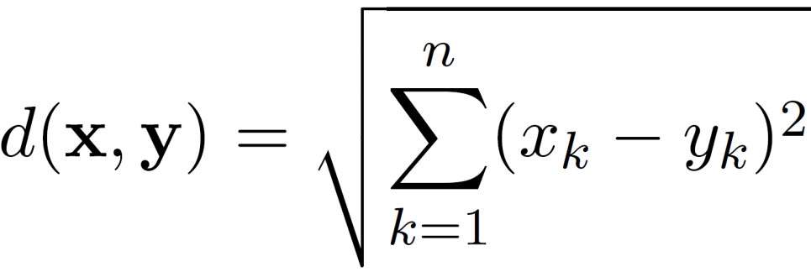
Euclidean Distance
Euclidean Distance

Slide 4
Euclidean Distance
Distance Matrix

Slide 5
Common Properties of a Distance
Distances, such as the Euclidean distance, have some well known properties.
Positivity
Symmetry
Triangle Inequality

Slide 6
Common Properties of a Similarity
Similarities, also have some well known properties.
s(x, y) = 1 (or maximum similarity) only if x = y. (does not always hold, e.g., cosine)
s(x, y) = s(y, x) for all x and y. (Symmetry)
where s(x, y) is the similarity between points (data objects), x and y.

Slide 7
Similarity Between Binary Vectors
Common situation is that objects, x and y, have only binary attributes
Simple Matching and Jaccard Coefficients
SMC = number of matches / number of attributes
J = number of 11 matches / number of non-zero attributes

Slide 8
SMC versus Jaccard: Example
x = 1 0 0 0 0 0 0 0 0 0
y = 0 0 0 0 0 0 1 0 0 1
SMC = (f₁₁ + f₀₀) / (f₀₁ + f₁₀ + f₁₁ + f₀₀)
= (0+7) / (2+1+0+7) = 0.7
J = (f₁₁) / (f₀₁ + f₁₀ + f₁₁) = 0 / (2 + 1 + 0) = 0

Slide 9
Cosine Similarity
If d₁ and d₂ are two document vectors, then
cos( d₁, d₂ ) = <d₁,d₂> / ||d₁|| ||d₂|| ,
Example:
d₁ = 3 2 0 5 0 0 0 2 0 0
d₂ = 1 0 0 0 0 0 0 1 0 2
<d₁, d2> = 3*1 + 2*0 + 0*0 + 5*0 + 0*0 + 0*0 + 0*0 + 2*1 + 0*0 + 0*2 = 5
| d₁ || = (3*3+2*2+0*0+5*5+0*0+0*0+0*0+2*2+0*0+0*0)^{0.5} = (42) ^{0.5} = 6.481
|| d₂ || = (1*1+0*0+0*0+0*0+0*0+0*0+0*0+1*1+0*0+2*2) ^{0.5} = (6) ^{0.5} = 2.449
cos(d₁, d₂ ) = 0.3150

Slide 10
Visually Evaluating Correlation
Scatter plots showing the correlation from –1 to 1.

Slide 11
Data Preprocessing
Aggregation
Sampling
Dimensionality Reduction
Feature subset selection
Discretization and Binarization
Attribute Transformation

Slide 12
Aggregation
Combining two or more attributes (or objects) into a single attribute (or object)
Purpose
Data reduction
Change of scale
More “stable” data

Slide 13
Sampling
Sampling is the main technique employed for data reduction.
Entire set of data is too expensive or time consuming.

Slide 14
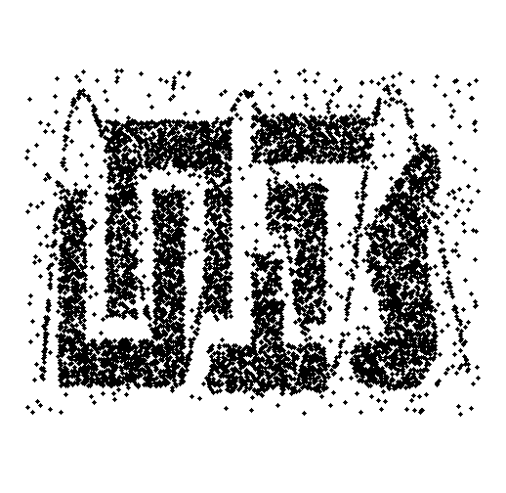
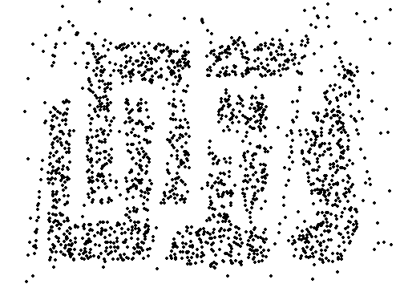
Sample Size
8000 points 2000 Points 500 Points

Slide 15
Types of Sampling
Simple Random Sampling
There is an equal probability of selecting any particular item
Sampling without replacement
Sampling with replacement
Stratified sampling
Split the data into several partitions; then draw random samples from each partition

Slide 16
Curse of Dimensionality
Definitions of density and distance between points, which are critical for clustering and outlier detection, become less meaningful
Randomly generate 500 points
Compute difference between max and min distance between any pair of points

Slide 17
Dimensionality Reduction
Purpose:
Avoid curse of dimensionality
Reduce amount of time and memory required by data mining algorithms
Allow data to be more easily visualized
May help to eliminate irrelevant features or reduce noise
Techniques
Principal Components Analysis (PCA)
Singular Value Decomposition
Others: supervised and non-linear techniques

Slide 18
Dimensionality Reduction: PCA
Goal is to find a projection that captures the largest amount of variation in data
x₂
e
x₁

Slide 19
Feature Subset Selection
Another way to reduce dimensionality of data
Redundant features
Duplicate much or all of the information contained in one or more other attributes
Irrelevant features
Contain no information that is useful for the data mining task at hand
Many techniques developed, especially for classification

Slide 20
Discretization and Binarization
Discretization is the process of converting a continuous attribute into an ordinal attribute
Binarization maps a continuous or categorical attribute into one or more binary variables

Slide 21
Attribute Transformation
An attribute transform is a function that maps the entire set of values of a given attribute to a new set of replacement values such that each old value can be identified with one of the new values
Simple functions: x^{k}, log(x), e^{x}, |x|
Normalization
Refers to various techniques to adjust to differences among attributes in terms of frequency of occurrence, mean, variance, range
Take out unwanted, common signal, e.g., seasonality
In statistics, standardization refers to subtracting off the means and dividing by the standard deviation

