Slide 1
Visual programming
Chapter 1: Introduction

Slide 2
Contents
Introduction – Visual Studio 2019
Start Page
Create a New Project
Forms.cs
Solution Explorer
Toolbox
Properties Window
Project Physical Folder
Run the Project

Slide 3
Introduction – Visual Studio 2019
Visual Studio 2019 is Microsoft’s Integrated Development Environment (IDE) for creating, running and debugging apps (also called applications) written in various .NET programming languages.

Slide 4
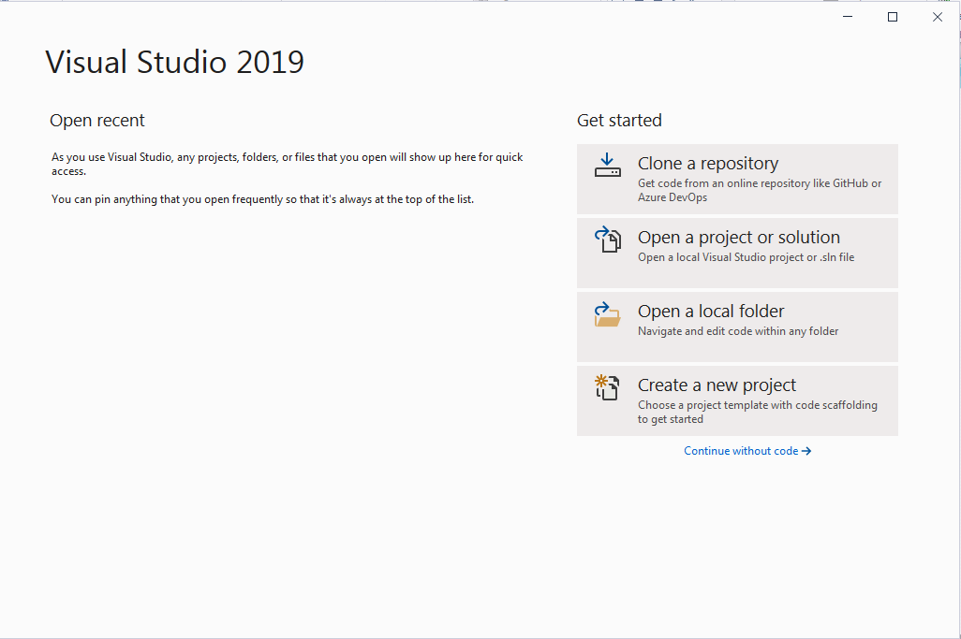
Start Page

Slide 5
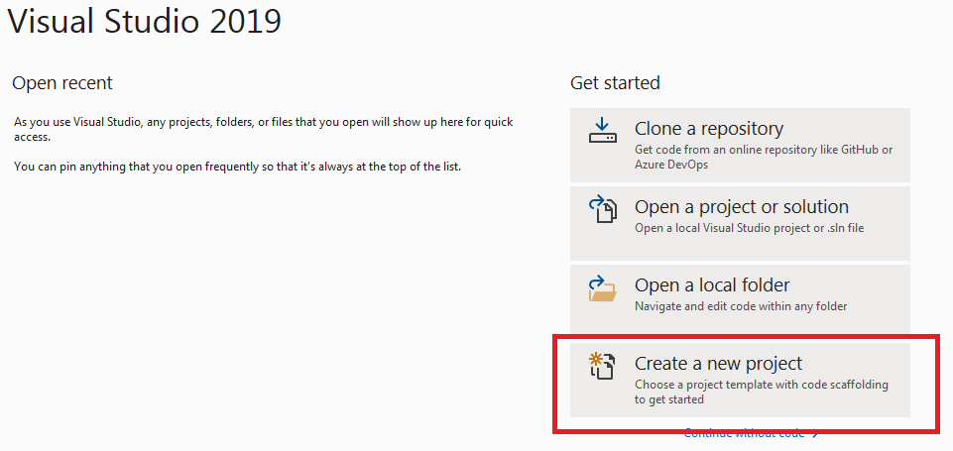
Create a New Project
  A Project: is a group of related files, such as the Visual C# code and any images that might make up an app.

Slide 6
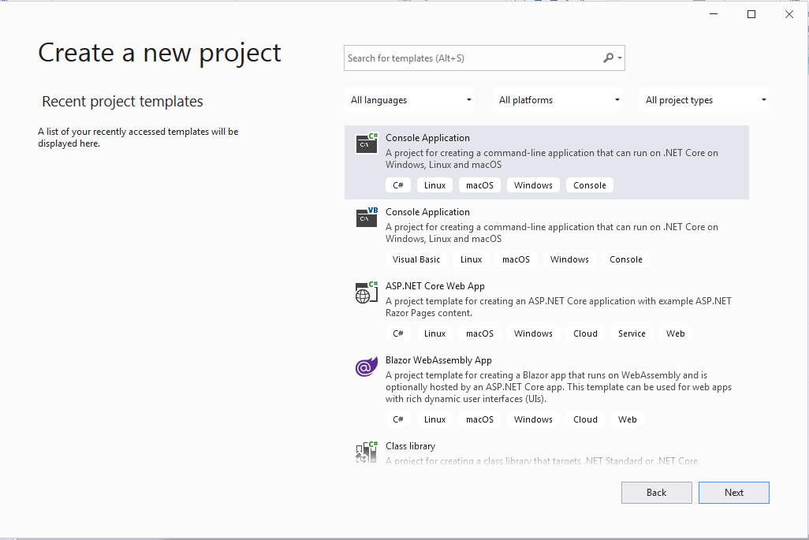
Create a New Project

Slide 7
Create a New Project
Make sure to choose the proper language “Visual C#”.
From the templates displayed, choose “Windows” and From project type choose “Desktop”.
Choose “Windows Form App (.NET Framework)”
  This will enable you to start your project with the first screen that will be displayed to the users of the resulted application. This form (window) will be filled with controls that can be used by the user.
Click Next

Slide 8
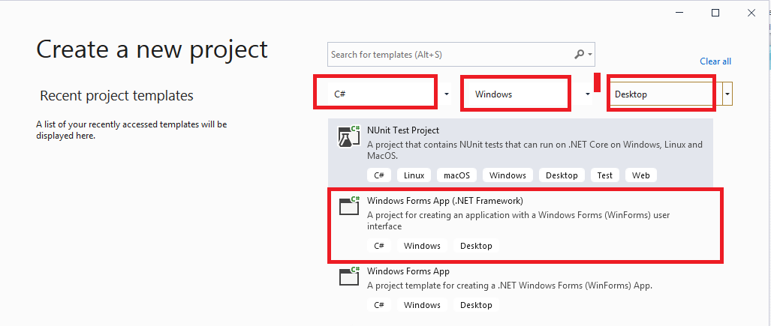

Create a New Project

Slide 9
Create a New Project
Give a name of your project, specify its location on your PC, and finally give a name to the solution. For beginners, we use the same name of the project.
A Solution: contains several projects, and it is usually used for large systems.
In this course, we will create only one project in a solution.
Now, Press “Create”

Slide 10
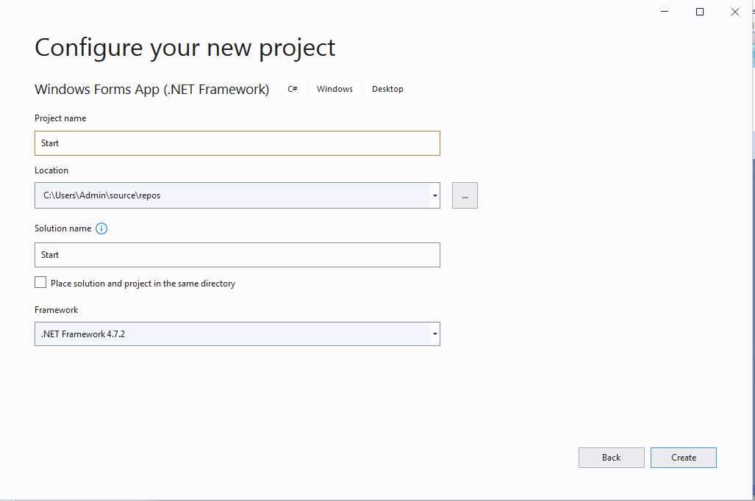
Create a New Project

Slide 11
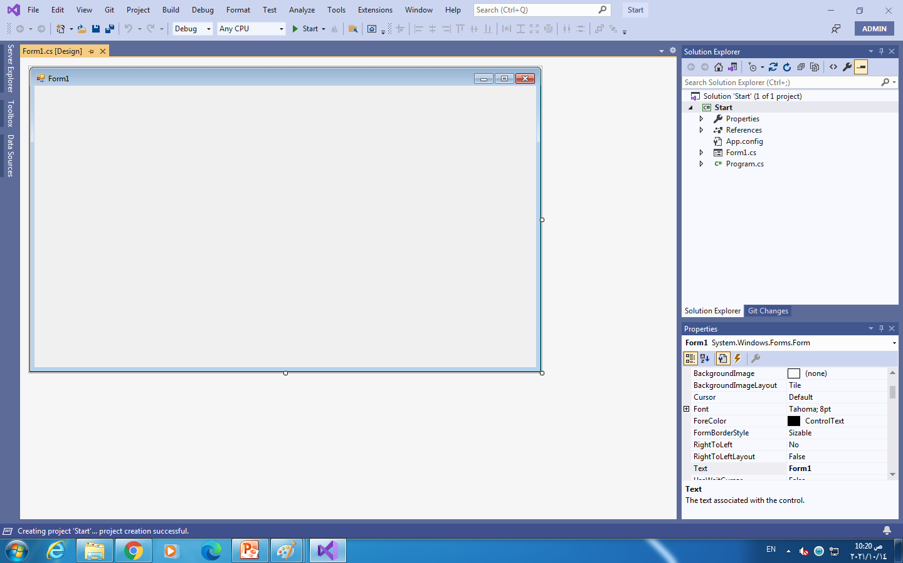
A Project “Start” is created

Slide 12
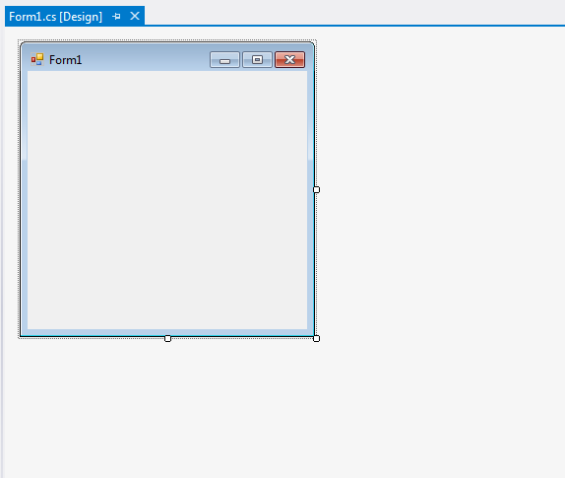
Forms.cs
Form1.cs [Design]
This window displays the file form1.cs in design mode.
In this window you can add the needed controls to the form.
Your project may contain several forms that act as the windows of the application.

Slide 13
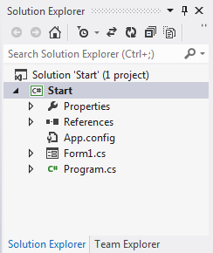
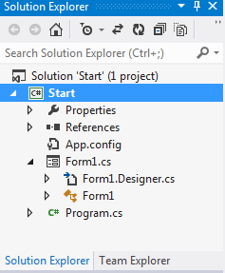
Solution Explorer
Solution Explorer is used to review all files in your project. Mainly, the form1.cs file, references, and any images you include in the project.

Slide 14
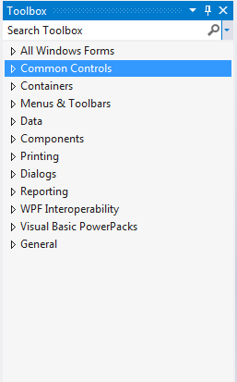
Toolbox
Toolbox: is a window that contains all the controls and components that you can add and use in a form.
The controls are categorized in several categories.

Slide 15
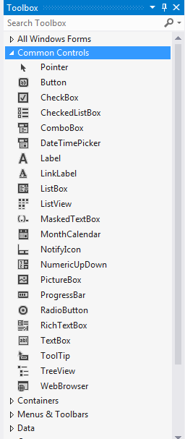
Toolbox
Common Controls: is the most used categories, since it contains the most common controls that you can find in most forms. For example, buttons and textboxes.
To add any control from the toolbox to the form, drag and drop the control to the desired location, or double click on it, and it will be placed in a location automatically selected by the system.

Slide 16
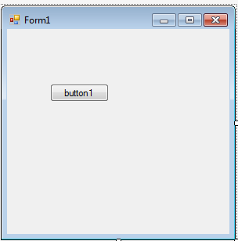
Toolbox
This image displays a form after adding a button to it.

Slide 17
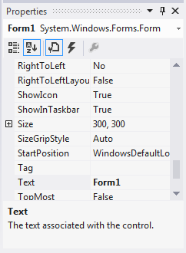
Properties Window
The Properties window, displays all properties associated to the selected control.
You can see at the top of this window, in the image, that these are the properties of Form1.

Slide 18
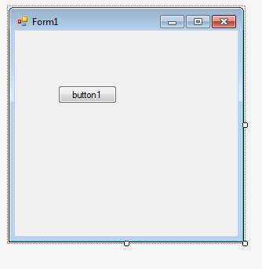
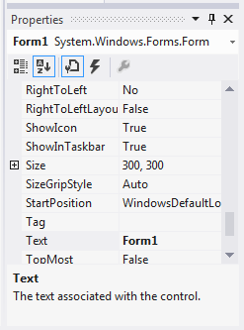
Properties Window
Here, Form1 is selected (check the selection handlers), so the properties displayed are associated to the form.

Slide 19
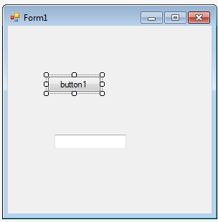
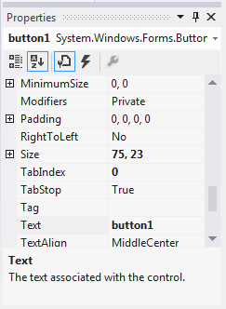
Properties Window
Here, button1 is selected, so
button1properties are displayed in the window.

Slide 20
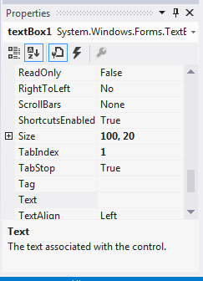
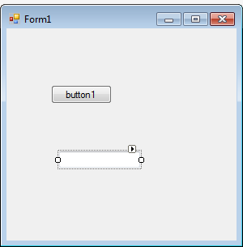
Properties Window
Here, textBox1 is selected, so textBox1 properties are displayed in the window.
Note that there are some properties are common with the button properties, and others are special for the textbox.

Slide 21
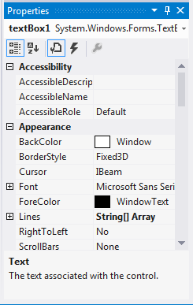
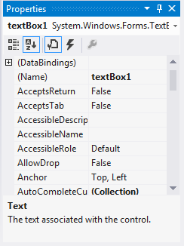
Properties Window
You can display the properties of any control, either alphabetically, as in the first image, or categorized as in the second image.

Slide 22
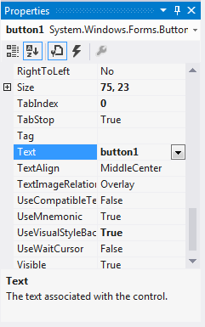
Properties Window
Note that each property has a name and a value of a certain data type. For example, property named “Text”, has a string value of “button1”, a property named “TabIndex”, has an integer value of “0” and a property named “Visible” has a boolean value of “True”.

Slide 23
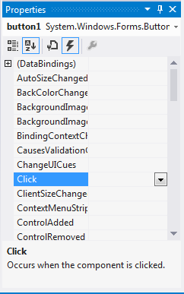

Properties Window
The same property window can be used to display the events associated to a control.
The concept of Events will be discussed in Chapter 2.

Slide 24
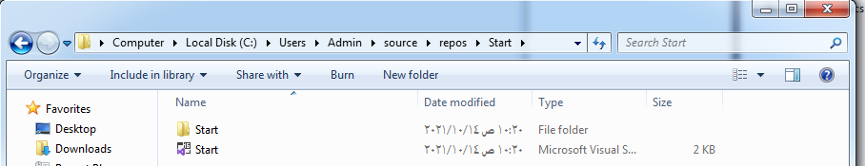
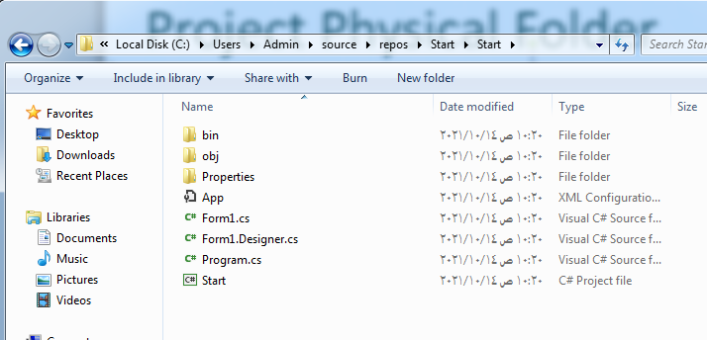
Project Physical Folder
When the project is created, a physical folder is created with the same project name in the selected location, and all files listed in the Solution Explorer, can be found there.

Slide 25

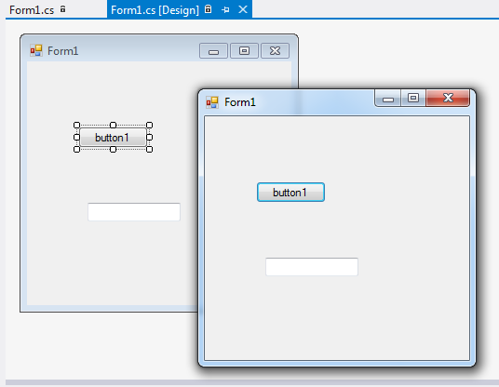
Run the Project
Click on “Start” button, at the toolbar in Visual Studio Window, and an execution file will be generated of the project, and it will be executed as displayed in the image.

Slide 26
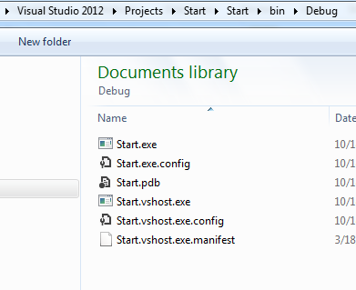
Run the Project
Go to the Project folder, from bin ➔ Debug, you can find the execution file projectname.exe (start.exe), when you double click the file the project will be distributed, even if the Visual Studio IDE is closed.

Slide 27
The End

