Slide 1
Visual programming
Chapter 3: GUI (Graphical User Interface) Part I

Slide 2
Contents
Form
Buttons
Labels
TextBoxes
GroupBoxes
Panels
CheckBoxes
RadioButtons
Font Class
MessageBox
PictureBox

Slide 3
Form
The form is the most important element in a Visual C# Project, since it is the interface (window) that the user interacts with.
When you first create your project, form1, is always created at the beginning, meaning that you can’t have a project without a form.

Slide 4
What does a form represent in Object Oriented?
To relate the visual programming to Object Oriented concept.
  The project ➔ a namespace
  The Form ➔ a class
Assume you have a project named “Test”
Check the Solution Explorer window, and open file “Form1.cs” by double clicking on it.

Slide 5
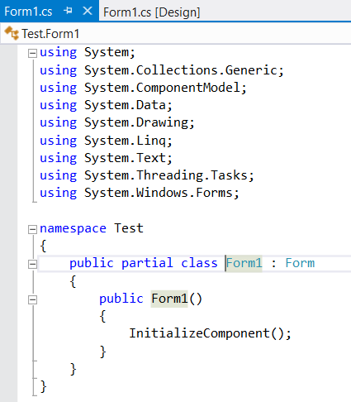
What does a form represent in Object Oriented?
What does a Partial modifier mean?
Note here, that Form1 is inherited from a pre-defined class “Form”
Project Name
This method is pre-defined to set the initial values of all controls’ properties in the form.
Form Name
Form1 Constructor

Slide 6
Partial Modifier
The Partial Modifier is used to be able to define the same class in several files.
This file “form1.cs”, is used by the developer to add his/her own code and event handlers. And Form1 class is defined partially, so where is the rest of this class?

Slide 7
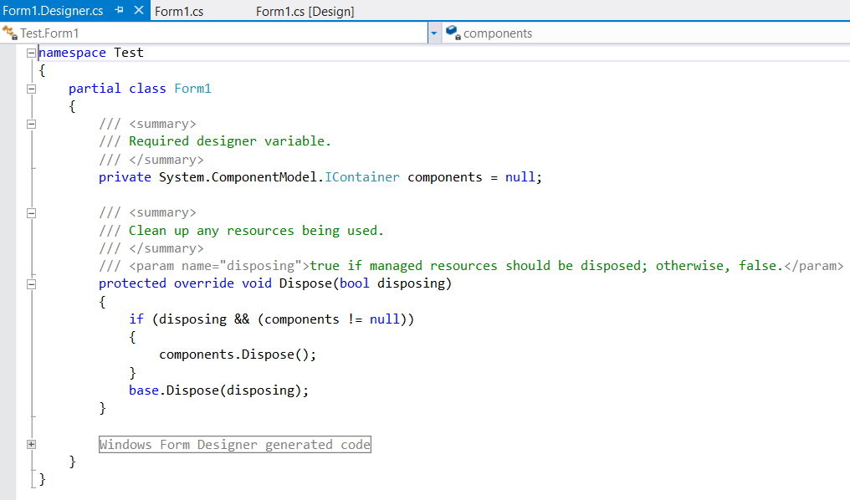
Partial Modifier
Return back to the Solution Explorer, and double click the file “form1.Designer.cs”.
Check here, that the Form1 class is re-defined again in this file, which is not possible unless you use the modifier Partial.

Slide 8
Form1.Designer.cs
Why is this file created? And who created it?
This file is automatically created by Visual C#, to contain all definitions of all controls added to the form. We will discuss this shortly.

Slide 9
Form: Properties
Text: The title of the form
  Ex: this.Text = "FFF";
BackColor: The background color of the form.
  Ex: this.BackColor = Color.Red;
ForeColor: The color of the font of any control added to the form.
  Ex; this.ForeColor = Color.Green;
Font: The style of the font of any control added to the form.
Size: Determines the width and height of the form.
  Ex: this.Size = new Size(200, 100);
Maximum Size: Determines the maximum width and the maximum height of the form the user can reach at run time.
  this.MaximumSize = new Size(300, 300);
Minimum Size: Determines the minimum width and the minimum height of the form the user can reach at run time.
  Ex; this.MinimumSize = new Size(100, 100);
To change any of these properties, you can relate to it by using the keyword “This”, or directly. (since you are dealing with a class here).

Slide 10
Form: Default Event
Load: This event occurs at the beginning of the execution of the project (i.e. when the form is loaded)

Slide 11
Form: Method
Close();
This method closes the form.

Slide 12

Buttons
A Button, is a very common control that you may find in any program works under Windows.
To add a Button, or any control we will discuss later, go to the toolbox, then:
  Either, double click on it, then it will appear to a default location on the form.
  Or, drag it from the Toolbox and drag it on the form to the location you desire.

Slide 13
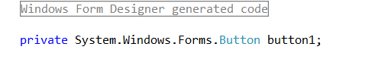
A Button in Form1.Designer.cs File
When you add a button, or any control, to your form, you actually instantiate an object of a related class.
Meaning button1 is actually an object of a pre-defined class named Button.
The code needed for this instantiation will be automatically generated in Form1.Designer.cs file by the visual C#, as soon as you add the button.

Slide 14
A Button in Form1.Designer.cs File
This leads us to the reason why Form1 class is divided into these two files. Form1.Designer.cs to be used mainly by the visual C#, and Form1.cs is to be used by the developer (YOU!).
And of course all controls that we will discuss later are added in the same way.

Slide 15
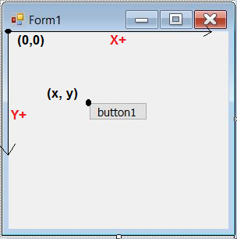
Button: Properties
Text: The label on the button.
Name: The name of the object
  This name is used in the code when referring to the object.
Size: Width and height of the
button.
Ex: button1.Size= new Size(20, 10);
Location: the coordinates
X and Y on the form,
where the button resides.
Ex:button1.Location = new Point(60, 90);

Slide 16
Button: Properties
Enabled: True ➔ a control can be accessed by the user
Ex: button1.Enabled = true;
False ➔ a control cannot be accessed by the user.
Ex: button1.Enabled = false;
Visible: True ➔ a control is displayed on the form
Ex: button1.Visible = true;
False ➔ a control is hidden from the form.
Ex: button1.Visible = false;
Important Note: The previous properties apply on almost all controls, and are handled in the same way.

Slide 17
Show and Hide Methods
Show()
Hide()
These two methods are almost available for all controls along with the form itself. If you need to hide a button for example, you write:
Ex: button1.Hide();
To show it again:
Ex: button1.Show();
These two methods actually change the value of the Visible property in the desired control.

Slide 18

LABELs
A Label is an un-editable text that is added to the form, to display a certain message or a hint about a control.
Usually, the label takes the size of the text written in it and the font size, unless the “autosize” property is set to false.

Slide 19
Label: Properties
Text: The string displayed by the label.
  Ex: label1.Text = "FFF";
Autosize:
  True ➔ the label takes the size of the text written in it.
  Ex: label1.AutoSize = true;
  False ➔ you can resize the label as you like in the design time.
  EX: label1.AutoSize = false;
TextAlign ➔ Changes the alignment of the text within the borders of the label. It works properly when the Autosize property is set to False.

Slide 20
Changing Properties at Runtime
Each control has certain properties defined for it in the property window. These properties resembles the attributes defined in classes.
Each attribute has its own data type and you can assign it a value.
Any updates you apply on the Property Window (Design-time) are considered the default values for these properties.
Sometimes, you need to change some properties at run time.
There are several ways to change the property value according to the data type of such a property.

Slide 21
How to determine a data type for a property?
When you need to change a certain property for a certain control (i.e. assign a new value to it), you need to write an assignment statement starting with this property.
Suppose you need to change the text property of a label, you will start the assignment statement as:
label1.Text =
Now you need to figure out the data type of this property, just hover the mouse over this property (in the code), and a tooltip will be displayed to give you a hint about it.

Slide 22
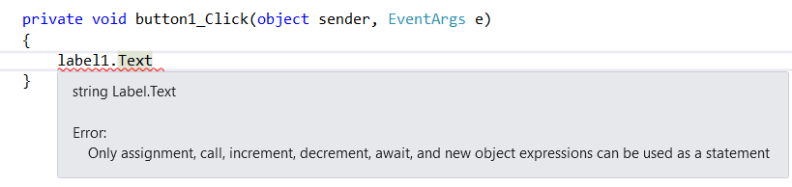
How to determine a data type for a property?
To find out the data type of property Text:
From the above picture, you can find out that the Text data type is string.

Slide 23
Changing Properties (Basic Data Types)
To change the value of a property that have a basic data type (int, float, double, decimal, string, char, ..etc.), you can use a simple assignment statement to provide the value you need.
Ex:
label1.Text = “Hello World”; // assign a direct value
Or
this.Text = label1.Text;
//changes the title of the form with the Text value in the label
Note: Just make sure that you are assigning the right data type to the property, or you need to convert it if applicable.
Ex: label1.Text = 215 + “”;
//here you will add 215 to the text, but after converting it to a string.

Slide 24
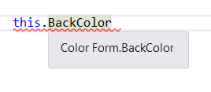
Changing Properties (pre-defined enumeration)
Some properties have pre-defined data types (enumerations) with several values, so you need to use these values to change them.
Example, the backColor property.
Note here that BackColor is of
data type “Color”, this is not
a basic data type,
so you will have to use it to change the property value.

Slide 25
Changing Properties (pre-defined enumeration)
When using Color.
a list of all valid values
will appear so that you
can select from them.

Slide 26
Changing Properties (Composite Properties)
Some properties consist of other several properties, such as
  Font (Name, Size, Style)
  Size (width, height)
  Location (X, Y)
So, to change these properties, or properties they consist of, we have to instantiate an object of the class related to this property.

Slide 27
Changing Properties (Composite Properties)
Example: To change the property of a label font.
In this code, you can change the three composite properties of the font. Here you change the font name to “Arial”, the font size to 16 and the style to Bold.
Of course you can change only one of them, by remaining the others as they are set in the Properties Window. This will be discussed Later.

Slide 28


TextBoxes
A TextBox is an editable control that is mainly used to enable the user to enter data using keyboard.

Slide 29
TextBox: Properties
Text
  Ex: textBox1.Text = "TTTTT";
Multiline: If true, you can use Enter and add several lines to the textbox
Ex: textBox1.Multiline = true;
textBox1.Multiline = false;
WordWrap:
  True ➔ The lines won’t exceed the borders of the textbox.
    Ex: textBox1.WordWrap = true;
  False ➔ you can continue writing in the line until you press Enter.
    Ex: textBox1.WordWrap = false;
  This property only works when Multiline is activated.
ScrollBars: In case of Multiline Textboxes, vertical and horizontal (active WordWrap Property) scrollbars can be displayed.
Ex: textBox1.ScrollBars = ScrollBars.Vertical;
textBox1.ScrollBars = ScrollBars.Horizontal;
textBox1.ScrollBars = ScrollBars.Both;

Slide 30
TextBox: Properties
Forecolor: The color of the text inside.
  Ex: textBox1.ForeColor = Color.Green;
Readonly: when True, the user cannot write in the textbox, but can access it and copy its contents.
Ex: textBox1.ReadOnly = true;
textBox1.ReadOnly = false;
Enabled
Ex: textBox1.Enabled = true;
textBox1.Enabled = false;
PasswordChar: takes a single character as a value, and this character will be used to mask the entry in the textbox (password behavior)
  Ex: textBox1.PasswordChar = 'x';
UseSystemPasswordChar: If True ➔ it masks the value in PasswordChar, and uses the password character used by Windows on the current PC.
  Ex: textBox1.UseSystemPasswordChar = true;

Slide 31
TextBox: Default Even
TextChanged: This event takes place when the user writes or deletes any character in the textbox.

Slide 32
Convert
Take into consideration that Text in a TextBox is a string. So whenever you need to use it for numbers, you will have to convert the string. And whenever you need to assign a numeric value to a textbox, you will have to convert it to string.

Slide 33



Convert from String to Numeric Value
In the statement below, a syntax error appears, because you are trying to assign a string into an integer.
To convert a string into a numeric value:

Slide 34
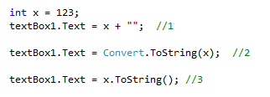
Convert from a numeric value into a string
We have several ways to convert into a string:

Slide 35

TextBox: Method
Clear(): This method is used to clear any text in the textbox.
AppendText():
  textBox1.AppendText("VP");

Slide 36
GroupBoxes
A GroupBox is considered a container. It is used to gather several controls in one place, were you can apply several actions on them at the same time.
Example: groubBox1.Hide();
  This method will hide the groupbox and its contents, without the need to hide each control in a separate statement.

Slide 37
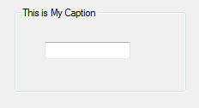
GroupBox: Properties
Text: The caption appears at the top of a GroupBox
  Ex: groupBox1.Text = "GGGGGG";

Slide 38
Panels
A Panel is another type of containers, that is used mainly as the groupbox, but it has extra properties that don’t exist in a groupbox.

Slide 39
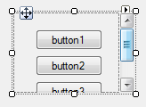
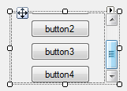
Panel: Properties
BorderStyle: Can be (None, FixedSingle, Fixed3D)
AutoScroll: if True, the scrollbars will appear if the controls inside the panel exceed its borders.
  Ex: panel1.AutoScroll = true;

Slide 40
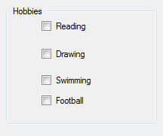
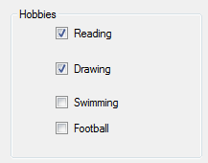
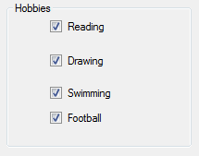
CheckBoxes
CheckBoxes are used to give several options to a user to check or uncheck. The user can select only one or several of them, or can unselect all of them.

Slide 41
CheckBox: Properties
Text
Checked:
  True
  Ex: checkBox1.Checked = true;
  False
  Ex: checkBox1.Checked = false;
CheckState:
  Checked
  Ex: checkBox1.CheckState = CheckState.Checked;
  UnChecked
  Ex: checkBox1.CheckState = CheckState.Unchecked;
  Indeterminate
  Ex: checkBox1.CheckState = CheckState.Indeterminate;

Slide 42
CheckBox: Default Event
CheckedChanged
  This event takes place whenever the Checked Property is changed either to True or False.

Slide 43
RadioButton: Properties/Default Event
Properties:
  Checked
    True
    Ex: radiobutton1.Checked = true;
    False
    Ex: radiobutton1.Checked = false;
Default Event
  CheckedChanged: Takes place when the checked property is changed to True or False.

Slide 44
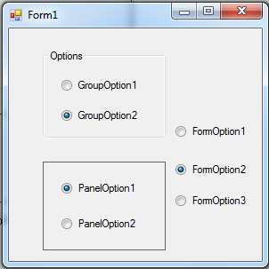
RadioButtons
RadioButtons are used to give several options to user, but the user have to choose only one of each group. To separate several radio buttons into several groups, we can use any of the containers in Visual C#, such as: GroupBox, Panel and the Form itself.

Slide 45
Font Classs
To change the font of a certain control, for example a label or a textbox, we instantiate an object from Font Class, and send the new values of (FontName, FontSize and FontStyle).
But, in this statement, we change all the 3 values at the same time.

Slide 46
Font Class - Cont.
To change the style alone, for example, we remain the other values as defined.
But, in the previous statement, the FontStyle is changed into Bold, regardless of the style that already is applied to the label.

Slide 47
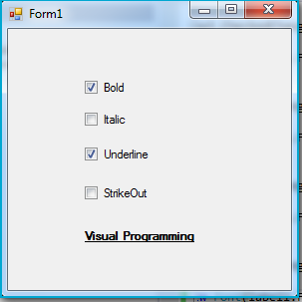
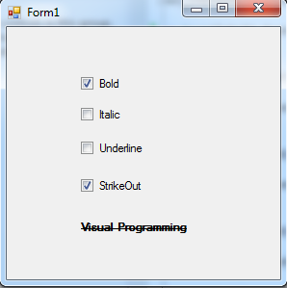
Font Class - Cont.
To change the FontStyle while reserving the current style, we will use the XOR operator (^), as in the following example:

Slide 48
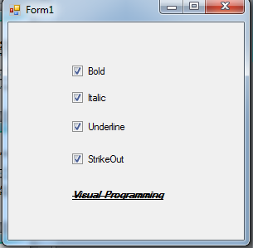
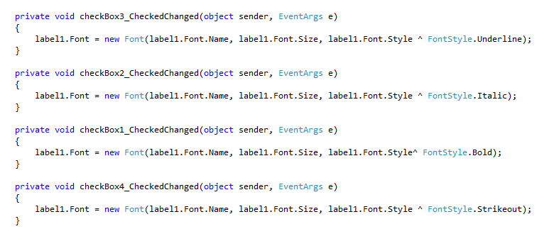
Font Class - Cont.

Slide 49
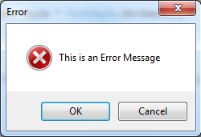
MessageBox
To show a message dialog to the user, we will use MessageBox class along with the method Show().
MessageBox.Show() method is overloaded into several methods, but we will use in this course the following method, to display the following message:
In this method, we send the message text, the message title, number and types of buttons to be displayed, and the icon.

Slide 50
MessageBox – User Respond
In the previous example, we only show a message, and don’t handle the respond of the user (i.e. whither the user clicked OK or CANCEL).
To handle the user respond, we need to define a variable of type DialogResult, as in the following example

Slide 51
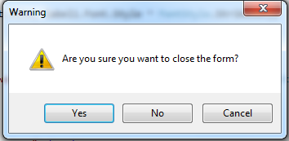
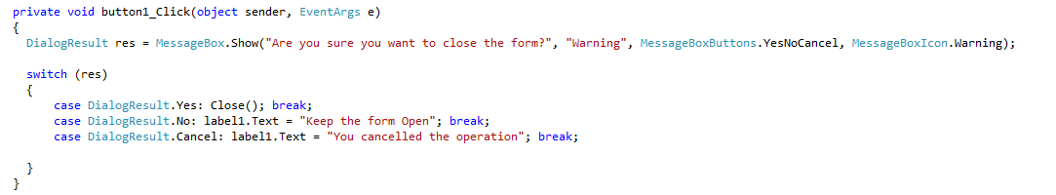
MessageBox – User Respond

Slide 52
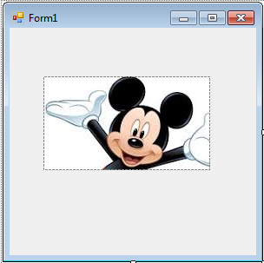
PictureBox and Properties
A PictureBox is used to display an image to the user.
Properties:
  Image: where the selected image file resides. You can import an image from your PC.

Slide 53
PictureBox: Properties
SizeMode: Determines how the image is displayed in the pictureBox.
  Normal: Displays the topleft corner of the original image, according to the size of the picurebox.
  StretchImage: Changes the ratios of the original image to fit exactly in the pictureBox.
  AutoSize: changes the size of the PictureBox, according to the size of the original image.
  CenterImage: crops a part of the original image from its center according to the size of the PictureBox.
  Zoom: Changes the size of the original image, to fit in the PictureBox, but with reserving the ratios of the image.

Slide 54


PictureBox – Default Event and Method
Default Event:
  Click: occurs when the user clicks on the image using mouse.
Method:
  FromFile: This method is used to change the displayed image at runtime.
Important Note: Make sure to write the path in a correct way, so that the program can find the actual file. Also, make sure to write the correct extension of the image.

Slide 55
The End

