Slide 1
Visual programming
Chapter 2: Events and Event Handling
Eman Alnaji
Dareen Hamoudeh

Slide 2
Contents
What is an Event?
What is an Event Handler?
What is the default event and how to create an event handler for it?
How to create an Event Handler other than the default?
How to call the same Event Handler by different controls?

Slide 3
What is an Event?
An event is an action done by the user, or by the program itself, during the runtime of the project.
Example:
  When a user clicks a button.
  When a user checks a checkbox.
  When the user moves the mouse over the form.
Sometimes you need to relate these events with certain action(s) in your project.
  Example: when the button is clicked ➔ close the form.
  Here, you will need to create an Event Handler.

Slide 4
What is an Event Handler?
An Event Handler, is a Method created in your code, but is attached to the control and event you need, so that whenever the event takes place the Method will be called and executed.
Important Note: You don’t need to call the Event Handler explicitly, all you need is to relate it to a certain event and this event will call it.

Slide 5
What is the default event? And how to create an Event Handler for it?
Each control has a default event, which is the common event that a user is familiar with.
  Example: When a user sees a button on the form, he/she will anticipate that this button should be clicked, so the default event for a button is click.
So how to create an Event Handler for a default event? Simply, by doubleclick on the control at design area, and a new method (event handler) will be created in the code file, and connected to this control and event.

Slide 6
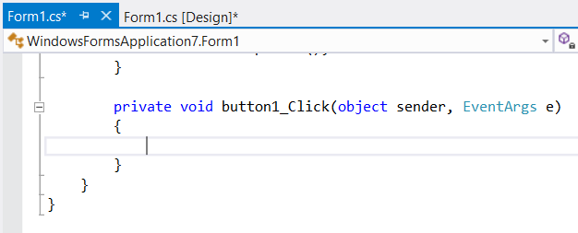
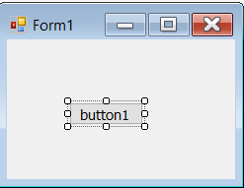
What is the default event? And how to create an Event Handler for it?
Suppose you have a button1 in your form.
Double click on the button, and check the code in form1.cs.
Note here that the event handler is named after both the control and the event button1_Click

Slide 7
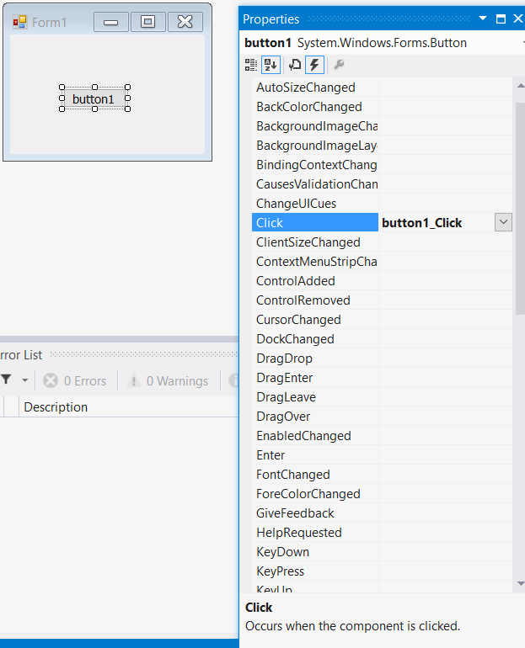
What is the default event? And how to create an Event Handler for it?
How to relate this function to this event, surely the name is not enough.
In the Properties window, click on the Events Icon
This icon will display all the possible events for the selected control. (form also has its own events).
Check here, the name of the event handler button1_Click is displayed next to event Click. This connection is created as soon as you double clicked on the button, and the event handler was created and connected directly.

Slide 8

What is the default event? And how to create an Event Handler for it?
Now you can add the code you need to be executed when this button is clicked.

Slide 9
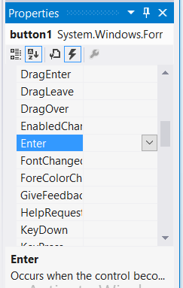
How to create an Event Handler other than the default?
Suppose you need to activate another event on the button other than the default (click).
For example, you need to activate the (Enter) event.
All you need to do is go the Properties Window, and click on the Events button, and search for the (Event) event.
Then, you either double click on it, or press enter.

Slide 10
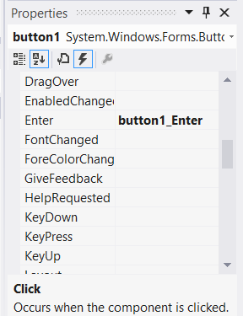
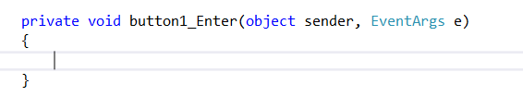
How to create an Event Handler other than the default?
This simple action, will create the event handler in the code and connect it directly with the button and the Enter event.

Slide 11

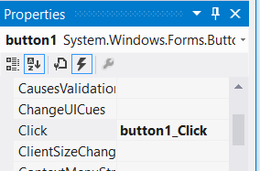
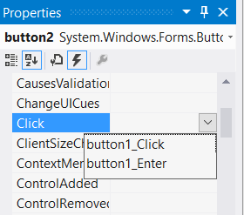
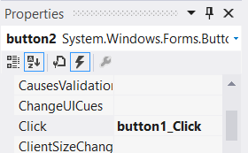
How to call the same Event Handler by different controls?
Sometimes, you need to repeat the same code in several controls.
For example, you need to create 2 buttons, and both of them should close the form.
So, all you need is to create the event handler (button1_Click) for button1, and write the needed code in it. Then, point to this event handler by button2, via the Properties Window.
Here select the needed event handler

Slide 12
The End

