Slide 1
Chapter 4
Object-Oriented Analysis
Software Analysis and Design
0721322

Slide 2
Analysis workflow
The purpose of requirements analysis is to produce an analysis or a logical model of the desired system.
The analysis model is an abstraction or a generalization of the design.
It omits most of the details of how the system works and provides an overview of the system's functionality.

Slide 3
Use case Analysis
Purpose
To identify the classes which perform a use case’s flow of events.
To distribute the use case behavior to those classes, using use-case realizations.
To identify the responsibilities, attributes and associations of the classes.
Input Artifacts
Glossary
Supplementary Specifications
Use-Case Model
Resulting Artifacts
Analysis Model
  Use case collaborations
  Communication diagrams
  Use case class diagrams
  Analysis class diagram

Slide 4
Use Case Analysis Steps
Supplement the Descriptions of the Use Case
We must first review the use-case descriptions, as developed in the Requirements workflow.
For each use case:
  Find Classes from Use-Case Behavior
  Distribute Use-Case Behavior to Classes
  The use case flows of events will be studied, analysis classes will be identified, and use case responsibilities allocated to those analysis classes
For each resulting analysis class
  Describe Responsibilities
  Describe Attributes and Associations
  Qualify Analysis Mechanisms
Unify Analysis Classes
We need to make sure that our developed analysis model is consistent.

Slide 5
A First Step Towards Executables
Use Cases
Analysis
Classes
Design
Classes
Source
Code
Exec
Use-Case Analysis

Slide 6
Use case realization
A use-case realization describes how a particular use case will be implemented, in terms of collaborating objects.
A use-case realization specifies what classes must be built, how they collaborate (relationships, dependencies…), and the messages passed between objects necessary to implement each use case.
Class Diagrams can be used to describe the classes and relationships that participate in the realization of the use case. These diagrams model the context of the use-case realization.

Slide 7
Interaction Diagrams (sequence and/or collaboration diagrams) can be used to describe how the use case is realized in terms of collaborating objects.
It is recommended that collaboration diagrams are used during Analysis and that sequence diagrams are used during Design.
The use-case realization can be used by class designers to understand the class’s role in the use case and how the class interacts with other classes. This information can be used to determine/refine the class responsibilities and interfaces.
Use case realization

Slide 8
Use case realization
Use Case Model
Design Model
Add a new campaign
<<realizes>>
:Customer
:Campaign
Use Case
Use Case Realization
Sequence Diagrams
Collaboration Diagrams
Use Case Realization Documentation
Class Diagrams

Slide 9
Supplement the Descriptions of the Use Case
The first step of use case analysis
The purpose of ‘Supplement the Descriptions of the Use-Case’ is to capture additional information needed in order to understand the required internal behavior of the system that may be missing from the use-case description written for the customer of the system.
This information will be used as input the rest of the steps in Use Case Analysis and is used to assist in the allocation of responsibility.

Slide 10
Supplement the Descriptions of the Use Case
Sometimes the description of
the use case is not sufficient
for identifying analysis classes and
their objects.
Remember, customer doesn’t
care about the inside of the
system, so many details may
have been left out – leaving the
use case description like a black
box.
To find objects that perform the
use cases, we may need ‘white
box’ descriptions – that is, what does
the system do from an internal
perspective. From this, some objects
may be identified.
Many times we do not have
enough detail.
The system retrieves and displays a list of current course offerings from the course catalog legacy database
given specific
parameters, such as...
The system displays a list of course offerings.

Slide 11
  Finding analysis classes

Slide 12
Find Classes from Use-Case Behavior
Finding a candidate set of analysis classes is the first step in the transformation of the system from a mere statement of required behavior to a description of how the system will work.
The technique described here uses three different perspectives of the system to drive the identification of candidate classes.
The three perspectives are that of the boundary between the system and its actors, the information the system uses, and the control logic of the system.
The candidate set of analysis class includes :
- Boundary class - Entity classes - Control classes
The complete behavior of a Use-Case has to be distributed to analysis classes.

Slide 13
Find Classes from Use-Case Behavior
Analysis class modeling represents an early conceptual model for ‘things in the system which have responsibilities and behaviors’.
Analysis classes are used to capture a ‘first-draft’, rough-cut of the object model of the system.
Analysis classes handle primary functional requirements, interface requirements, and some control
<<boundary>>
<<control>>
<<boundary>>
<<entity>>
<<entity>>
13

Slide 14
Analysis Classes
Three things likely to change in a system:
  The boundary between the system and its actors (interfaces…)
  The information a system uses (data)
  The control logic of the system (who does what)
We isolate the different kinds of analysis classes
  Each of these has a set of responsibilities
  The distinction between these classes is used in analysis but changes in design or becomes less of an issue
  We transform these analysis classes into design artifacts / design entities to accommodate the problem domain representations in a solutions space.

Slide 15
Boundary Class
A boundary class is a class within the analysis model used to model the interaction between the system and its actors.
The following aspects of the interaction are captured on boundary classes:
  coordinating the actor's behavior with the "internals" of the system;
  receiving input from the actor to the system, e.g., information or requests;
  providing output from the system to the actor, e.g., stored information or derived results.

Slide 16
Boundary Class
Types of Boundary Classes
  User interface classes – classes that facilitate communication with human users of the system
    Menus, forms, etc.
  System interface classes – classes which facilitate communications with other systems.
    These boundary classes are responsible for managing the dialogue with the external system, like getting data from an existing database system or flat file…
  Device Interface Classes – provide an interface to devices which detect external events – like a sensor
There is at least one boundary class for each use-case actor-pair.

Slide 17
Boundary Class
<<boundary>>
<<control>>
<<boundary>>
External
Database??
Customer
<<boundary>>
<<entity>>
<<entity>>
Actors can only communicate with boundary classes.
.

Slide 18
Boundary class:
User Interface Class
Boundary classes are chosen in Elaboration Phase of development and are typically at a high level. For example, you may model a window but not model each of its dialogue boxes and buttons. At this point, you are documenting the user interface requirements, not implementing the interface.
Sketches, or screens from a user-interface prototype, may have been used during the Requirements workflow to illustrate the behavior and appearance of the boundary classes.

Slide 19
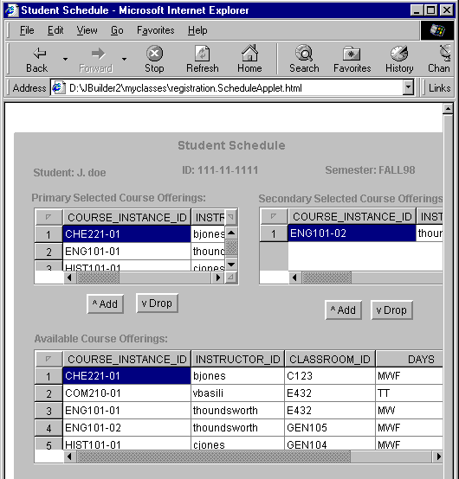
Example: User Interface Class
Register for Courses
MaintainScheduleForm
(from Student Interface)

Slide 20
Boundary Class:
System Interface Class
A boundary class which communicates with an external system is responsible for managing the dialogue with the external system; it provides the interface to that system for the system being built.
During design, these classes are refined to take into consideration the chosen communication protocols.
If the interface to an existing system is already well-defined, the responsibilities should be derived directly from the interface definition.

Slide 21
Example: System Interface Class
Close Registration
Finance System
FinanceSystem
(from Finance System)

Slide 22
Boundary Class:
Device Interface Class
The system may contain elements that act as if they were external (change value spontaneously without any object in the system affecting them), such as sensor equipment.
If the device is represented as an actor in the use-case model, it is easy to justify using a boundary class to intermediate communication between the device and the system.
If the use-case model does not include these "device-actors", now is the appropriate time to add them, updating the Supplementary Descriptions of the Use Cases where appropriate.
For each "device-actor", create a boundary class to capture the responsibilities of the device or sensor.
If there is a well-defined interface already existing for the device, make note of it for later reference during design.

Slide 23
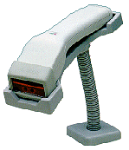
Example: Device Interface Class
BarCodeReader

Slide 24
Entity Class
An entity class models information and associated behavior that is generally long lived.
This type of class may reflect a real-world entity or it may be needed to perform tasks internal to the system.
They are typically independent of their surroundings; that is, they are not sensitive to how the surroundings communicate with the system.
Many times, they are application independent, meaning that they may be used in more than one application.
The main responsibilities of entity classes are to store and manage information in the system.
Entity classes typically are found early in the Elaboration Phase. They are often called "domain" classes since they usually deal with abstractions of real-world entities.

Slide 25
The Role of an Entity Class
Entity objects are usually not specific to one use-case realization; sometime, an entity object is not even specific to the system itself.
<<boundary>>
<<control>>
<<boundary>>
<<boundary>>
<<entity>>
<<entity>>
Store and manage information in the system

Slide 26
Entity objects (instances of entity classes) are used to hold and update information about some phenomenon, such as an event, a person, or some real-life object. They are usually persistent, having attributes and relationships needed for a long period, sometimes for the life of the system.
An entity object is usually not specific to one use-case realization; sometimes, an entity object is not even specific to the system itself. The values of its attributes and relationships are often given by an actor.
An entity object may also be needed to help perform internal system tasks. Entity objects can have behavior as complicated as that of other object stereotypes. However, unlike other objects, this behavior is strongly related to the phenomenon the entity object represents. Entity objects are independent of the environment (the actors).
The Role of an Entity Class

Slide 27
Finding Entity Classes
Use use-case flow of events and domain model and glossary as inputs. The more of these you have the better you are!
Traditional, filtering nouns approach (but I’d recommend using classes from the domain model as a starting place, if available)
  Underline noun clauses in the use-case flow of events
  Remove redundant candidates
  Remove vague candidates
  Remove implementation constructs
  Remove attributes (save for later)
  Remove operations

Slide 28
Example: Candidate Entity Classes
Register for Courses (Create Schedule)
<<entity>>
Student
CourseOffering
A person enrolled in classes at the university
A specific offering for a course
including days of week and times
Schedule
The courses a student has selected for current semester

Slide 29
Example: Candidate Entity Classes
Sometimes there is a need to model information about an actor within the system. This is not the same as modeling the actor (actors are external by definition).
For example, a course registration system maintains information about the student which is independent of the fact that the student also plays a role as an actor of the system.
  This information about the student that is stored in a ‘Student’ class is completely independent of the ‘actor’ role the student plays;
  The Student class (entity) will exist whether or not the student is an actor to the system.

Slide 30
Example: Entity Classes
Course - A class offered by the university.
CourseOffering - A specific offering for a course, including days of the week and times.
Student - A person enrolled in classes at the university.
Professor - A person teaching classes at the university.
Schedule - The courses a student has enrolled in for the current semester.
Separation of concerns
Abstraction

Slide 31
What is a Control Class?
Use-case behavior coordinator
One control class per use case
The control class is responsible for the flow of events in the use case.
<<control>>
Analysis class stereotype
Use Case
Use-case dependent, Environment independent

Slide 32
The Role of a Control Class
<<boundary>>
<<control>>
Customer
<<boundary>>
<<boundary>>
<<entity>>
<<entity>>
Coordinate the use-case behavior

Slide 33
The Role of a Control Class
A control class is a class used to model control behavior specific to one or a few use cases. Control objects (instances of control classes) often control other objects, so their behavior is of the coordinating type.
The behavior of a control object is closely related to the realization of a specific use case. In many scenarios, you might even say that the control objects "run" the use-case realizations. However, some control objects can participate in more than one use-case realization if the use-case tasks are strongly related. Furthermore, several control objects of different control classes can participate in one use case.
When the system performs the use case, a control object is created. Control objects usually die when their corresponding use case has been performed.

Slide 34
The Role of a Control Class
Not all use cases require a control object. For example, if the flow of events in a use case is related to one entity object, a boundary object may realize the use case in cooperation with the entity object.
You can start by identifying one control class per use-case realization, and then refine this as more use-case realizations are identified and commonality is discovered.
Control classes can contribute to understanding the system because they represent the dynamics of the system, handling the main tasks and control flows.
The addition of a control class per actor/use case pair is only an initial cut—as analysis and design continues, control classes may be eliminated, split up, or combined.
In the early stages of the Elaboration Phase, a control class is added for each actor/use case pair.

Slide 35
Example: Control Classes
RegistrationController
CloseRegistrationController
MaintainStudentController
MaintainProfessorController
SelectCoursesToTeachController
SubmitGradesController
ReportCardController

Slide 36
Example : Objects and Classes in the ESU Course Registration Problem
Classes extracted from Select Courses To Teach use case:
We will look at the Add a Course Offering to Teach scenario, which is one of the subflows of the Select Courses to Teach use case.
The main capability provided by this scenario is the ability for the professor to select a course offering to teach for a given semester.
Identify Boundary Classes
A class containing all the options available to the Professor as stated in the use case is created to satisfy this need. This class is called ProfessorCourseOptions.
Additionally, we can identify a class that deals with the addition of a new Course Offering for the Professor. This class is called AddACourseOffering.
2. Identify Entity Classes
This scenario deals with Courses, their Course Offerings, and the Professor assignment. We can identify three entity classes:
Course, CourseOffering, and Professor.
3. Identify Control Classes
We will add one control class to handle the flow of events for the use case. This class is called ProfessorCourseManager.

Slide 37
Objects and Classes in the ESU Course Registration Problem .. cont
Professor
Select Courses to Teach
Use Case Model
Analysis Model
ProfessorCourseOptions
AddACourseOffering.
CourseOffering
Professor.
Course
ProfessorCourseManager.

Slide 38
Objects and Classes in the ESU Course Registration Problem .. cont
Student
Register for Courses
Use Case Model
Analysis Model
MainForm
MaintainScheduleForm
RegistrationController
Schedule
CourseCatalogSystem

Slide 39
Analysis classes handle primarily functional requirements, and model objects from the "problem" domain; design elements handle non-functional requirements, and model objects from the "solution" domain.
Throughout the design activities, analysis classes are refined into design elements (e.g., design classes, packages, subsystems etc.). In general, there is a many-to-many mapping between analysis classes and design elements:
An analysis class can become one single class in the design model.
An analysis class can become a part of a class in the design model.
An analysis class can become an aggregate class in the design model. (Meaning that the parts in this aggregate may not be explicitly modeled in the analysis model.)
From Analysis Classes to Design Elements

Slide 40
From Analysis Classes to Design Elements.. cont
An analysis class can become a group of classes that inherits from the same class in the design model.
An analysis class can become a group of functionally related classes in the design model (e.g., a package).
An analysis class can become a subsystem in the design model .
An analysis class can become a relationship in the design model.
A relationship between analysis classes can become a class in the design model.
Part of an analysis class can be realized by hardware, and not modeled in the design model at all.
Any combination of the above are also possible.

Slide 41
From Analysis Classes to Design Elements .. cont

Slide 42
Analysis Classes and the Architecture
Layer 1
Layer 2
Layer 3
Once the analysis classes have been identified, they should be allocated to specific layers in the architecture. These layers are the initial layers defined during Architectural Analysis. This should be done here because the allowable dependencies between layers may affect the responsibilities allocated to the classes in the next step.

Slide 43
  Distributing Use-Case Behavior to Classes

Slide 44
  Distribute Use-Case Behavior to Classes
Now we need to allocate responsibilities of the use cases to the analysis classes and model this allocation by describing the way the class instances collaborate to perform the use case in use-case realizations.
A use-case realization- analysis is a collaboration within the analysis model that describe how a specific use case is realized and performed in terms of analysis classes and their interacting analysis objects.
A use-case realization has a flow-of-events descriptions, class diagrams that depicts its participating analysis classes, and interaction diagrams that depict the realization of a particular flow of the use case in terms of analysis object interactions.
The purpose of “Distribute Use-Case Behavior to Classes” is to:
Express the use-case behavior in terms of collaborating analysis classes.
Determine the responsibilities of analysis classes.

Slide 45
Distribute Use-Case Behavior to Classes ..cont
Use Case
Use-Case Realization

Slide 46
Guidelines
Use analysis class stereotypes as a guide
  Boundary Classes (the Interface)
    Behavior that involves communication with an actor
  Entity Classes (Persistent Data)
    Behavior that involves the data encapsulated within the abstraction
  Control Classes (the Use Case flow of events)
    Behavior specific to a use case or part of a very important flow of events
(continued)

Slide 47
Guidelines:
Who has the data needed to perform the responsibility? Design options:
  One class has the data, put the responsibility with the data – best case!!!
  Multiple classes have the data:
    Put the responsibility with one class and add a relationship to the other (a dependency relationship)
    Create a new class, put the responsibility in the new class, and add relationships to classes needed to perform the responsibility
    Put the responsibility in the control class, and add relationships to classes needed to perform the responsibility

Slide 48
Guidelines:
Be careful when adding relationships -- all relationships should be consistent with the abstractions they connect.
Don’t just add relationships to support the implementation without considering the overall affect on the model.
When a new behavior is identified, check to see if there is an existing class that has similar responsibilities, reusing classes where possible.
Only when sure that there is not an existing object that can perform the behavior should you create new classes.

Slide 49
Collaboration Diagram
The collaboration diagram should show interactions of the system with its actors (the collaborations should begin with an actor, since an actor always invokes the use case). If you have several actor instances in the same diagram, try keeping them in the periphery of the diagram.
Interactions BETWEEN actors should NOT be modeled.
→By definition, actors are external, and are out of scope of the system being developed.
Thus, you do not include interactions between actors in your system model.
Let’s look at how to distribute behavior to classes:

Slide 50
The Anatomy of Collaboration Diagrams
Client Object
Link
Supplier Object
:Client
1: PerformResponsibility
:Supplier
Message

Slide 51
Collaboration Diagram
A collaboration diagram describes a pattern of interaction among objects; it shows the objects participating in the interaction by their links to each other and the messages that they send to each other.
An object is represented in three ways: Objectname:Classname, ObjectName, and :ClassName.
A link is a relationship among objects across which messages can be sent. In collaboration diagrams, a link is shown as a solid line between two objects.
A message is a communication between objects that conveys information with the expectation that activity will ensue.
In collaboration diagrams, a message is shown as a labeled arrow placed near a link. This means that the link is used to transport, or otherwise implement the delivery of the message to the target object. The arrow points along the link in the direction of the target object (the one that receives the message). The arrow is labeled with the name of the message, and its parameters. The arrow may also be labeled with a sequence number to show the sequence of the message in the overall interaction.

Slide 52
The following example shows the collaboration of objects to support the Register for Courses use case.
: Main
Form
2: // open schedule form( )
1: // select maintain schedule( )
5: // select 4 primary and 2 alternate offerings( )
: Maintain
ScheduleForm
: Student
3: // get course offerings( )
6: // add courses to schedule( )
: Registration
: CourseCatalog
4: // get course offerings( )
Controller
System
7: // create with offerings( )
:Schedule

Slide 53
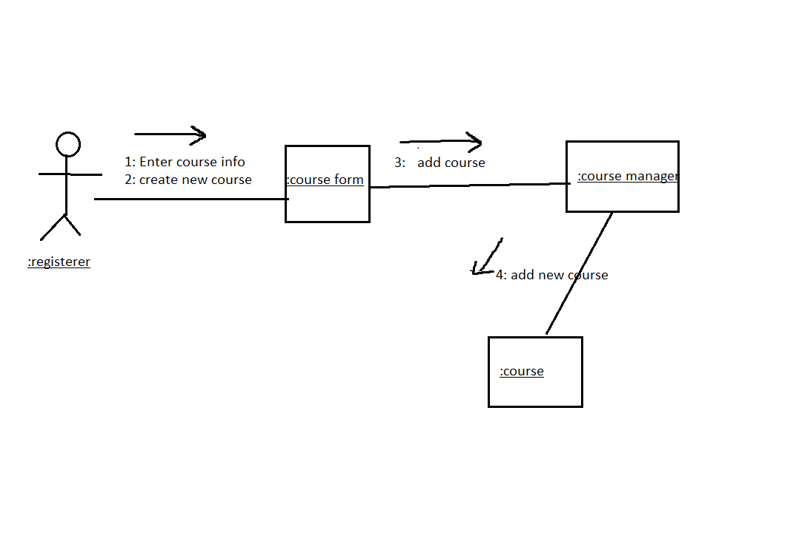
The following example shows the collaboration of objects to support the
Create Course use case.

Slide 54
  Describing Responsibilities

Slide 55
Describe Responsibilities
A class and its objects often participate in several use-case realizations. It is important to coordinate all the requirements on a class and its objects that different use-case realizations may have.
The ultimate objective of these class-focused activities is to document what the class knows and what the class does.
The resulting analysis model gives you a big picture and a visual idea of the way responsibilities are allocated and what such an allocation does to the class collaborations.
The purpose of “Describe Responsibilities” step is namely to describe the responsibilities of an analysis class.

Slide 56
Describe Responsibilities
What are responsibilities and How do I find them?
A responsibility is a statement of something an object can be asked to provide. Responsibilities evolve into one (but usually more) operations on classes in design; they can be characterized as:
- The actions that the object can perform.
- The knowledge that the object maintains and provides to other objects.
Each analysis class should have several responsibilities; a class with only one responsibility is probably too simple, while one with a dozen or more is pushing the limit of reasonability and should potentially be split into several classes.

Slide 57
Describe Responsibilities
Responsibilities are derived from messages in collaboration diagrams. For each message, examine the class of the object to which the message is sent. If the responsibility does not yet exist, create a new responsibility that provides the requested behavior.
Other responsibilities will derive from non-functional requirements. When you create a new responsibility, check the non-functional requirements to see if there are related requirements which apply. Either augment the description of the responsibility, or create a new responsibility to reflect this.

Slide 58
Example: Class Responsibilities
<<boundary>>
MaintainScheduleForm
// select 4 primary and 2 alternate offerings()
// open ()
<<boundary>>
<<entity>>
MainForm
Schedule
// select maintain schedule()
// create with offerings()
<<control>>
<<boundary>>
RegistrationController
CourseCatalogSystem
// add courses to schedule()
// get course offerings()

Slide 59
  Describing attributes and associations

Slide 60
Describe attributes and association
An attributes specifies a property of an analysis class, and it is often implied and required by the responsibilities of its class.
The purpose of “Describe Attributes and association” step is to
- Define the other classes on which the analysis class depend.
- Define the events in other analysis classes that the class must know about .
- Define the information that the analysis class is responsible for maintaining .

Slide 61
What is an Attribute?
<<stereotype>>
ClassName
Attribute : Type = InitValue
Attribute : Type = InitValue
Attribute : Type = InitValue
<<entity>>
CourseOffering
number :String=“100”
startTime : Time
endTime: Time
days: enum
attribute

Slide 62
Describe attributes and association
The following general guidelines should be kept in mind when attributes are identified :
The name of attribute should be a noun that clearly states what information the attribute holds.
The description of the attribute should describe what information is to be stored in the attribute
Attributes are used to store information. Attributes are atomic things with no responsibilities.
A single attribute instance cannot be shared by several analysis objects. If this is required, the attribute needs to be defined in its own class.
If the information has complex behavior, or is shared by two or more objects the information should be modeled as a separate class.

Slide 63
Describe attributes and association
If an entity classes traces to a domain class or business entity class, the attributes of those classes are valuable input.
Attributes of boundary classes that interact with the human actors often represent information items manipulated by the actors, such as labeled text fields.
Attributes of boundary classes that interact with system actors often represent properties of a communication interface.
Attributes of control classes are rare because of their short life span. However control classes can have attributes that represent accumulated or derived values during the realization of a use case.
During analysis, the attribute types should be from the domain, and not adapted to the programming language in use.

Slide 64
Relationships of classes
The Need for Relationships
All systems are made up of many classes and objects. System behavior is achieved through the collaborations of the objects in the system.
For example, a student is added to a course offering when the course offering receives the add student message. This is often referred to as an object sending a message to another object.
Relationships provide the conduit for object interaction.
Two types of relationships discovered during analysis from collaboration diagrams are associations and aggregations.

Slide 65
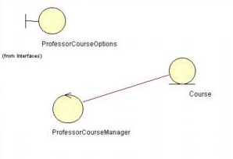
What is an Association?
An association is a bidirectional semantic connection between classes.
An association between classes means that there is a link between objects in the associated classes.

Slide 66
What is an Association?
The number of objects connected depends upon the multiplicity of the association.
You can use associations to show that objects know about other objects.
Sometimes, objects must hold references to each other to be able to interact.
Most associations are simple (exist between exactly two classes), and are drawn as solid paths connecting pairs of class symbols.
Ternary relationships are also possible.
Sometimes, a class has an association to itself. It means that one instance if the class has associations to other instances of the same class.
An association may have a name that is placed on, or adjacent to the association path. The name of the association should reflect the purpose of the relationship and be a verb phrase; the name of an association can be omitted, particularly if role names are used.
Avoid names like "has" and "contains", as they add no information about what the relationships are between the classes.

Slide 67
What is an Association?
Models a semantic connection among instances
Student
CourseOffering
Simple association
is a pre-requisite of
Schedule
Course
unary association

Slide 68
What are Roles?
Instructor
Department head
CourseOffering
Professor
Department
Pre-requisites
Course
Each end of an association is a role specifying the face that a class plays in the association.
Each role must have a name.
Aggregation relationships typically are not named since they are read using the words "has" or "contains."
The use of association names and role names is mutually exclusive: one would not use both an association name and a role name. For each association, decide which conveys more information.
In the above example, the Professor participates in two separate association relationships, playing a different role in each.
In the case of self-associations, role names are essential to distinguish the purpose for the association.

Slide 69
Example:
+primaryCourses
<<entity>>
0..4
<<entity>>
0..*
0..4
Schedule
0..*
CourseOffering
0..*
+alternateCourses
0..*
0..2
0..2
Multiple associations must reflect multiple roles
If there is more than one association between two classes then they MUST be named.
In the above example, two associations are required between Schedule and CourseOffering because a Schedule can contain two kind of CourseOfferings, primary and alternate. These must be distinguishable, so two separate associations are used

Slide 70
Multiplicity
For each role you can specify the multiplicity of its class, how many objects of the class can be associated with one object of the other class.
Exactly one
Zero or more (many, unlimited)
One or more
Zero or one (optional scalar role)
Specified range
1
0..*
*
1..*
0..1
2..4
During analysis, assume a multiplicity of 0..* (zero to many) unless there is some clear evidence of something else. A multiplicity of zero implies that the association is optional.

Slide 71
Example:
Multiplicity
0..*
0..4
1
0..1
primaryCourses
0..*
0..2
alternateCourses
Student
Schedule
CourseOffering
A Student can have 1 Schedule, or no Schedule.
A Schedule is only associated with 1 Student.
A Schedule can contain up to 4 primary courses and 2 alternate courses.
A CourseOffering can appear on any number of Schedules, as either a primary course or as an alternate course.
A CourseOffering does not have to appear on any Schedule.

Slide 72
What is Aggregation?
A special form of association that models a whole-part relationship between an aggregate (the whole) and its parts
Since aggregation is a special form of association, the use of multiplicity, roles, navigation, etc. is the same as for association.

Slide 73
What is Aggregation?
Some situations where aggregation may be appropriate:
- An object is physically composed of other objects (e.g. car
being physically composed of an engine and four wheels).
- An object is a logical collection of other objects (e.g., a family
is a collection of parents and children).
- An object physically contains other objects (e.g., an airplane
physically contains a pilot).

Slide 74
Association or Aggregation?
Aggregation should be used only in cases where there is a compositional relationship between classes, where one class is composed of other classes, where the "parts" are incomplete outside the context of the whole.
The use of aggregation versus association is dependent on the application you are developing.

Slide 75

Example: Aggregation
The following tests may be used to determine if an association should be an aggregation:
-Is the phrase "part of" used to describe the relationship?
-Are some operations on the whole automatically applied to its parts? For example, delete a course then delete all of its course offerings.
-Is there an intrinsic asymmetry to the relationship where one class is subordinate to the other?
For example, a Course (Math 101) may be offered at different times during a semester. Each offering is represented as a Course Offering (e.g., Math 101, Section 1, and Math 101, Section 2). The relationship between a Course and a CourseOffering is modeled as an aggregation—a Course "has" CourseOfferings.

Slide 76
Association Class
A class “attached” to an association
Contains properties of a relationship
One instance per link
<<entity>>
Grade
value
<<entity>>
0..4
<<entity>>
0..*
0..*
+primaryCourses
Schedule
CourseOffering
+alternateCourses
0..*
0..*
0..2
0..2

Slide 77
Association Class
An association class is a class that is connected to an association. It is a full-fledged class and can contain attributes, operations and other associations.
Association classes allow you to store information about the relationship itself.
In many cases, association classes are used to resolve many-to-many relationships, as shown in the example above.
In previous example, a Schedule includes multiple primary CourseOfferings and a CourseOffering can appear on multiple schedules. Where would a Student’s grade for a primary CourseOffering “live”? It cannot be stored in Schedule because a Schedule contains multiple CourseOfferings. It cannot be stored in CourseOffering because the same CourseOffering can appear on multiple Schedules. Grade is really an attribute of the relationship between a Schedule and a CourseOffering. Thus, an association class, Grade, is created.

Slide 78
Generalization (in entity classes)
Account
One class shares the structure and/or behavior of one or more classes
“Is-a-kind of” relationship
In analysis, use sparingly
Inheritance relationships may be identified – especially in entity classes.
balance
Superclass (parent)
name
number
Withdraw()
CreateStatement()
Generalization Relationship
In analysis, generalization should be
used to model shared behavioral
semantics only (that is, generalization
that passes “is a kind of’ test)
The use of generalization makes the
definition of the abstractions easier to
document and understand.
Checking
Savings
Subclasses
Withdraw()
GetInterest()
Withdraw()
When generalization found,
create a common super-class
that contains common attributes
associations, aggregations, and
operations

Slide 79
Finding Generalization: Generalization of Classes
Stock
Savings
Checking
More general
Bond
Base class
subclasses
RealEstate
Asset
BankAccount
Security
RealEstate
Subclasses have
Unique semantics
And behavior.
Savings
Checking
Stock
Bond
Can generalize when you have a set of classes that share some semantics and behavior

Slide 80
Finding Generalization: Specialization of Classes
Do not mistake generalization (inheritance) for hierarchy.
Hierarchy involves ‘decomposition.’ IN generalization, we
are ‘factoring out commonalities.’ This is MUCH
different than hierarchy. Here, the motivation is for
reuse and extensibility….
Asset
Asset
BankAccount
Security
RealEstate
Savings
Checking
Stock
Bond
More specific
More specialized properties are placed in the lower part of the inheritance hierarchy.

Slide 81
Example: Generalization (Shared Semantics)
Part-timeStudent
Full-timeStudent
Without Generalization
name
name
address
address
studentID
studentID
numberCourses
gradDate
Student
name
With Generalization
address
studentID
FulltimeStudent
ParttimeStudent
gradDate
maxNumCourses

Slide 82
Finding relationships
To find relationships, start studying the links in the collaboration diagrams.
Links between classes indicate that objects of the two classes need to communicate with one another to perform the Use Case. Thus, an association or an aggregation is needed between the associated classes.
Remember to give the associations role names and multiplicities.
Write a brief description of the association to indicate how the association is used, or what relationships the association represents.

Slide 83
Finding relationships
1: PerformResponsibility
Collaboration
Diagram
:Client
:Supplier
Link
Client
Supplier
Class
Diagram
0..*
0..*
Prime suppliers
Client
Supplier
Association

Slide 84
Example: Finding relationships
Classes in Register for courses use case
<<boundary>>
<<boundary>>
MaintainScheduleForm
MainForm
1
0..1
// select maintain schedule()
1
+ // open()
+ // select 4 primary and 2 alternate offerings()
1
1
<<boundary>>
1
0..*
<<control>>
CourseCatalogSystem
RegistrationController
// get course offerings()
// add courses to schedule()
// get course offerings ()
1
1
<<entity>>
Schedule
// create with offerings()

Slide 85
Example: Finding relationships
The diagram on the previous slide shows classes that collaborate to perform the “Register for Courses” use case, along with their relationships.
The relationships were defined based on the interaction diagrams for the “Register for Courses” use case provided earlier in this module.
Rationale for relationships:
From MainForm to MaintainScheduleForm: MaintainScheduleForm does not make any sense outside of the context of a particular use session. Only one MaintainScheduleForm can be active at any one time, or none may be active.
From MaintainScheduleForm to Registration Controller: There is one controller for each Schedule being created (e.g., each Student registration session).
From MaintainScheduleForm to CourseCatalogSystem: There’s only one CourseCatalogSystem instance for possibly many MaintainScheduleForms. This serializes access to the legacy system. Many MaintainScheduleForms can be active at one time (for different sessions/students).
From RegistrationController to Schedule. A RegistrationController deals with one Schedule at a time (the Schedule of the Student that has logged in).

Slide 86
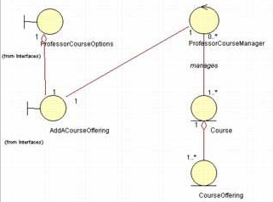
Example: Finding relationships
Classes in Add a Course Offering scenario

Slide 87
Example: Finding relationships
Multiple objects belonging to the same class may have to communicate with one another. This is shown on the class diagram as a reflexive association or aggregation. Role names rather than association names typically are used for reflexive relationships
The reflexive relationship in previous diagram may be read in the following ways:
- One Course object playing the role of Prerequisite is related to zero or more Course objects.
- One Course object is related to zero or more Course objects playing the role of Prerequisite.

Slide 88
  Unifying analysis classes

Slide 89
Unify Analysis Classes
At this point, we have a pretty good understanding of the analysis classes, their responsibilities, the analysis mechanisms they need to implement, and the collaborations required to support the functionality described in the use cases.
Now we must review our work and make sure that it is as complete and as consistent as possible before moving on to the architecture activities.
The purpose of “Unify Analysis Classes” is to ensure that each analysis class represents a single well-defined concept, with non-overlapping responsibilities.
Verify that the analysis objects meet the functional requirements made on the system
Verify that the analysis objects and collaborations are consistent

Slide 90
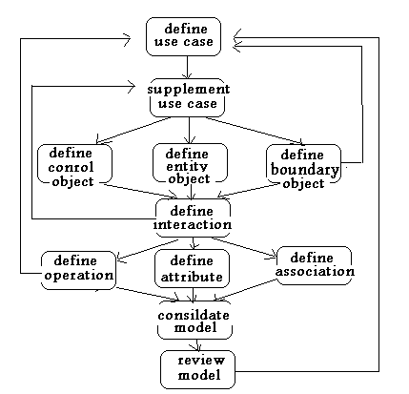
Analysis activities (UML activity diagram)

