Slide 1
Chapter 5
Refining Analysis Model
Software Analysis and Design
0721322

Slide 2
Refine your Analysis model
Add generalization to achieve reuse
Organize the analysis model by using packages and Software components
Package is a grouping of any model elements
Software component is an independent unit, having well-defined interfaces and dependencies that can be composed and deployed independently.

Slide 3
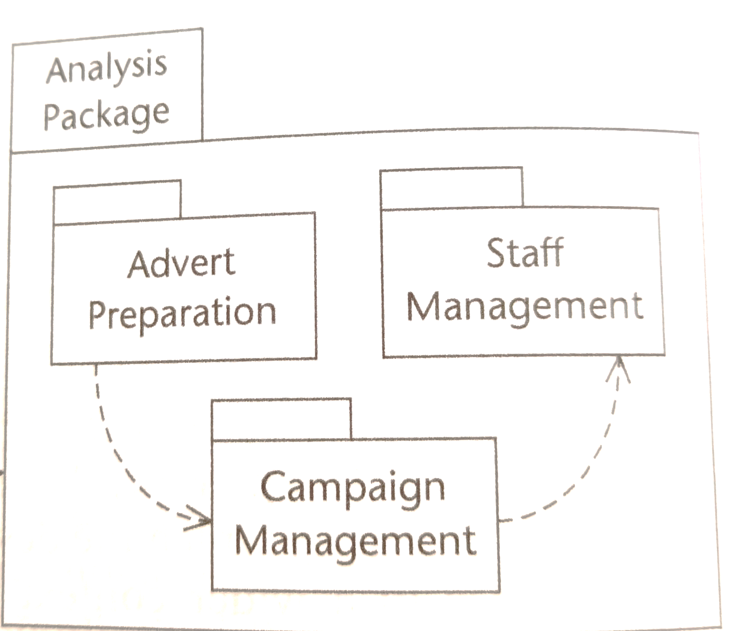
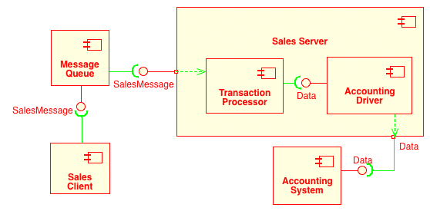
Refine your Analysis model
Use case packages
Component diagram

Slide 4
Object Interaction
Refine analysis model by creating a sequence diagram for interaction
A sequence diagram shows an interaction between objects arranged in a time sequence
Sequence diagrams can be drawn at different levels of detail and to meet different purposes at several stages in the development lifecycle.

Slide 5
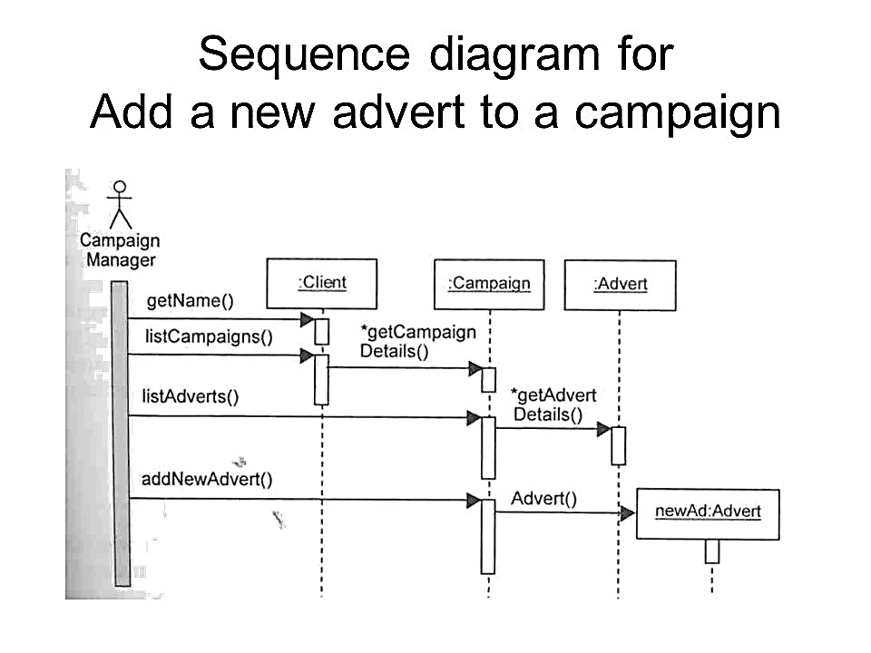

Slide 6
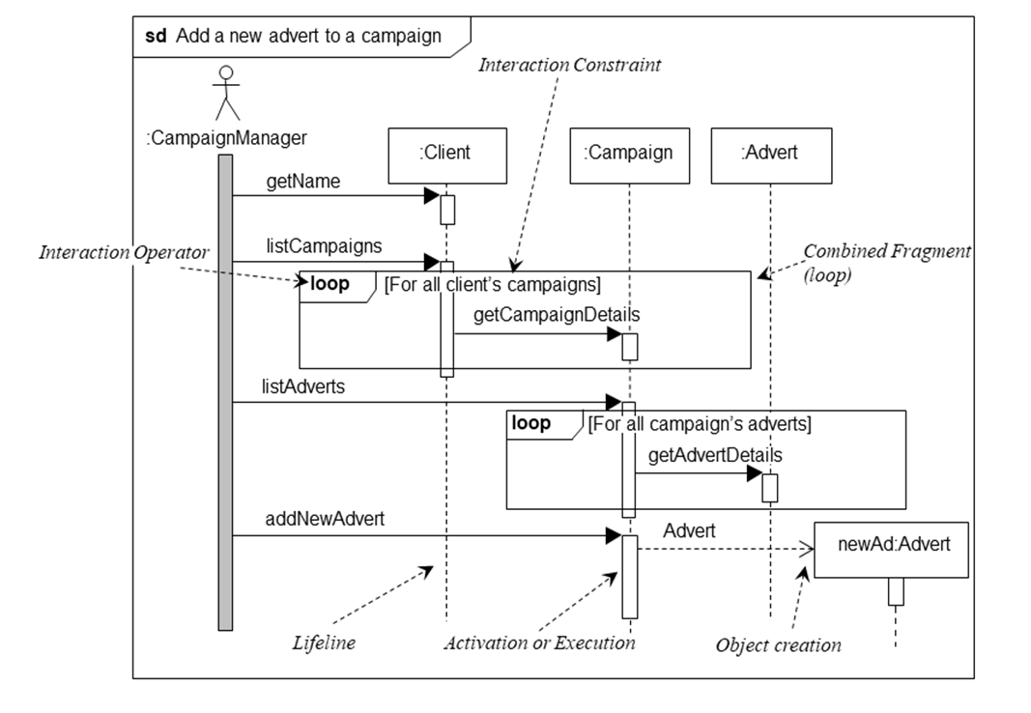

Slide 7
Object interaction
Sequence diagram
Vs
Collaboration diagram ?

Slide 8
Specifying operations
Non-algorithmic approach
  Decision table
  pre- and post- conditions
Algorithmic approach
  Structured English
  Activity diagram

Slide 9
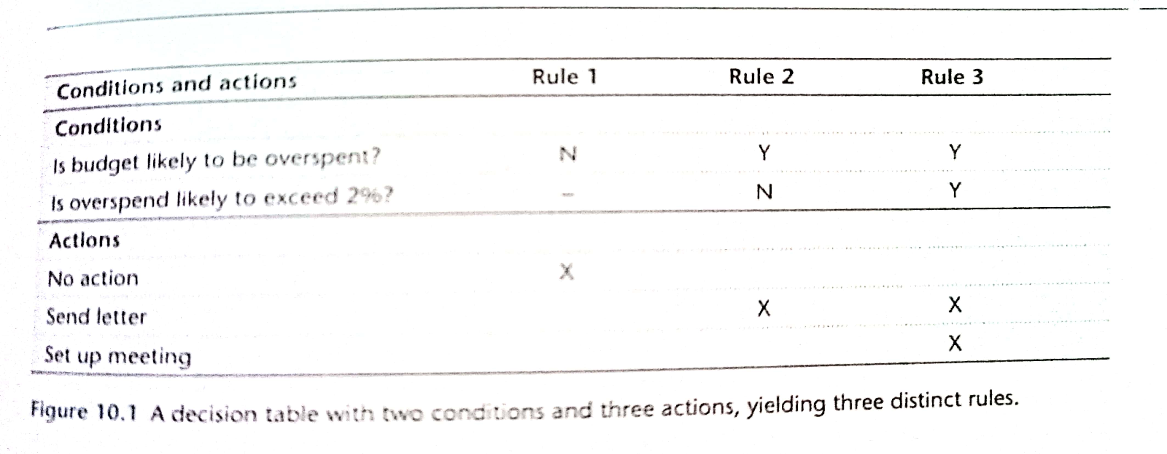
Specifying operations
  Decision table

Slide 10
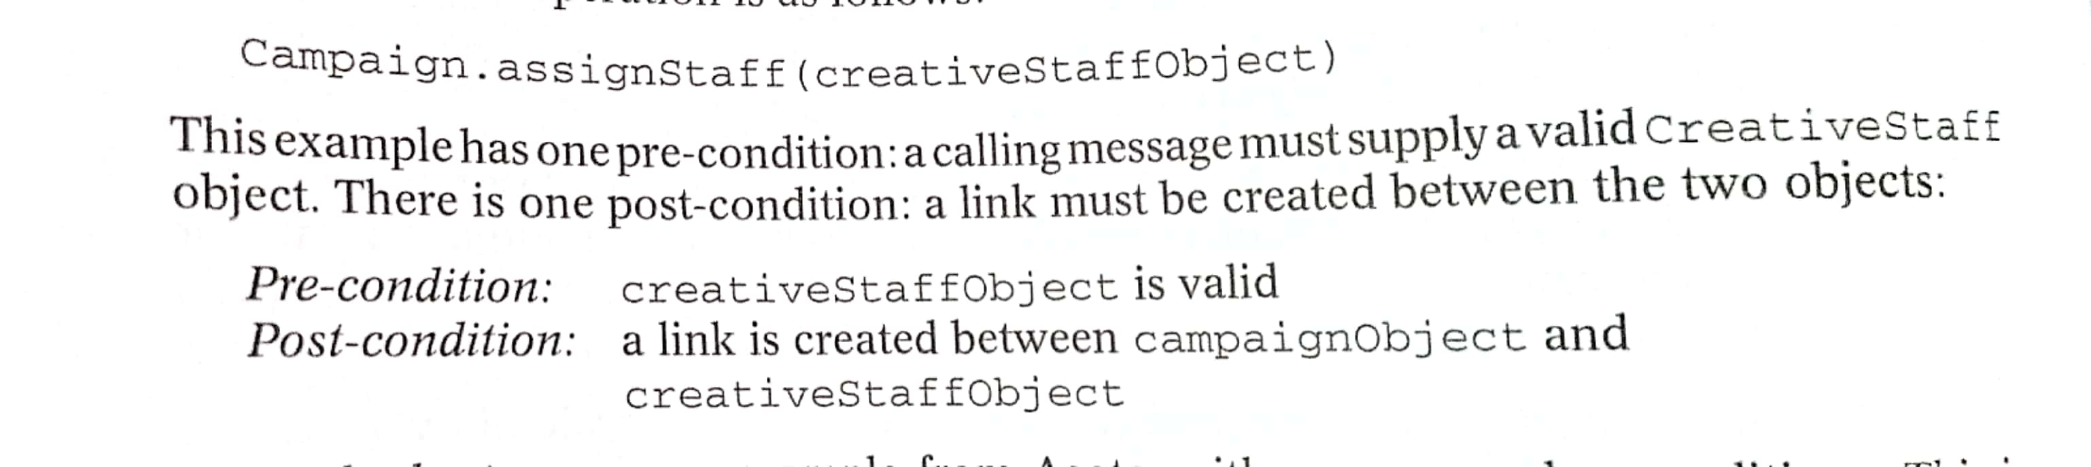
Specifying operations
  Pre- and post- conditions

Slide 11
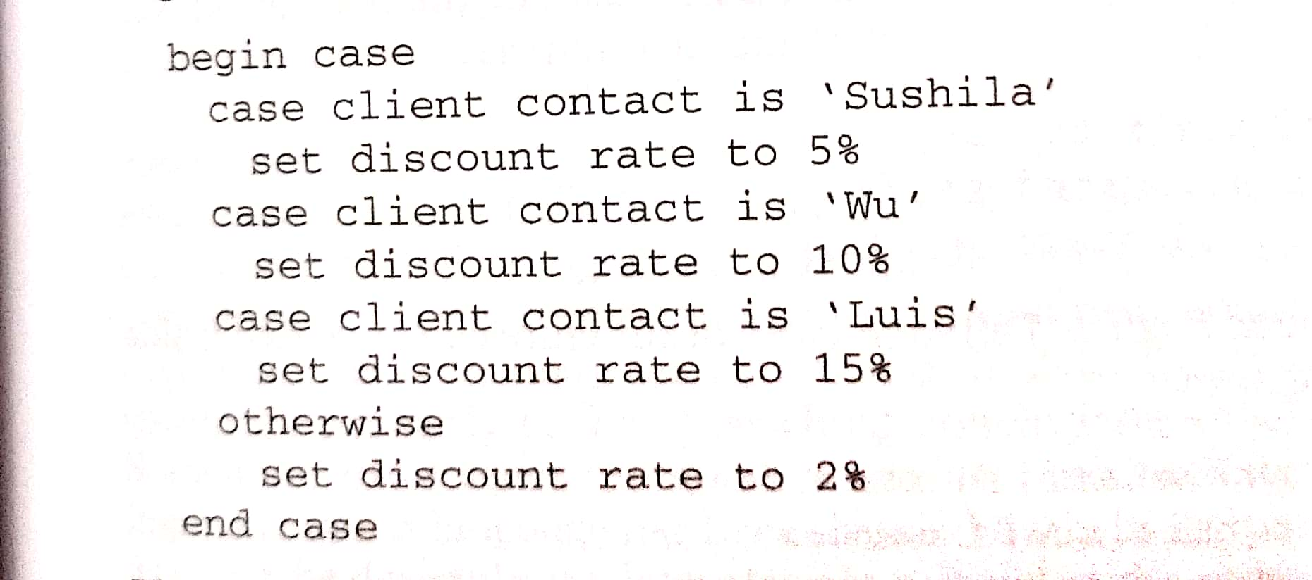
Specifying operations
  Structured English

Slide 12
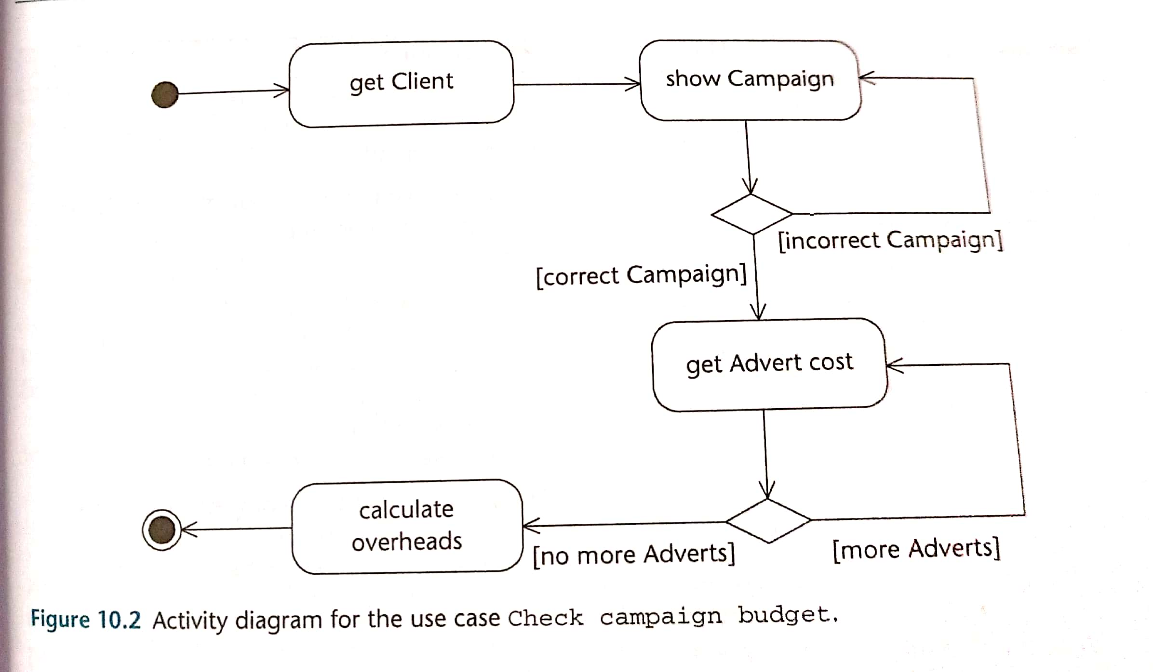
Specifying operations
  Activity diagram

Slide 13
Specifying Control
Specifying the control aspects of a system deals with how the system should respond to events.
UML uses state machines or state diagrams to model objects behavior during their lifetime.

Slide 14
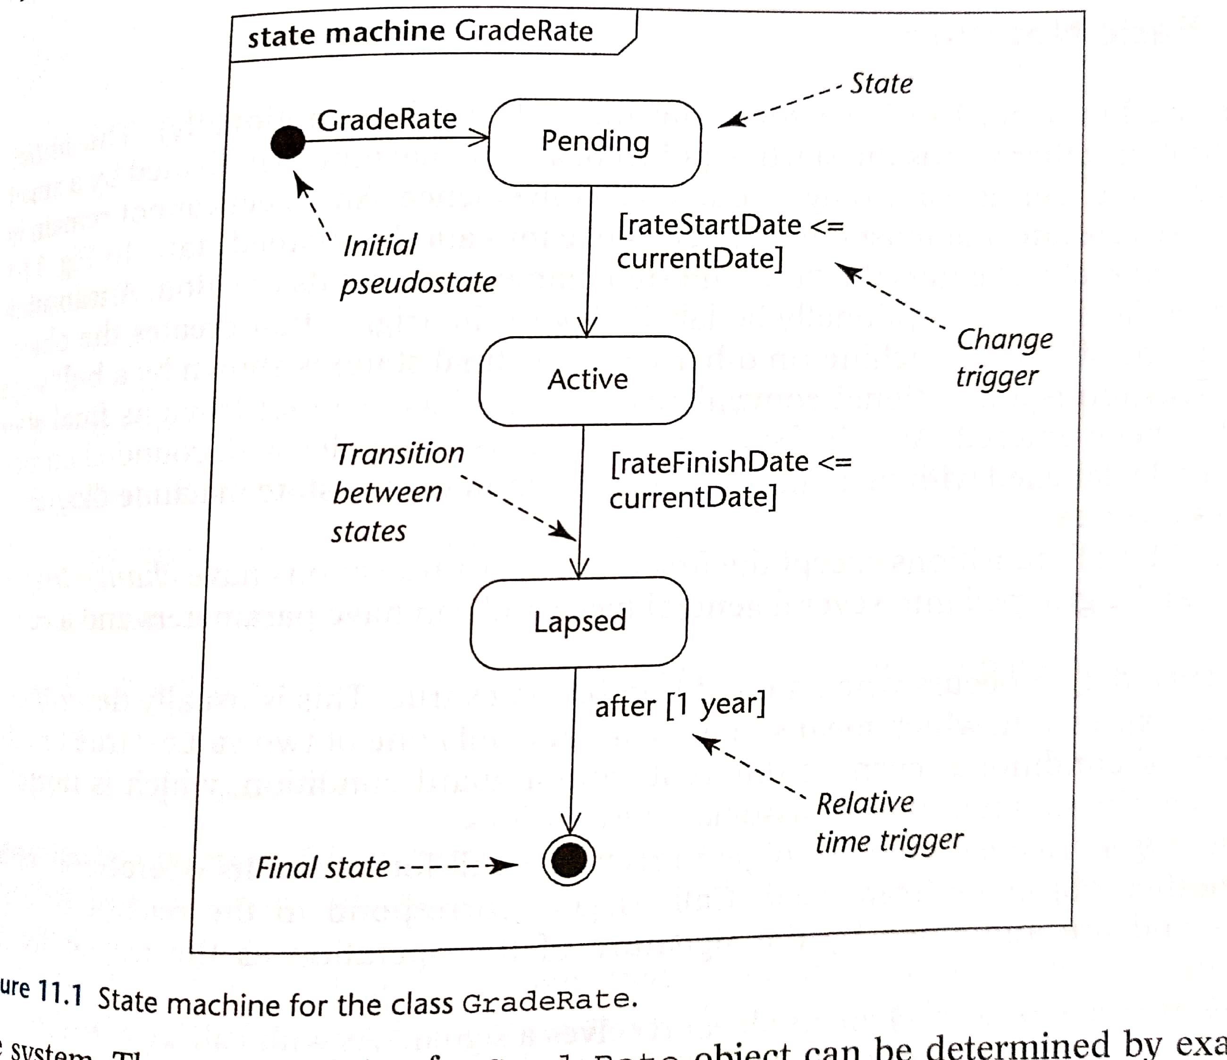
Specifying Control

