Slide 1
Chapter 6
Object-oriented Design
Software Analysis and Design
0721322

Slide 2
Analysis vs Design
The analysis activity is characterized as asking what happens in the current system and what is required in the new system.
It is a process of seeking to understand the organization, investigating its requirements and modeling them.
The result of this analysis activity is a specification of what the proposed system will do based on the requirements.
Design is about producing a solution that meets the requirements that have been analyzed.
The design activity is concerned with specifying how the new system will meet the requirements.

Slide 3
Analysis vs Design
There may be many possible design solutions, but the intention is to produce the best possible solution in the circumstances.
Design can be seen either as a stage in the systems development lifecycle or as an activity that takes place within the development of a system.
In projects that follow the waterfall lifecycle model, the Analysis stage will be completed before the Design stage begins.
However, in projects that follow an iterative lifecycle, design is not such a clear-cut stage, but is rather an activity that will be carried out on the evolving model of the system.

Slide 4
Analysis vs Design
Example from Agate case study:
Analysis identifies the fact that each Campaign has a tittle attribute, and this fact is documented in the class model.
Design determines how this will be entered into the system, displayed on screen and stored in some kind of database together with all the other attributes of Campaign and other classes.

Slide 5
System Design vs Detailed Design
During system design the designer make decisions that will affect the system as a whole.
The most important aspect of this is the overall architecture of the system.
System design includes choosing technologies and frameworks, and setting standards.
For example:
  If a system uses client-server architecture, how processes and objects will be distributed on different machines? What subsystems will be allocated to different processers ?
  Existing standards such as screen layouts , construction guidelines, database design

Slide 6
System Design vs Detailed Design
Detailed design is simply about designing inputs, outputs, processes and file or database structure.
Detailed design in OO systems, includes designing user interfaces, interactions, classes and data storage.
Design activity is concerned with turning an analysis model into a specification of a system that can be given to programmers to build.
Design adds details to analysis model , attributes type and visibility , operations visibility and signature
New classes might be added, new associations might emerge.
Design will add classes that supports input and output and that allows data to be stored in a database

Slide 7
What to add to OO detailed design?
Attributes data types
Derived attributes
Primary operations
Operation signature
Visibility

Slide 8
Attributes data types
Attributes have to be specified in terms of data types and sometimes initial values.
Common data types:
  Boolean
  Character
  Integer
  Floating-point data types (float, double, decimal)
  String
Some OO programming languages provide complex data types like currency (money) , date , etc.

Slide 9
Attributes data types
Examples:
campaignBudget : Money = 0.00
customerName : String {not null}
contact : String[0..5]

Slide 10
Derived attributes
The values of some attributes can be derived from other attributes in the same class or other class.
They will have an operation to get the value, but to set it.
It is necessary to decide how these values will be calculated. There are two choices:
  Calculate their values when they are needed
  Calculate their values whenever one of the values they depend on changes.

Slide 11
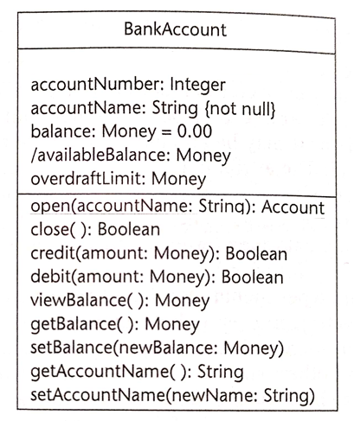
Derived attributes

Slide 12
Derived attributes
If overdraftlimit = -100 , and the user deposits 500 , then balance = 500 while availableBalance = (500+ -100) which equals 400
In BankAccount class availableBalance is a derived attribute.
Indicate in UML by adding “/” before the name of the attribute.
availableBalance is the sum of balance and overdarftLimit
Can be calculated in two ways. What are they?

Slide 13
Primary operations
In analysis we identify operations that are necessary to support use cases.
Since we design our classes for reuse; we add other operations.
Primary operations include:
  Constructor
  Destructor
  Get and Set operations or properties

Slide 14
Operation signatures
Operations have to be specified in terms of parameters (in and out) and their visibility.
Example:
  withdraw( amount: Money) : Boolean
  calcCampaignBudget( ) : Money
Exceptions are not shown as a part if the operation syntax in UML class diagram, but can be held in the model.

Slide 15
Visibility
+ : Public
- : Private
# : Protected
~ : Package

Slide 16
Grouping attributes and
operations in classes

Slide 17
Assigning responsibilities
A responsibility can be assigned to more than one class.
Take “reuse” into consideration when assigning responsibilities.

Slide 18
Coupling and cohesion
Coupling describes the degree of interconnections between design components and is reflected by the number of links an object has with other objects.
  Interaction coupling is a measure of the number of different messages an object sends to other objects and number of passed parameters with these messages.
  Inheritance coupling describes the degree to which a subclass actually needs the features in inherits from it’s abase class.

Slide 19
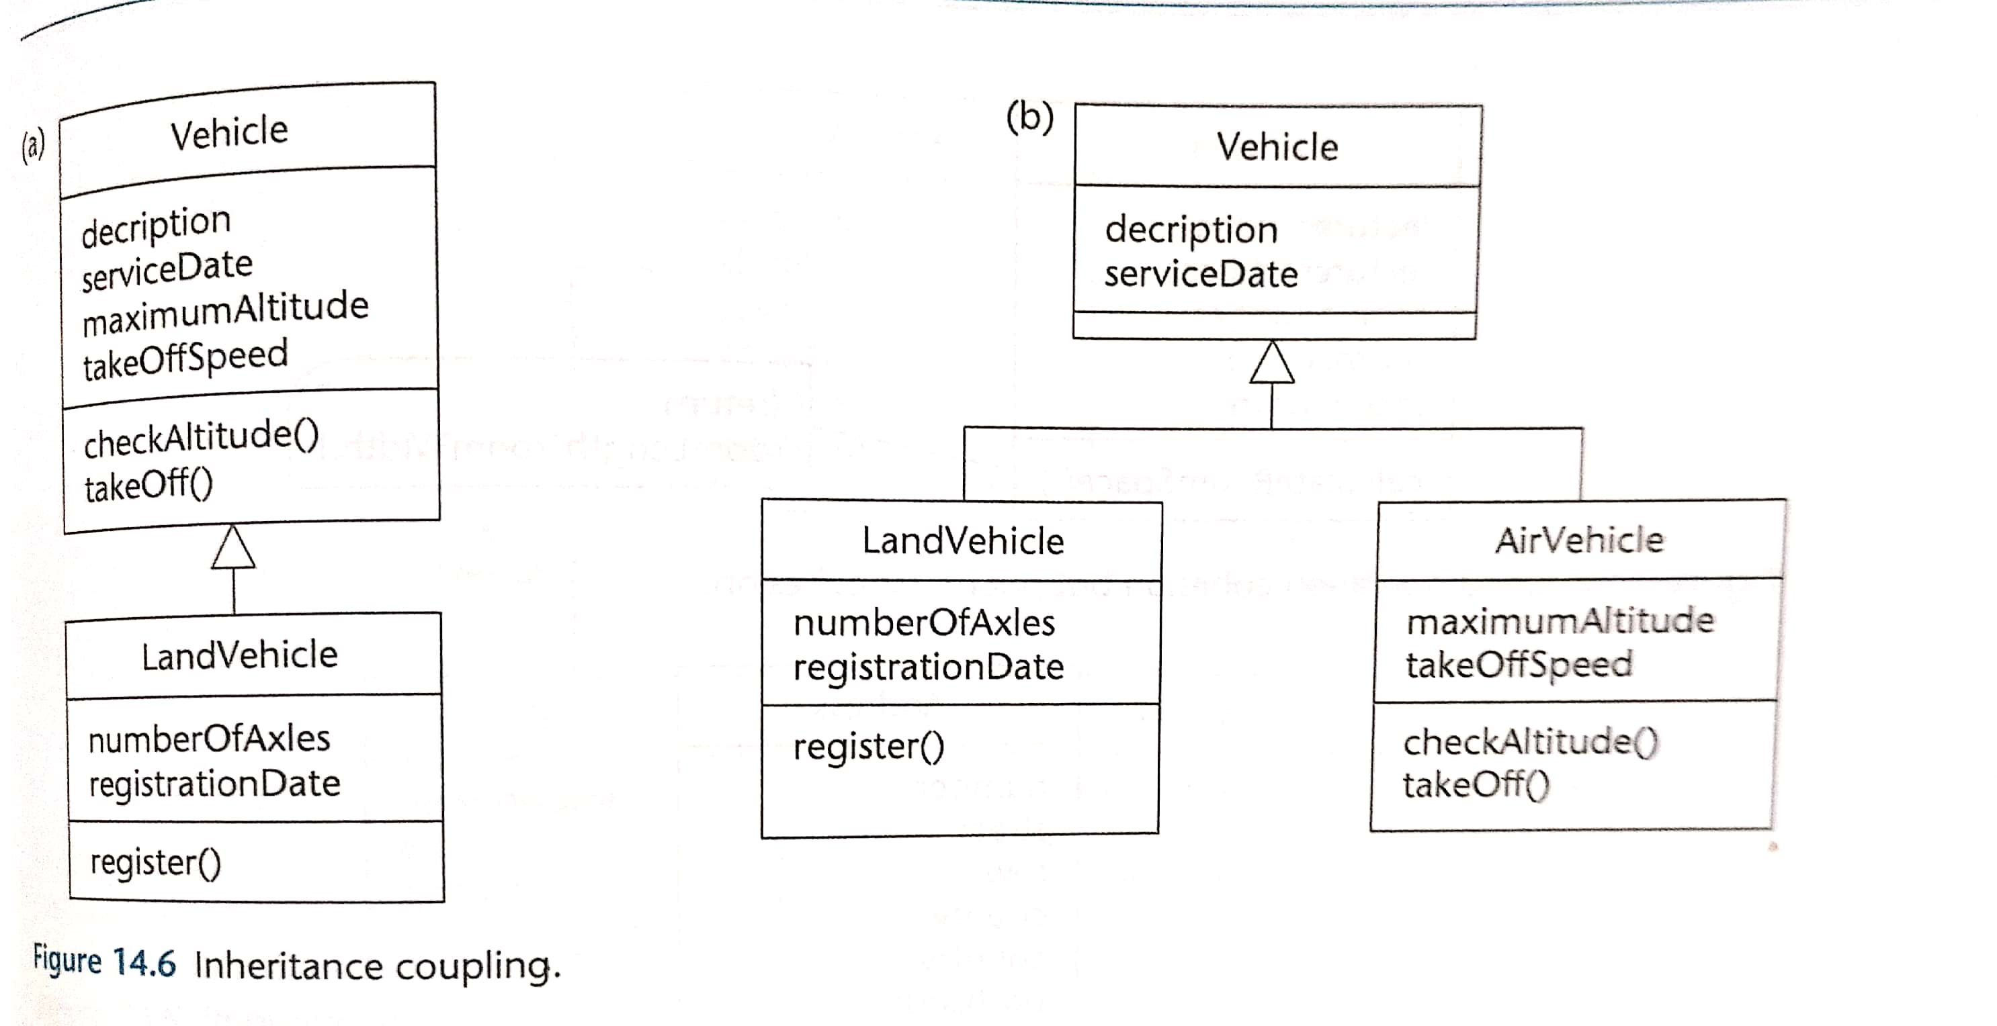

Slide 20
Coupling and cohesion
Cohesion is a measure of the degree to which an elements contributes to a single purpose.
  Operation cohesion measures the degree to which an operation focuses on a single functional requirement.
  Class Cohesion measures the degree to which a class focuses on a single requirement.

Slide 21
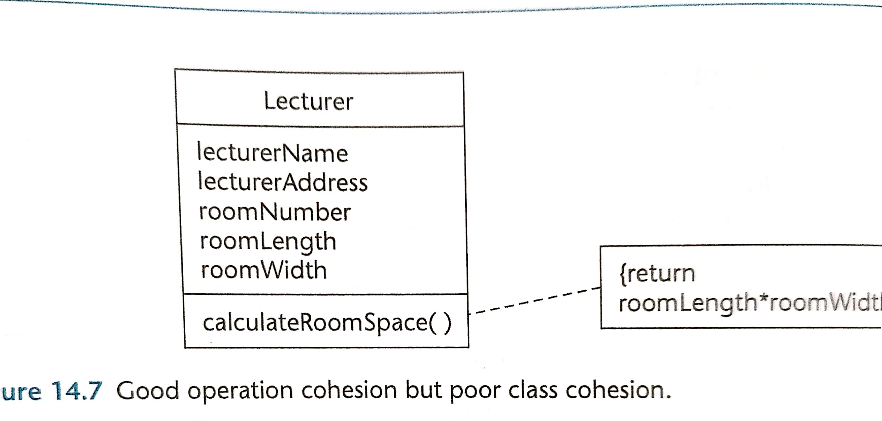
Room
…..
Width
length

Slide 22
Some design principles
A
B
Liskov substitution principle:
  applies to inheritance hierarchies.
  states that is should be possible to treat a derived object as if it were a base object.
Open-close principle:
  states that a module (or a class) should be open for extension but closed for modification.

Slide 23
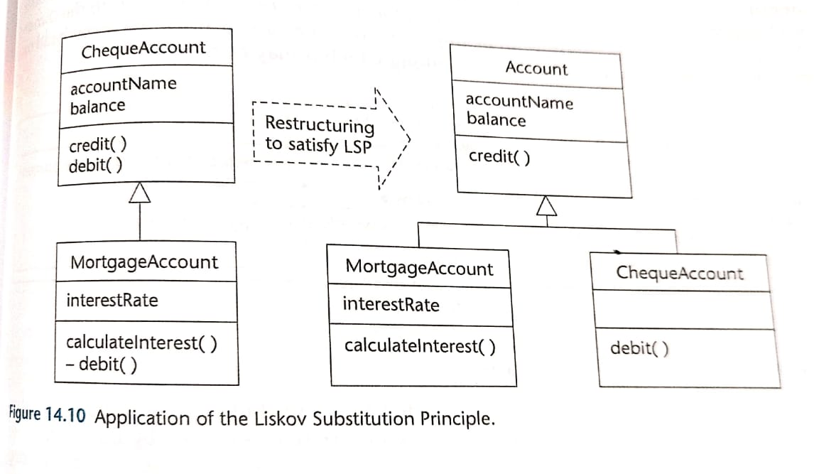

Slide 24
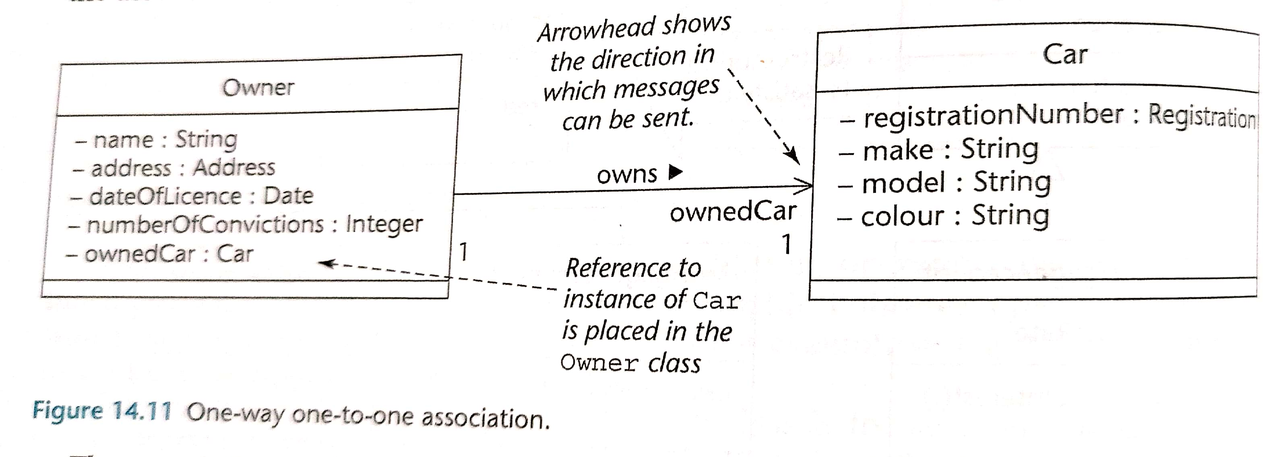
Designing associations
One – to – One associations : converting associations ends to an attribute
Class Car
{
Private registration number;
…………………
}
Class Owner
{
Private string name ;
…………
Private Car c1;
}

Slide 25
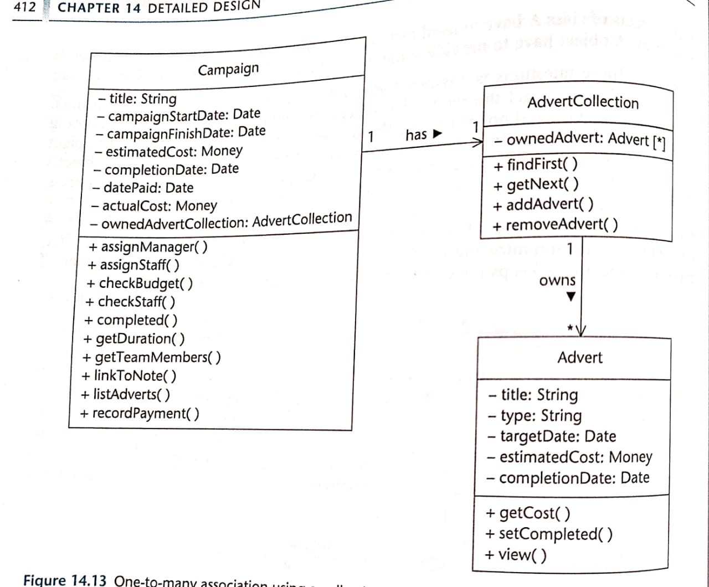
Designing associations
One – to – Many associations : using a collection class
- camAdvert : Advert[ ]

