Slide 1
Chapter 7
Design Patterns
Software Analysis and Design
0721322

Slide 2
Creational Patterns

Slide 3
Singleton pattern
This pattern involves a single class which is responsible of creating an object while making sure that only single object gets created.
This pattern provides a way to access its only object which can be accessed directly without need to instantiate the object of the class.

Slide 4
Singleton pattern
What is required?
  We want to ensure that there is exactly one instance of a class X, and to able to obtain the instance from anywhere in the application.
How to achieve that?
  make the constructor of X private
  define a private static attribute for X of type X
  define a public accessor for it.

Slide 5
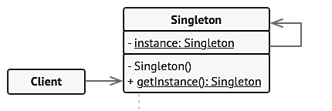
Singleton pattern
Structure
Notes:
correctness

Slide 6
Example
public class Company
{
private string name;
private static Company myComp = new Company("Agate");
private Company(string a)
{
this.name = a;
Console.WriteLine(name);
}
public static Company getCompany()
{
return myComp;
}
}
public class Test
{
static void Main()
{
Company c = Company.getCompany();
}
}

Slide 7
Factory method pattern
Create individual objects in situations where the constructor alone is inadequate.
Use methods to return required objects.
Notes:
Reusability and correctness

Slide 8
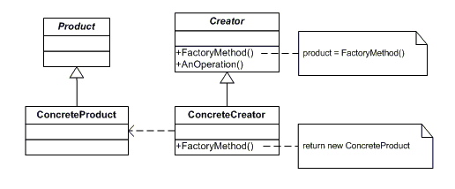
Factory method pattern
Structure
Notes:
Reusability and correctness

Slide 9
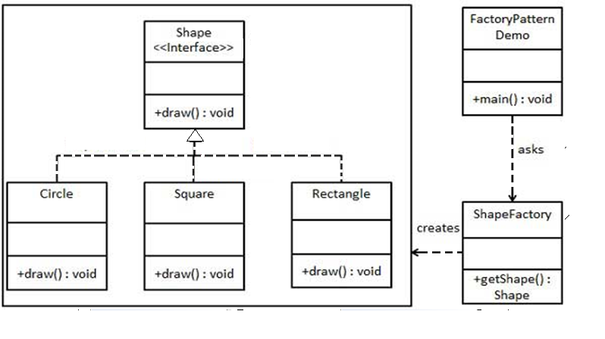
Example
Notes:
Reusability and correctness

Slide 10
public interface Shape
{
void draw();
}
public class Square : Shape
{
public void draw() //override
{
Console.WriteLine("drawing a square");
}
}
public class Rectangle : Shape
{
public void draw() //override
{
Console.WriteLine("drawing a rectangle");
}
}
public class ShapeFactory
{
public Shape getShape(string type)
{
if(type.ToLower().Equals("square"))
return new Square();
else if (type.ToLower().Equals("rectangle"))
return new Rectangle();
else
return null;
}
}
Notes:
Reusability and correctness

Slide 11
public class UseFactory
{
public static void Main()
{
ShapeFactory myFactory= new ShapeFactory();
Shape myShape = myFactory.getShape("sQuare");
//get an object of Square class
myShape.draw();
//call draw method of Sqaure
Shape shape2 = myFactory.getShape("RECTANGLE");
//get an object of Rectangle class
shape2.draw();
//call draw method of Rectangle
}
}
Notes:
Reusability and correctness

Slide 12
Structural Patterns

Slide 13
Adapter pattern
Adapter pattern works as a bridge between two incompatible interfaces.
This type of design pattern comes under structural pattern as this pattern combines the capability of two independent interfaces.
This pattern involves a single class which is responsible to join functionalities of independent or incompatible interfaces.

Slide 14
Adapter pattern
A real life example could be a case of card reader which acts as an adapter between memory card and a laptop. You plugin the memory card into card reader and card reader into the laptop so that memory card can be read via laptop.

Slide 15
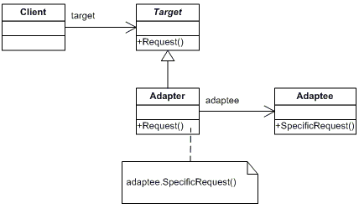
Adapter pattern
Structure

Slide 16
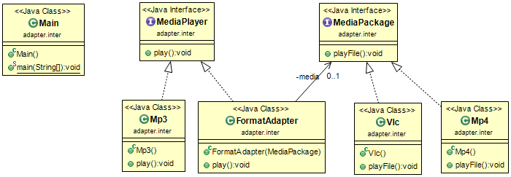
Example

Slide 17
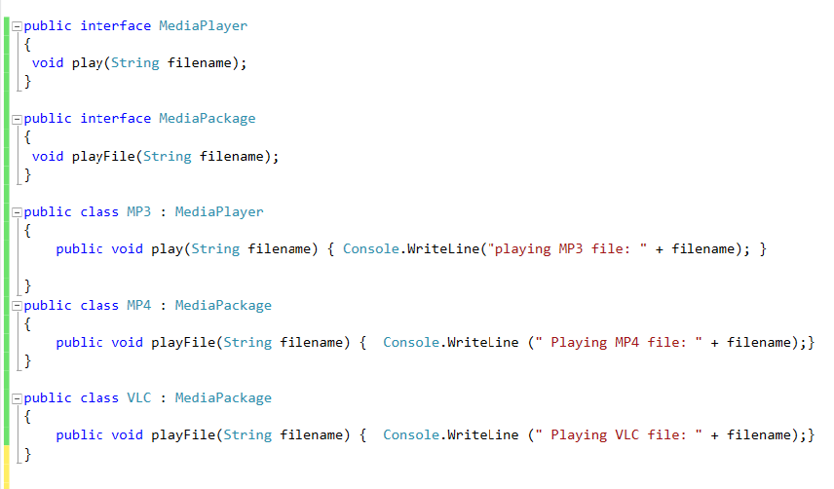
Example

Slide 18
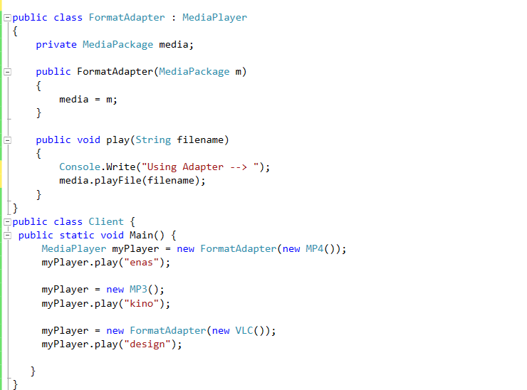
Example

Slide 19
Facade pattern
Facade pattern is a structural design pattern that provides a simplified interface to a library, a framework, or any other complex set of classes.
It comes from the term façade in architecture.
In software terms, Facade pattern hides the complexities of the systems and provides a simple interface to the clients.

Slide 20
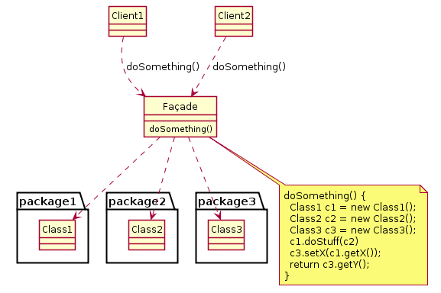
Facade pattern
Structure

Slide 21
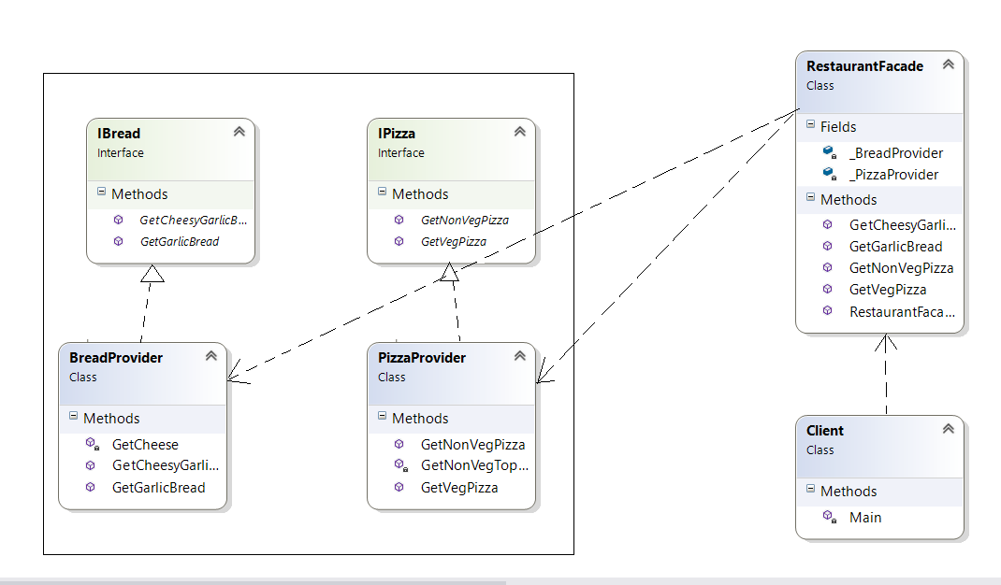
Example

Slide 22
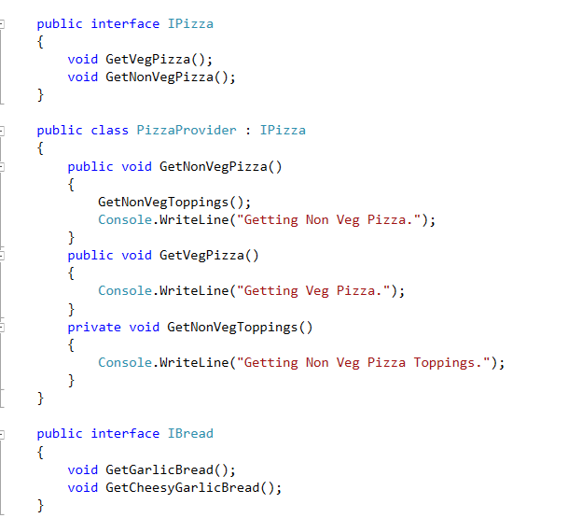
Example

Slide 23
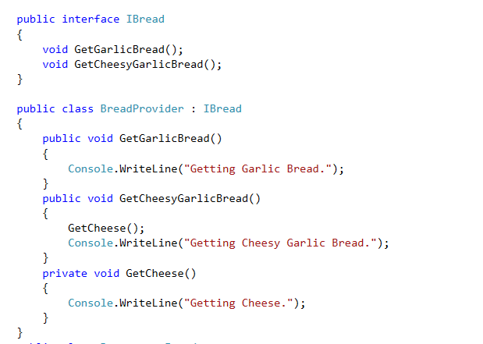
Example

Slide 24
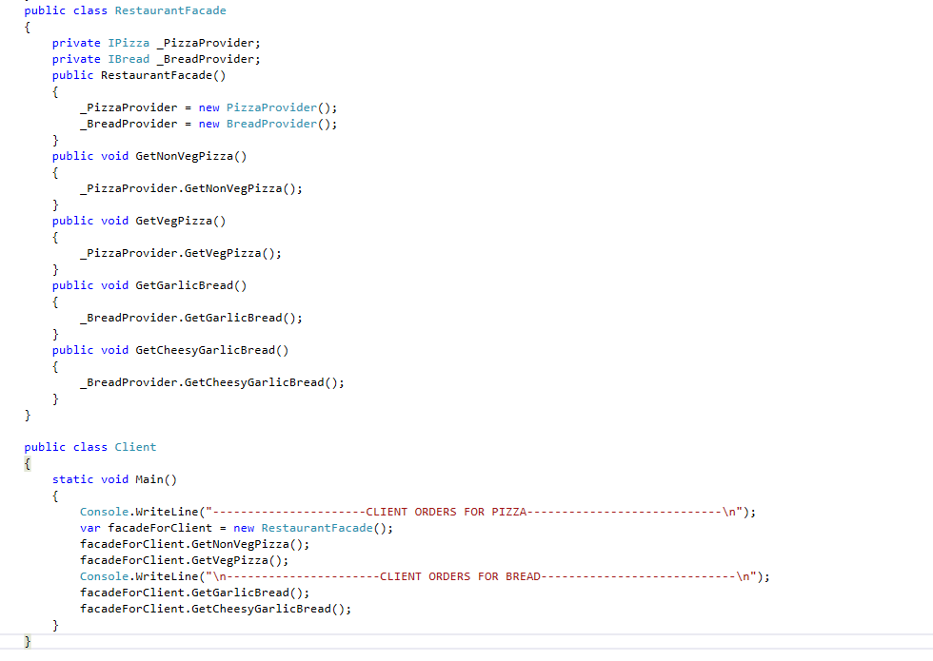
Example

Slide 25
Behavioral Patterns

Slide 26
State pattern
An object may have a complex behavior that is dependent upon its state.
State Design Pattern is used to alter the behavior of an object when it’s internal state changes.
In this pattern, an object is created which represent various states and a context object whose behavior varies as it's state object changes.

Slide 27
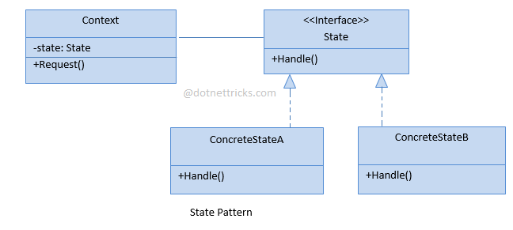
State pattern
Structure

Slide 28

Example

Slide 29
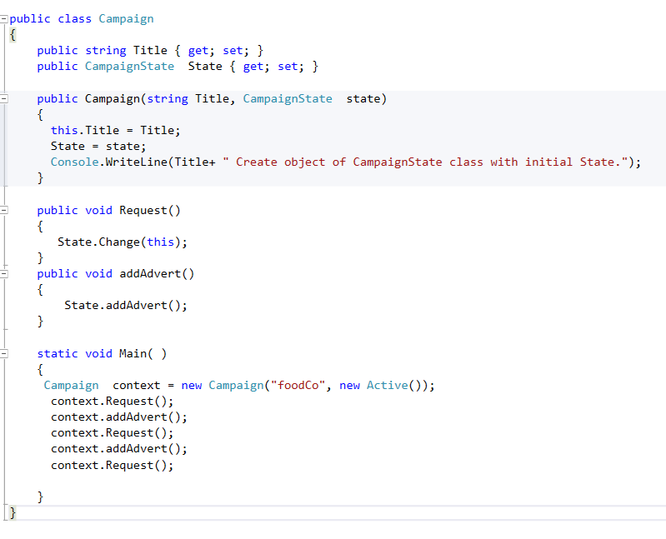

Slide 30
Design verification
Design Verification is a method to confirm if the output of a designed software product meets the input specifications by examining and providing evidence. The goal of the design verification process during software development is ensuring that the designed software product is the same as specified.
Design input is any requirement that is used as the basis for designing purpose. Design output is the result of each design phase and at the end of total design effort.

