Slide 1
Chapter 12
Skin, Hair, and Nails

Slide 2
Structure: Skin
Think of skin as body’s largest organ system
Covers 20 square feet of surface area in adults
Skin is the sentry that guards body
Skin has two layers
Epidermis: outer highly differentiated layer
Basal cell layer forms new skin cells
Outer horny cell layer of dead keratinized cells
Dermis: inner supportive layer
Connective tissue or collagen
Elastic tissue
Beneath these layers is a subcutaneous layer of adipose tissue

Slide 3
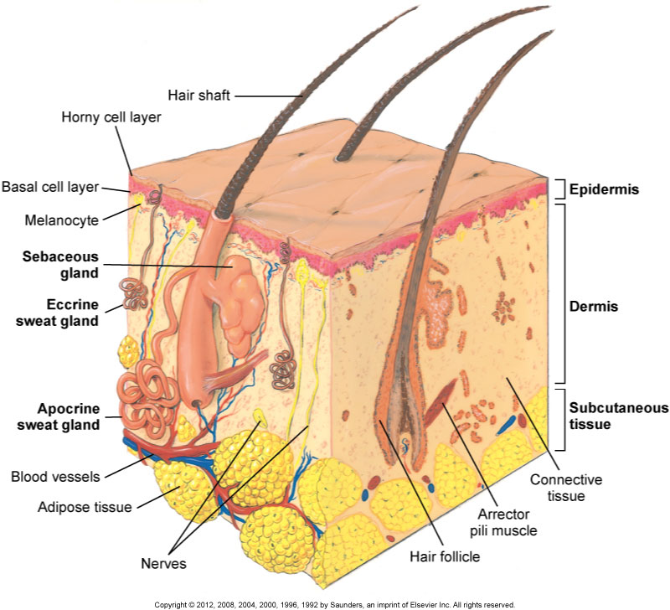
Structure of Skin

Slide 4
Structure: Epidermal Appendages
Structures formed by tubular invagination of epidermis down into underlying dermis
Hair
Sebaceous glands
Sweat glands: important for fluid balance and thermoregulation
Eccrine glands
Apocrine glands

Slide 5
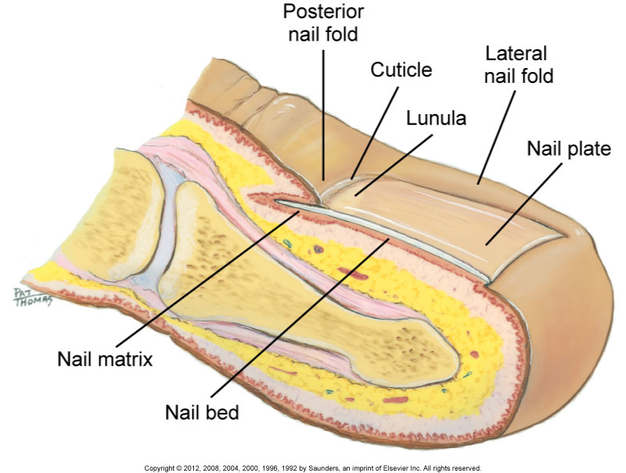
Structure of Nails

Slide 6
Skin Function
Skin is waterproof, protective, and adaptive
Protection from environment
Prevents penetration
Perception
Temperature regulation
Identification
Communication
Wound repair
Absorption and excretion
Production of vitamin D

Slide 7
Developmental Competence: Infants, Children, and Adolescents
Newborn infants
Lanugo: fine downy hair of newborn infant
Vernix caseosa: thick, cheesy substance
Sebum: holding water in the skin producing milia
Children
Epidermis thickens, darkens, and becomes lubricated
Hair growth accelerates
Adolescents
Secretions from apocrine sweat glands increase
Subcutaneous fat deposits increase
Secondary sex characteristics

Slide 8
Developmental Competence: The Pregnant Woman
Linea nigra
Increased pigmentation midline of abdomen
Chloasma
Discoloration changes on face representing the “mask of pregnancy”
Striae gravidarum
Stretch marks, which can develop over the abdomen, breast, and thighs

Slide 9
Developmental Competence: The Aging Adult
Elasticity
Loses elasticity; skin folds and sags
Sweat and sebaceous glands
Decrease in number and function, leaving skin dry
Senile purpura
Discoloration due to increasing capillary fragility
Skin breakdown due to multiple factors
Cell replacement is slower and wound healing is delayed
Hair matrix
Functioning melanocytes decrease, leading to gray fine hair

Slide 10
Culture and Genetics
Genetic attributes of dark-skinned individuals afford protection against skin cancer due to melanin
Increased likelihood of skin cancer in Whites than in Black and Hispanic populations
Most important environmental risk factor for skin cancer is exposure to ultraviolet (UV) radiation both from sun and tanning sources
Increased risk for melanoma related to increased number of sunburns during one’s lifetime
Certain skin presentations associated with different ethnic groups

Slide 11
Subjective Data Health History Questions
Past history of skin disease, allergies, hives, psoriasis, or eczema?
Change in pigmentation or color, size, shape, tenderness?
Excessive dryness or moisture?
Pruritus or skin itching?
Excessive bruising?
Rash or lesions?
Medications: prescription and over-the-counter?
Hair loss?
Change in nails’ shape, color, or brittleness?
Environmental or occupational hazards?
Self-care behaviors?
Notes:
Edition Change: Incidence of melanoma in Whites is noted to be 20 times higher than in Blacks and 4 times higher than in Hispanics.
Edition Change: Skin conditions that are noted to be specific to Black patients are as follows:
Keloids
Pigmentary disorders
Pseudofolliculitis
Melasma

Slide 12
Health History Questions for Infants and Children
Does child have any birthmarks?
Any change in skin color as a newborn?
Does child have any rash or sores?
Does child have diaper rash?
Does child have any burns or bruises?
Has child been exposed to contagious or communicable disease?
Does child have habits such as nail biting or twisting hair?
What steps are taken to protect child from sun exposure?
Notes:
Edition change: Incidence of melanoma in Whites is noted to be 20 times higher than in Blacks and 4 times higher than in Hispanics.
Edition change: Skin conditions that are noted to be specific to Black patients are as follows:
Keloids
Pigmentary disorders
Pseudofolliculitis
Melasma

Slide 13
Health History Questions
Adolescents
Skin problems such as pimples, blackheads?
Aging adults
What changes have you noticed in your skin in past few years?
Any delay in wound healing?
Any change in feet: toenails, bunions, wearing shoes?
Falling: bruises, trauma?
History of diabetes or peripheral vascular disease?
Notes:
Edition change: Incidence of melanoma in Whites is noted to be 20 times higher than in Blacks and 4 times higher than in Hispanics.
Edition change: Skin conditions that are noted to be specific to Black patients are as follows:
Keloids
Pigmentary disorders
Pseudofolliculitis
Melasma

Slide 14
Objective Data
Preparation
Consciously attend to skin characteristics; the danger is one of omission
Equipment needed
Strong direct lighting, gloves, penlight, and small centimeter ruler
For special procedures
Wood’s light
Magnifying glass
Materials for laboratory tests: potassium hydroxide (KOH) and glass slide
Notes:
Variables that influence skin color include emotional states, temperature, cigarette smoking, prolonged elevation/dependent position of extremities, and prolonged inactivity.

Slide 15
Complete Physical Examination
Skin assessment integrated throughout examination
Scrutinize the outer skin surface first before you concentrate on underlying structures
Separate intertriginous areas (areas with skinfolds) such as under large breasts, obese abdomen, and groin, and inspect them thoroughly
These areas are dark, warm, and moist and provide perfect conditions for irritation or infection
Always inspect feet, toenails, and between toes

Slide 16
Regional Examination
Individuals may seek health care for skin problems and assessment focused on skin alone
Assess skin as one entity; getting overall impression helps reveal distribution patterns
Inspect lesions carefully
With a rash, check all areas of body as you cannot rely on the history that rash is in only one location
Skills used are inspection and palpation because some skin changes have accompanying signs that can be felt

Slide 17
Inspection and Palpation: Skin
Color
General pigmentation, freckles, moles, birthmarks
Widespread color change
Note color change over entire body skin, such as pallor (pale), erythema (red), cyanosis (blue), or jaundice (yellow)
Note if color change transient or due to pathology
Temperature
Use backs of hands to palpate person
Skin should be warm, and temperature equal bilaterally; warmth suggests normal circulatory status
Hands and feet may be slightly cooler in a cool environment
Hypothermia
Hyperthermia

Slide 18
Inspection and Palpation: Skin (Cont.)
Moisture
Diaphoresis
Dehydration
Texture
Thickness
Edema
Mobility and turgor
Vascularity or bruising
Multiple bruises at different stages of healing and excessive bruises above knees or elbows should raise concern about physical abuse
Needle marks or tracks from intravenous injection of street drugs may be visible on antecubital fossae, forearms, or on any available vein

Slide 19
Inspection and Palpation: Skin (Cont.)
Lesions: if any are present, note the following:
Color
Elevation
Pattern or shape
Size
Location and distribution on body
Any exudate: note color and odor
Use a Wood’s light (ultraviolet light filtered through special glass) to detect fluorescing lesions

Slide 20
Inspection and Palpation: Hair
Color
Due to melanin production
Texture
Characteristics range from fine to thick to curly to straight and may be affected by use of hair care products
Distribution
Tanner staging identifies gender patterns of hair distribution
Lesions
Identification by looking at scalp and dividing hair into sections

Slide 21
Inspection and Palpation: Nails
Shape and contour
Profile sign: view index finger at its profile and note angle of nail base; it should be about 160 degrees
Consistency
Color
Capillary refill
Depress nail edge to blanch and then release, noting return of color; indicates status of peripheral circulation
Color return is normally instant
Sluggish color return takes longer than 1 or 2 seconds

Slide 22
ABCDE Skin Assessment
Promoting health and self-care
Teach skin self-examination using ABCDE rule to detect suspicious lesions
A: asymmetry
B: border
C: color
D: diameter
E: elevation and enlargement

Slide 23
Question
The nurse is assessing a patient who has been admitted for liver failure. What finding would the nurse expect?
Cyanosis
Flushing
Rubor
Jaundice
Notes:
The correct answer is 4. Jaundice is a common hallmark of cirrhosis, which is one complication of liver failure.
Answers 1, 2, and 3 have no common connection to liver failure.

Slide 24
Infant Skin Presentations
Skin color general pigmentation
Mongolian spot
Café-au-lait spot
Skin color change
Beefy red flush
Harlequin color change
Erythema toxicum
Temporary cyanotic conditions
Acrocyanosis
Cutis marmorata
Physiologic jaundice
Carotenemia
Vascularity or bruising

Slide 25
Skin Presentations: Life Cycle
Adolescent
Acne
Open and closed comedones
Pregnancy
Striae
Linea nigra
Chloasma
Vascular spiders
Aging
Senile lentigines
Keratoses
Xerosis
Skin tags or acrohordons
Thin parchment
Decreased hair growth
Decreased nail growth and brittle nails

Slide 26
Summary Checklist: Skin, Hair, and Nails
Inspection of the skin, hair, and nails
Color and pigmentation
Texture and distribution
Shape, contour, and consistency
Palpation of the skin, hair, and nails
Temperature and texture
Edema, mobility, and turgor
Note presence of lesions
Shape, configuration, and distribution
Teach self-examination
Health promotion

Slide 27
Shapes and Configurations of Lesions
Annular or circular
Confluent
Discrete
Grouped
Gyrate
Target or iris
Linear
Polycyclic
Zosteriform

Slide 28
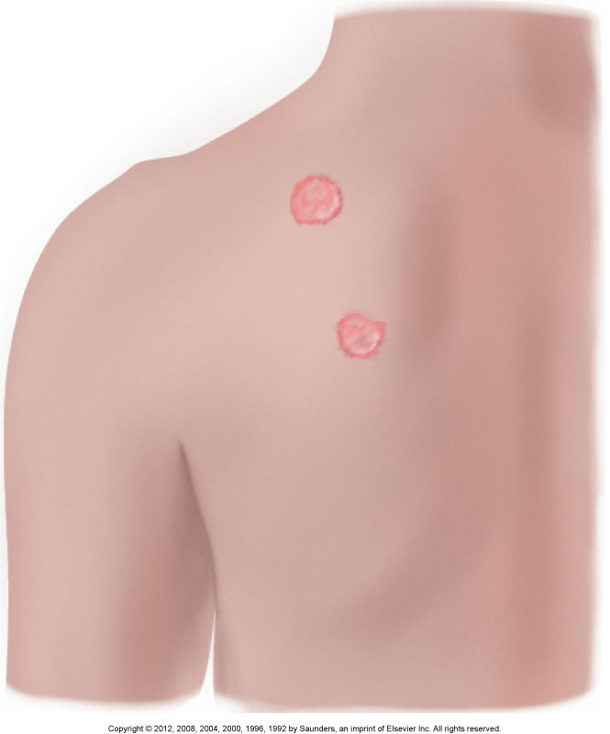
Annular or Circular

Slide 29
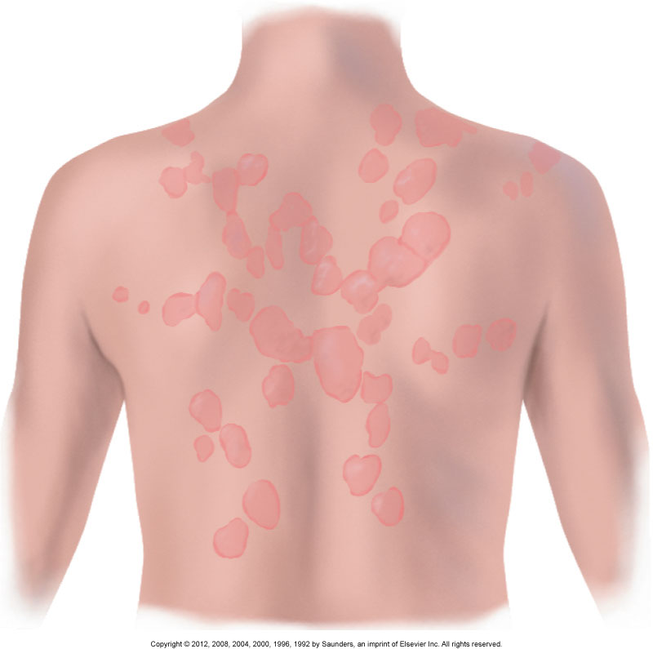
Confluent

Slide 30
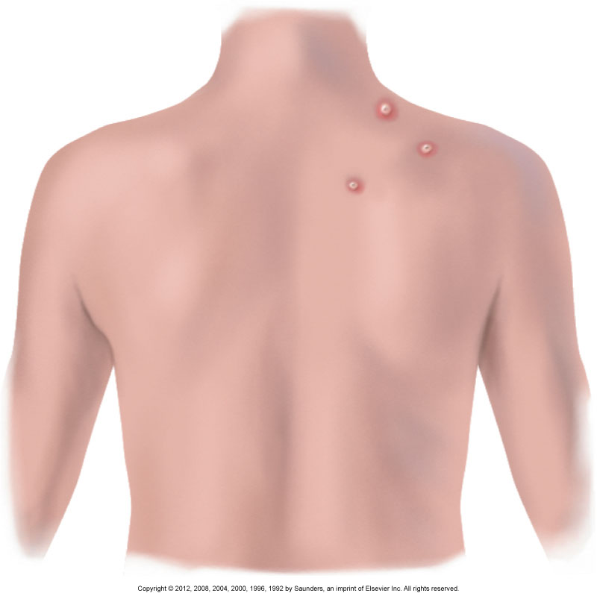
Discrete

Slide 31
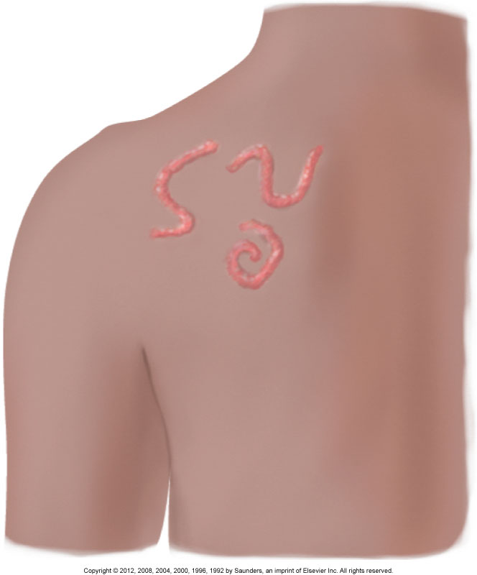
Gyrate

Slide 32
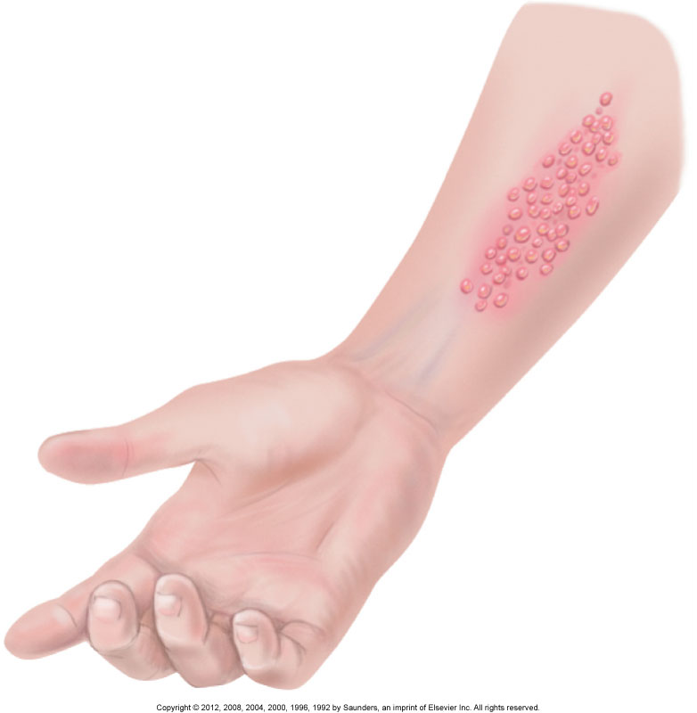
Grouped

Slide 33
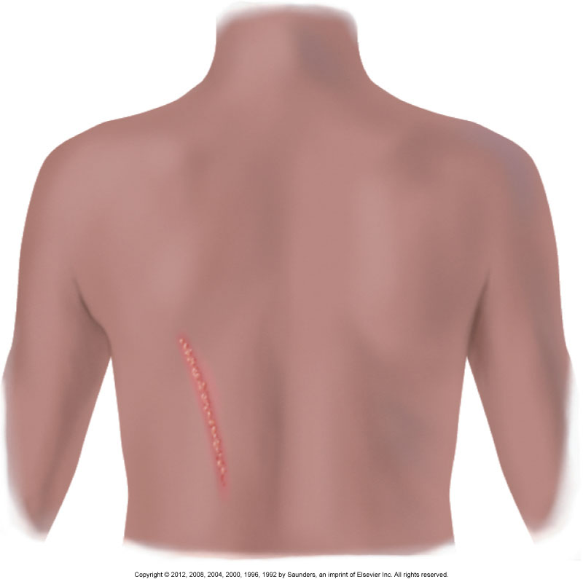
Linear

Slide 34
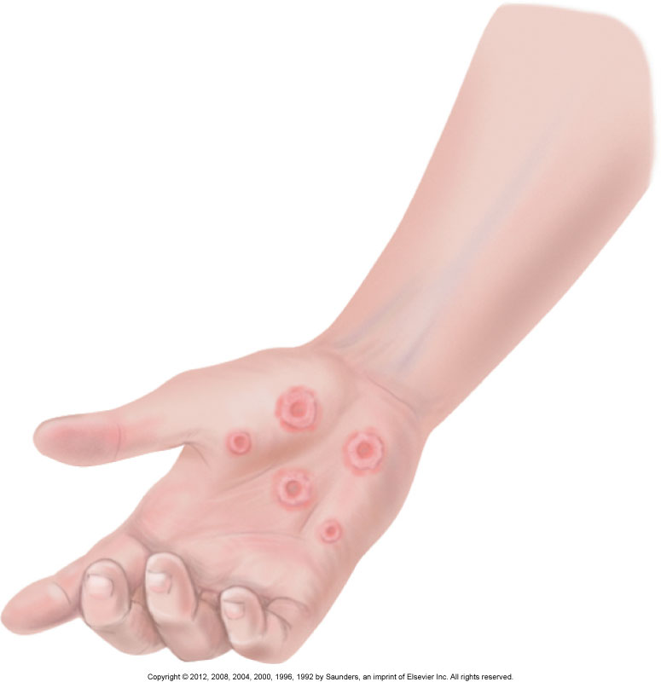
Target

Slide 35
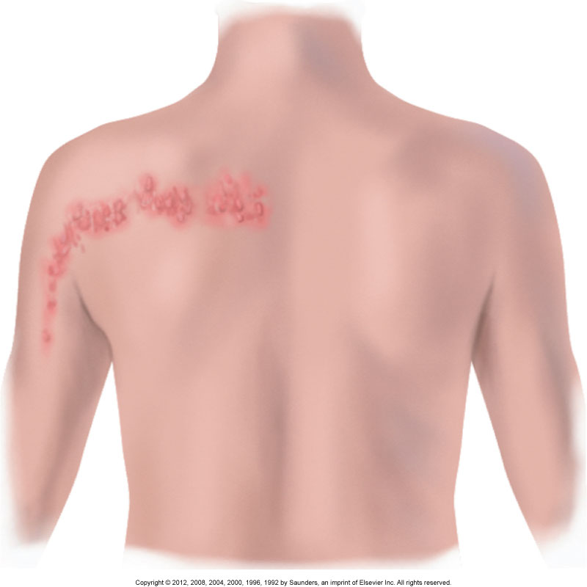
Zosteriform

Slide 36
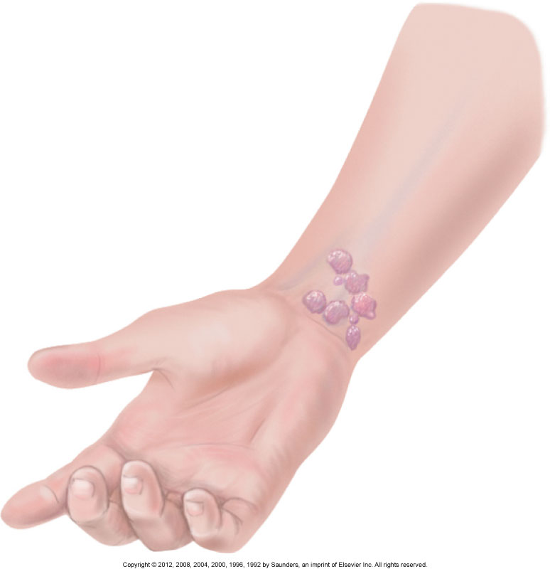
Polycyclic

Slide 37
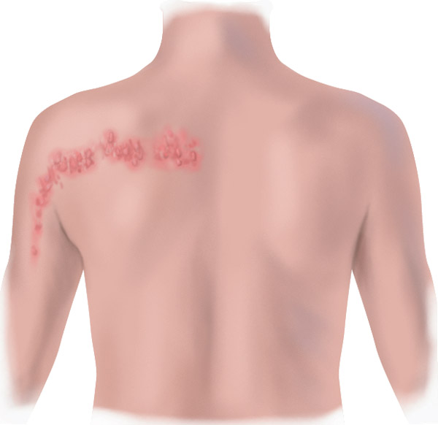
Question
The lesions in the illustration are best described as:
grouped.
zosteriform.
polycyclic.
linear.
Notes:
The correct answer is 2. Although there are other ways to describe these lesions, the fact that they follow the dermatome profile is a key feature because they associate these lesions with the possibility of herpes zoster, or shingles. Herpes zoster is extremely painful and highly contagious, which make early detection very important for the care of the patient and those around him or her.

Slide 38
Primary Skin Lesions
Macules
Papules
Patches
Plaques
Nodules
Wheals
Tumors
Urticaria (hives)
Vesicles
Cysts
Bullas
Pustules

Slide 39
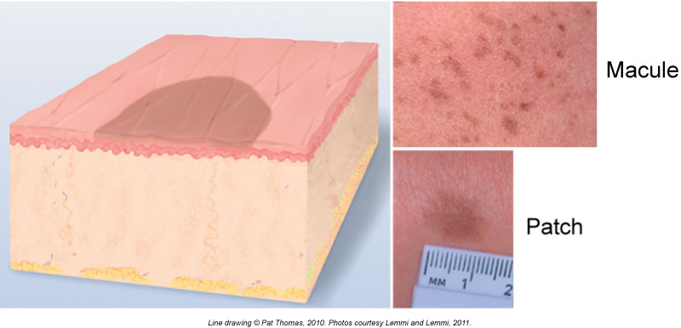
Macule

Slide 40
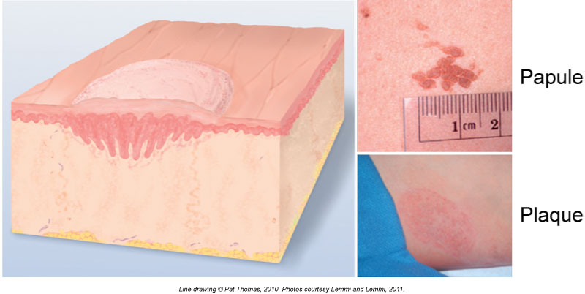
Papule

Slide 41
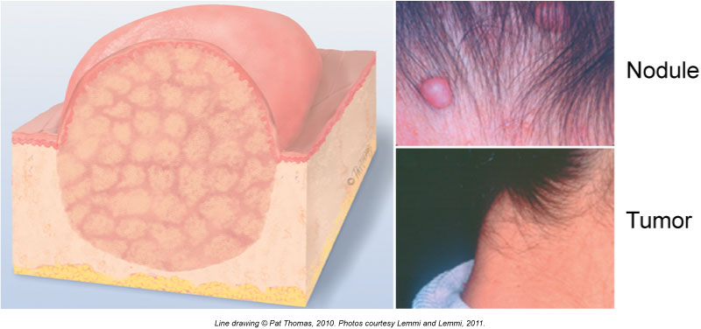
Nodule

Slide 42
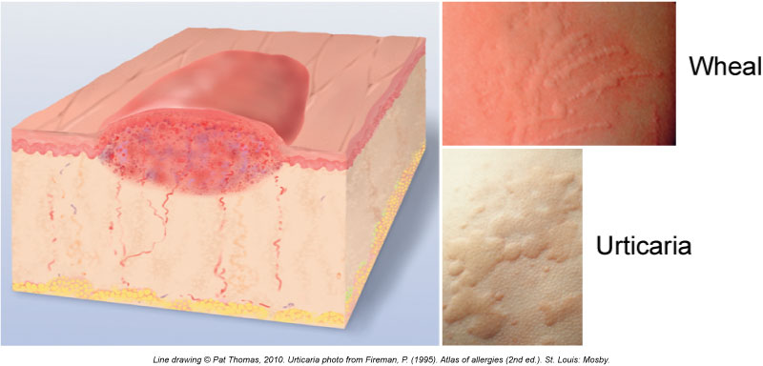
Wheal

Slide 43
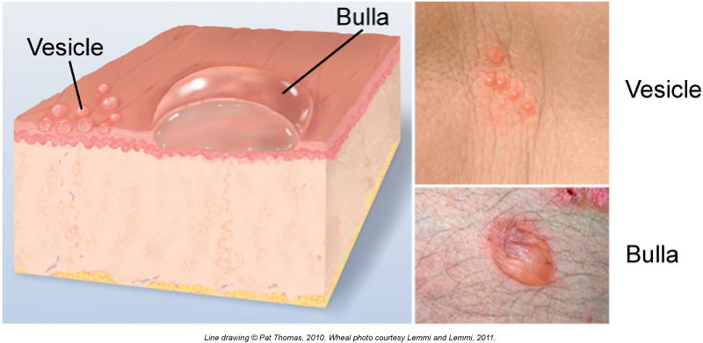
Vesicle/Bulla

Slide 44
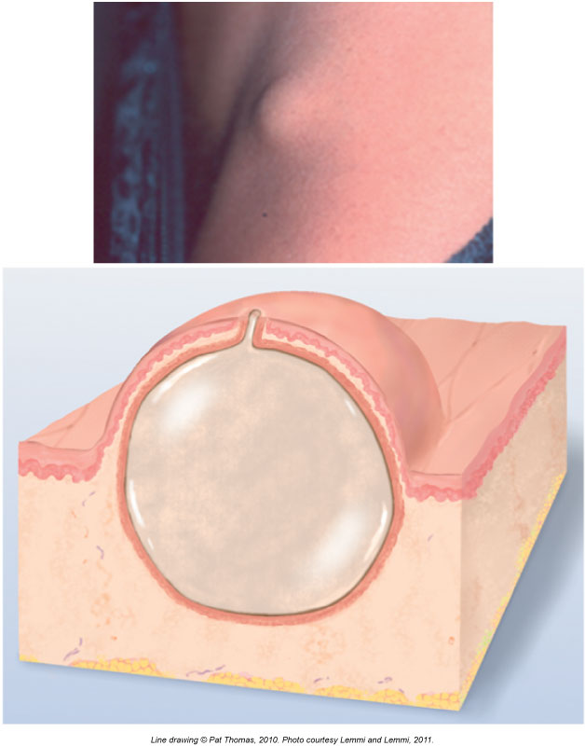
Cyst

Slide 45
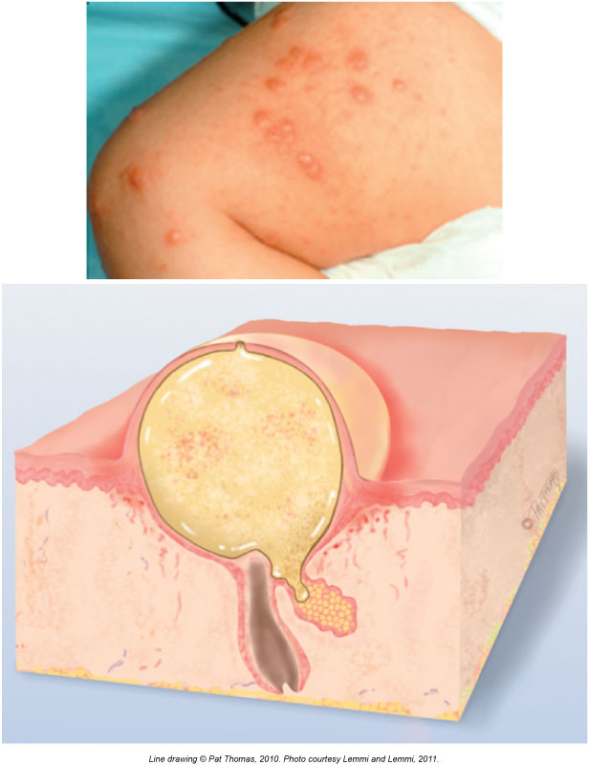
Pustule

Slide 46
Secondary Skin Lesions
Debris on skin surface
Crusts
Scales
Break in continuity of skin surface
Fissures
Erosions
Ulcers
Excoriations
Scars
Atrophic scars
Lichenifications
Keloids

Slide 47
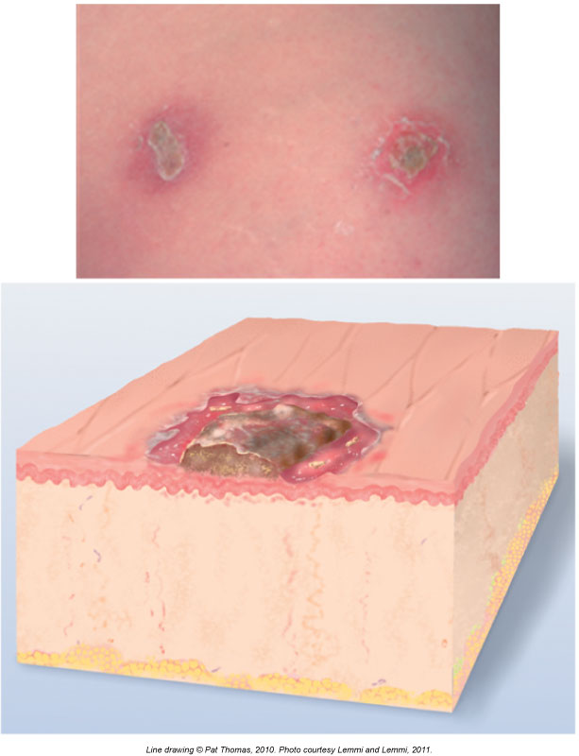
Crust

Slide 48
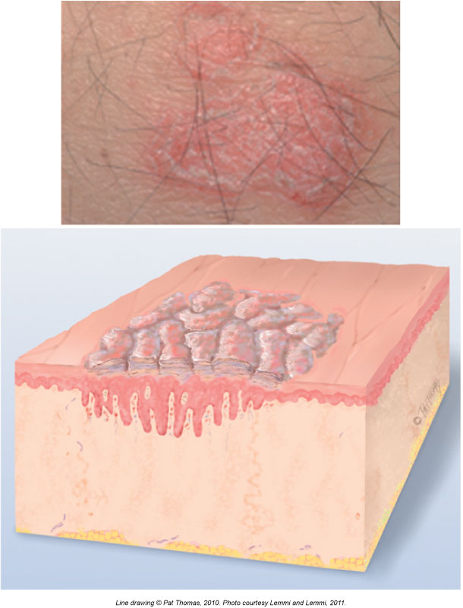
Scale

Slide 49
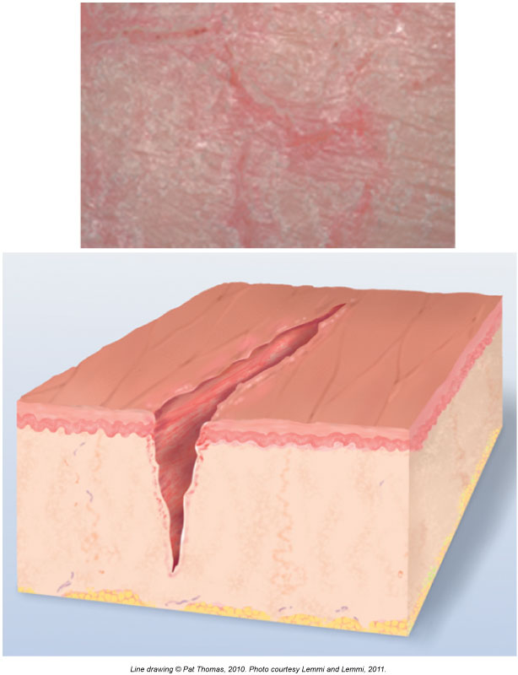
Fissure

Slide 50
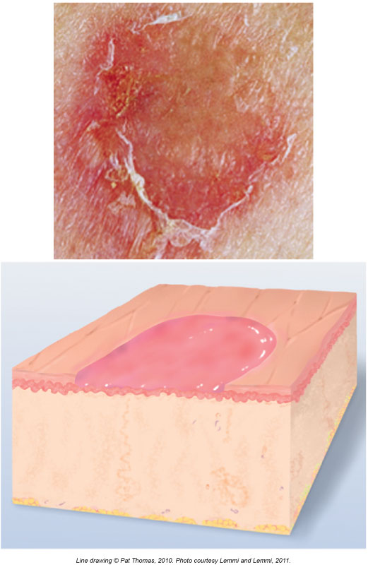
Erosion

Slide 51
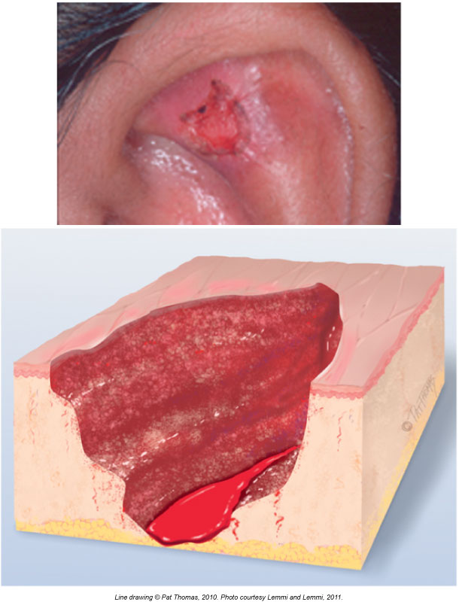
Ulcer

Slide 52
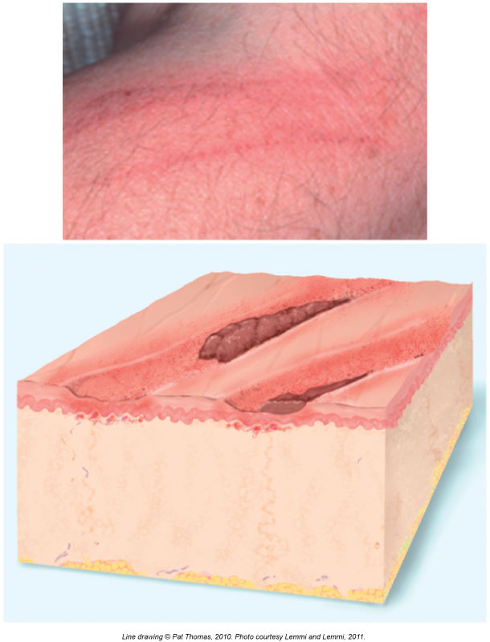
Excoriation

Slide 53
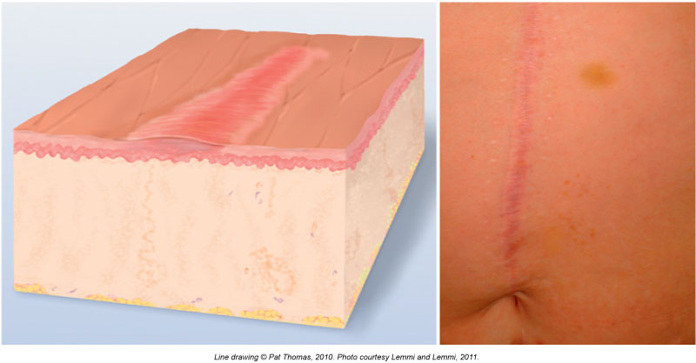
Scar

Slide 54
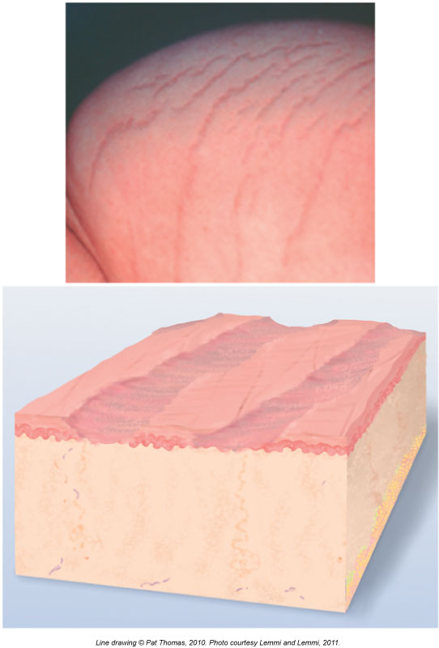
Atrophic Scar

Slide 55
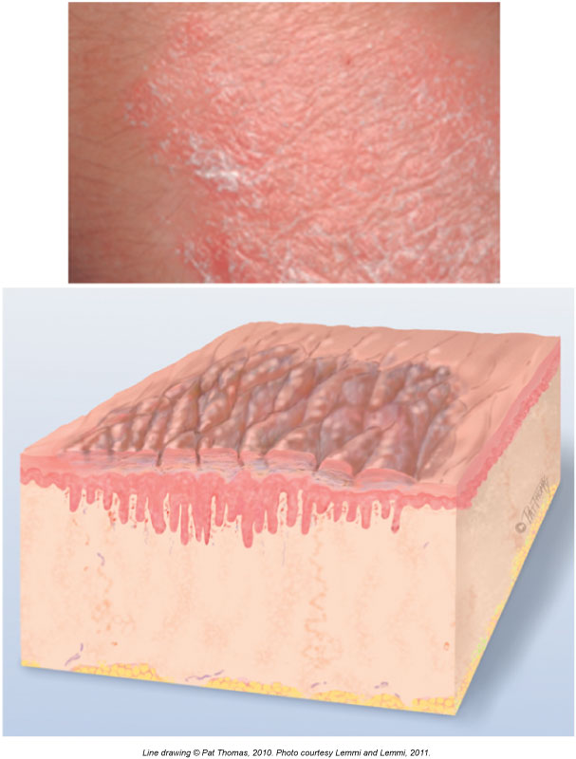
Lichenification

Slide 56
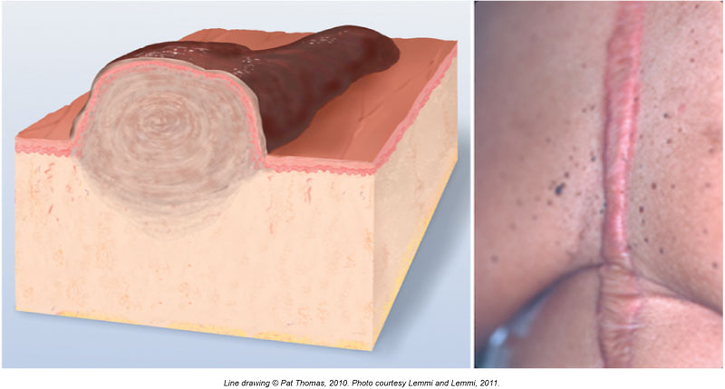
Keloid

Slide 57
Vascular Lesions
Hemangiomas
Port-wine stain (nevus flammeus)
Strawberry mark (immature hemangioma)
Cavernous hemangioma (mature)
Telangiectases
Spider or star angioma
Venous lake
Purpuric lesions
Petechiae
Purpura
Lesions caused by trauma or abuse
Pattern injury
Hematoma
Contusion (bruise)

Slide 58
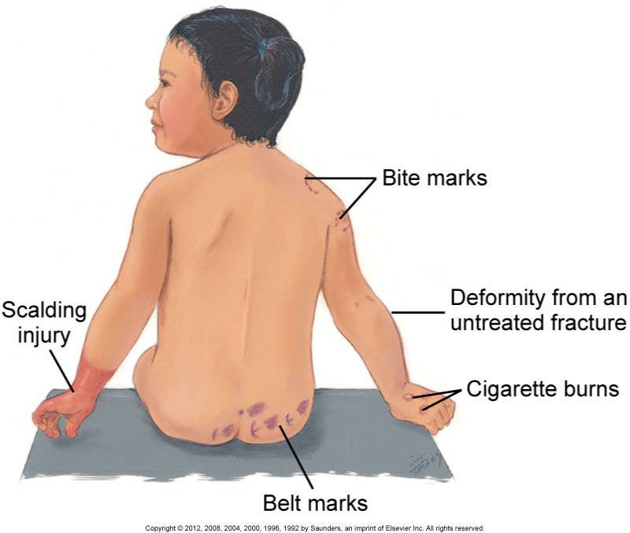
Lesions Caused by Trauma or Abuse: Pattern Injuries

Slide 59
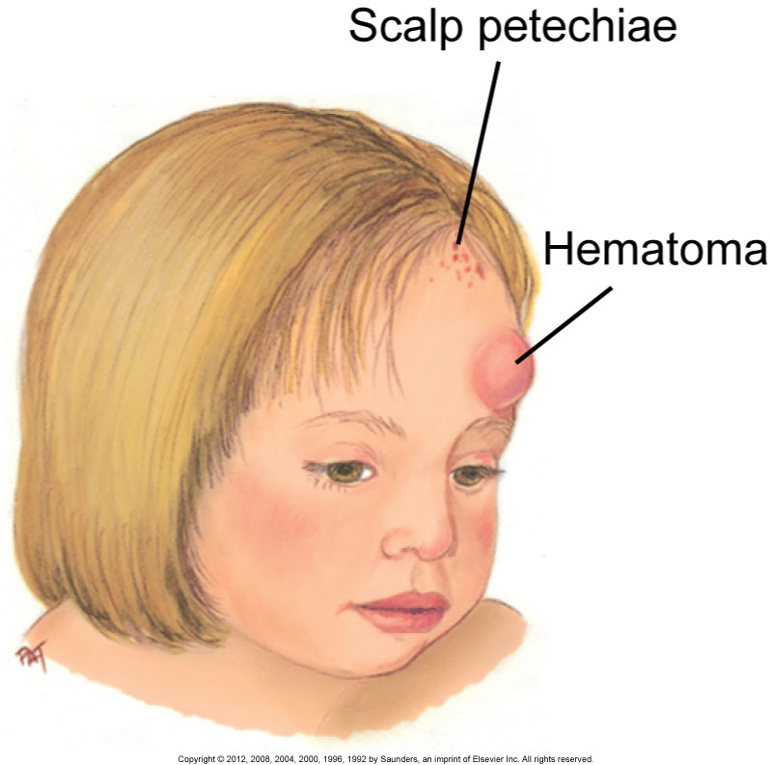
Lesions Caused by Trauma or Abuse: Hematomas

Slide 60
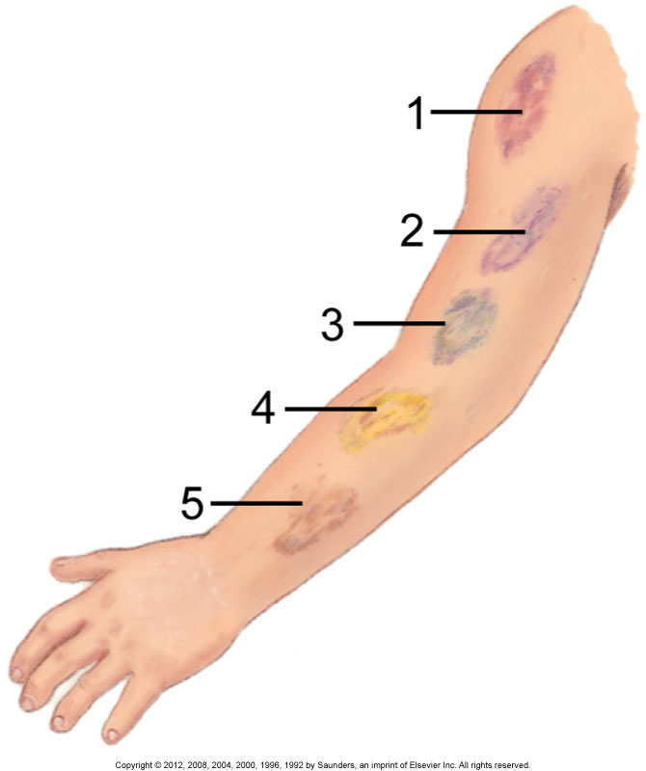
Lesions Caused by Trauma or Abuse: Contusions

Slide 61
Common Skin Lesions in Children
Diaper dermatitis
Intertrigo (candidiasis)
Impetigo
Atopic dermatitis (eczema)
Measles (rubeola)
German measles (rubella)
Chickenpox (varicella)

