Slide 1
Chapter 20
Peripheral Vascular System and Lymphatic System

Slide 2
Vascular System and Lymphatics
Vascular system consists of vessels of body
Vessels are tubes for transporting fluid, such as blood or lymph
Any disease in vascular system creates problems with delivery of oxygen and nutrients to tissues or elimination of waste products from cellular metabolism
The lymphatics form completely separate vessel system, which retrieves excess fluid from tissue spaces and returns it to the bloodstream

Slide 3
Structure and Function: Arteries I
Heart pumps freshly oxygenated blood through arteries to all body tissues
Pumping heart makes this a high-pressure system
Artery walls are strong, tough, and tense to withstand pressure demands
Contain elastic fibers, which allow their walls to stretch with systole and recoil with diastole
Contain muscle fibers (vascular smooth muscle, or VSM), which control amount of blood delivered to tissues
VSM contracts or dilates, which changes the diameter of arteries to control the rate of blood flow

Slide 4
Structure and Function: Arteries II
Each heartbeat creates a pressure wave, which makes arteries expand and then recoil
It is recoil that propels blood through like a wave
All arteries have this pressure wave, or pulse, throughout their length, but it can only be felt at body sites where artery lies close to skin and over a bone
Function of arteries is to supply oxygen and essential nutrients to tissues
Complete blockage leads to death of distal tissue
Partial blockage creates an insufficient supply, and ischemia may be apparent only at exercise when oxygen needs increase

Slide 5
Structure and Function: Arteries in the Arm
Major artery supplying arm is brachial artery, which runs in biceps-triceps furrow of upper arm and surfaces at antecubital fossa in elbow medial to biceps tendon
Immediately below elbow, brachial artery bifurcates into ulnar and radial arteries
These run distally and form two arches supplying hand; these are called superficial and deep palmar arches
Radial pulse lies just medial to radius at wrist
Ulnar artery is in same relation to the ulna, but it is deeper and often difficult to feel

Slide 6
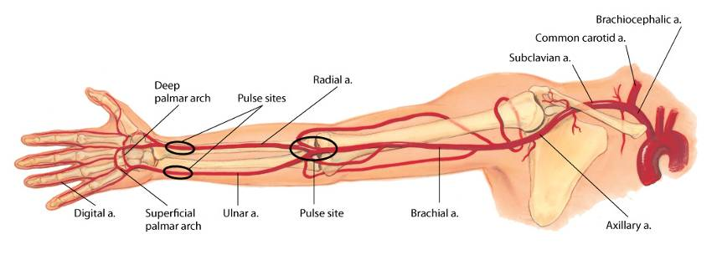
Arteries in the Arm

Slide 7
Structure and Function: Arteries in the Leg
Major artery to leg is femoral artery, which passes under inguinal ligament
Femoral artery travels down thigh; at lower thigh, it courses posteriorly, then is termed popliteal artery
Below knee, popliteal artery divides; anterior tibial artery travels down front of leg on to dorsum of foot, where it becomes dorsalis pedis
In back of leg, posterior tibial artery travels down behind medial malleolus and in foot forms plantar arteries
Peripheral arterial disease (PAD) affects noncoronary vessels and refers to arteries affecting the limbs

Slide 8
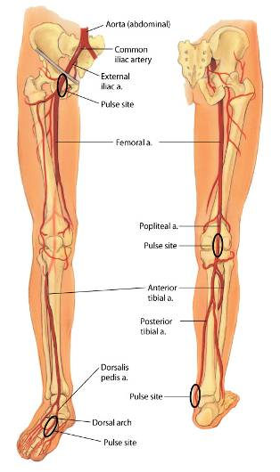
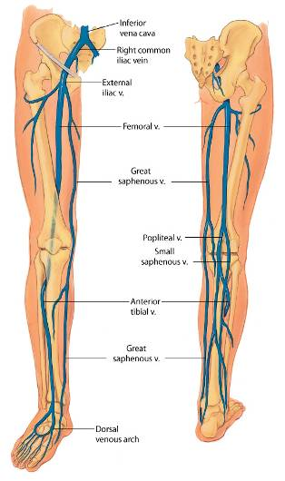
Vessels in the Leg

Slide 9
Structure and Function: Veins
Course of veins parallels that of arteries
Body has more veins, and they lie closer to skin surface
Veins in leg
Legs have three types of veins
Deep veins run alongside deep arteries and conduct most of venous return from the legs
Superficial veins are great and small saphenous vein
Perforators are connecting veins that join two sets

Slide 10
Structure and Function: Venous Flow
Veins drain deoxygenated blood and its waste products from tissues and return it to heart
In the legs, this mechanism is called calf pump or peripheral heart
Veins are called capacitance vessels because of their ability to stretch
Hypercoagulable states and vein wall trauma lead to increased risk for venous disease
Dilated and tortuous (varicose) veins create incompetent valves leading to increased venous pressure, which further dilates the vein

Slide 11
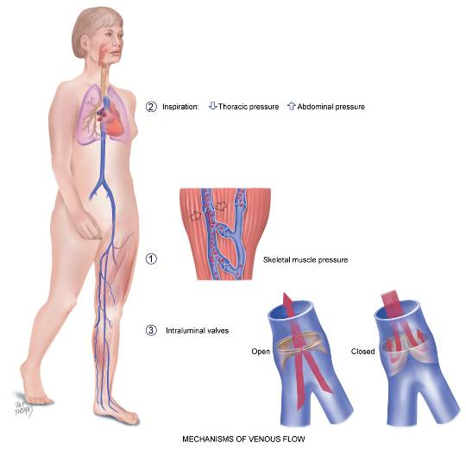
Venous Flow

Slide 12
Structure and Function: Lymphatics I
The lymphatics form a completely separate vessel system, which retrieves excess fluid from the tissue spaces and returns it to the bloodstream
Vessels drain into two main trunks, which empty into the venous system at the subclavian veins
The functions of lymphatic system are to
Conserve fluid and plasma proteins that leak out of capillaries
Form a major part of immune system that defends body against disease
Absorb lipids from intestinal tract

Slide 13
Structure and Function: Lymphatics II
Processes of immune system are complicated and not fully understood
Lymphatic vessels have a unique structure
Lymph nodes are small oval clumps of lymphatic tissue located at intervals along vessels
Superficial groups of nodes are accessible to inspection and palpation giving clues to status of lymphatic system

Slide 14
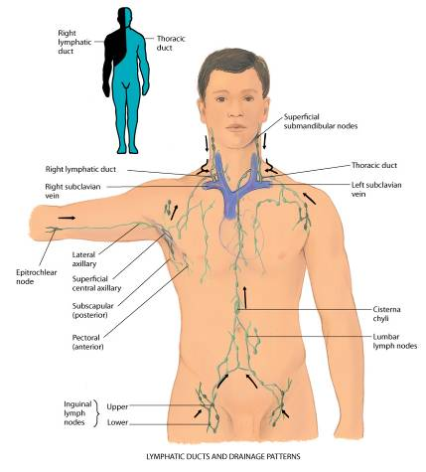
Lymphatic Ducts and Drainage Patterns

Slide 15
Structure and Function: Related Organs
Spleen, tonsils, and thymus aid lymphatic system
Located in left upper quadrant of abdomen, it has four functions:
Destroy old red blood cells
Produce antibodies
Store red blood cells
Filter microorganisms from blood
Tonsils (palatine, adenoid, and lingual) are located at entrance to respiratory and gastrointestinal tracts and respond to local inflammation
Thymus is flat, pink-gray gland located in superior mediastinum behind sternum and in front of aorta

Slide 16
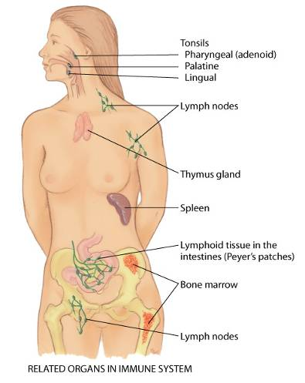
Immune-Related Organs

Slide 17
Developmental Competence: Infants and Children
Lymphatic system has the same function in children as in adults
Lymphoid tissue has a unique growth pattern compared with other body systems
It is well developed at birth and grows rapidly until age 10 or 11
Lymph nodes are relatively large in children
Superficial nodes often palpable even when child is healthy
With infection, excessive swelling and hyperplasia occur

Slide 18
Developmental Competence: Pregnant Woman
Hormonal changes cause vasodilation and a resulting drop in blood pressure
Growing uterus obstructs drainage of iliac veins and inferior vena cava
This condition causes low blood flow and increases venous pressure
This, in turn, causes dependent edema, varicosities in legs and vulva, and hemorrhoids

Slide 19
Developmental Competence: Aging Adult
Peripheral blood vessels grow more rigid with age, resulting in a condition called arteriosclerosis
Care for myocardial infarction (MI) now includes early mobilization and low-dose anticoagulant medication, which reduce risk of pulmonary embolism
Loss of lymphatic tissue leads to fewer numbers of lymph nodes in older people and to decrease in size of remaining nodes

Slide 20
Culture and Genetics
American Heart Association (AHA) considers PAD a CAD risk equivalent, thus screening and treatment are essential
PAD is associated with several genes interacting with themselves as well as the environment
Smoking is the strongest risk factor associated with PAD
PAD disproportionally affects Blacks, and the ethnic group with the highest PAD risk factors are non-Hispanic Blacks.
Ankle brachial index (ABI) is a noninvasive screening tool for PAD
AHA recommends screening for all people over age 70 and/or who are between ages 50 and 69 who have a history of smoking or diabetes

Slide 21
Subjective Data
Leg pain or cramps
Skin changes on arms or legs
Swelling
Lymph node enlargement
Medications
Smoking history

Slide 22
Leg Pain or Cramps Questions I
Any leg pain (cramps)? Where?
Describe the type of pain; is it burning, aching, cramping, stabbing? Did this come on gradually or suddenly?
Is it aggravated by activity or walking?
How many blocks (stairs) does it take to produce this pain?
Has this amount changed recently?
Is pain worse with elevation or cool temperature?

Slide 23
Leg Pain or Cramps Questions II
Does pain wake you up at night?
Have you had any recent change in exercise?
What relieves this pain: dangling, walking, rubbing? Is leg pain associated with any skin changes?
Is the leg pain associated with any change in sexual function (males)?
Do you have any history of vascular problems, heart problems, diabetes, obesity, pregnancy, smoking, trauma, prolonged standing, or bed rest?

Slide 24
Skin Changes Questions
On arms or legs
Any skin changes in arms or legs? What color: redness, pallor, blueness, brown discolorations?
Any change in temperature: excess warmth or coolness?
Do your leg veins look bulging and crooked? How have you treated these? Do you use support hose?
Any leg sores or ulcers? Where on leg? Any pain with leg ulcer?

Slide 25
Swelling Questions
In arms or legs
Swelling in one or both legs? When did this start?
What time of day is swelling at its worst: morning, or after up most of day?
Does swelling come and go, or is it constant?
What seems to bring it on: trauma, standing all day, sitting?
What relieves swelling: elevation, support hose?
Is swelling associated with pain, heat, redness, ulceration, or hardened skin?

Slide 26
Lymph Node Enlargement and Medications Questions
Lymph node enlargement
Any “swollen glands” (lumps, kernels)? Where in body? How long have you had them?
Any recent change?
How do they feel to you: hard, soft?
Are swollen glands associated with pain or local infection?
Medications
What medications are you taking, for example, oral contraceptives, hormone replacement?

Slide 27
Smoking History Questions
Do you smoke cigarettes?
How many packs per day?
At what age did you start?
How many years have you smoked?
Have you tried to quit? If so, what worked for you or what didn’t work for you?

Slide 28
Objective Data: Preparation
During a complete physical examination, examine arms at very beginning when you are checking vital signs and person is sitting
Examine legs directly after abdominal examination while person is still supine; then stand person up to evaluate leg veins
Examination of arms and legs includes peripheral vascular characteristics
Room temperature should be about 22°C and free of drafts to prevent vasodilation or vasoconstriction
Use inspection and palpation
Compare your findings with opposite extremity

Slide 29
Objective Data: Equipment
Occasionally need
Paper tape measure
Tourniquet or blood pressure cuff
Stethoscope
Doppler ultrasonic stethoscope

Slide 30
Inspect and Palpate the Arms
Lift person’s both hands in your hands
Inspect, then turn person’s hands over, noting color of skin and nail beds; temperature, texture, and turgor of skin; and the presence of any lesions, edema, or clubbing
Use profile sign (viewing finger from side) to detect early clubbing
Normal nail bed angle is 160 degrees
Note presence of any scars on hands and arms

Slide 31
Check Capillary Refill
With person’s hands near level of the heart, check capillary refill
An index of peripheral perfusion and cardiac output
Depress and blanch nail beds; release and note time for color return
Usually vessels refill within a fraction of a second
Normal if color returns in less than 1 or 2 seconds
Note conditions that can skew your findings: a cool room, decreased body temperature, cigarette smoking, peripheral edema, and anemia

Slide 32
Radial Pulses
Palpate both radial pulses, noting rate, rhythm, elasticity of vessel wall, and equal force
Grade force (amplitude) on a three-point scale
3+, increased, full, bounding
2+, normal
1+, weak
0, absent

Slide 33
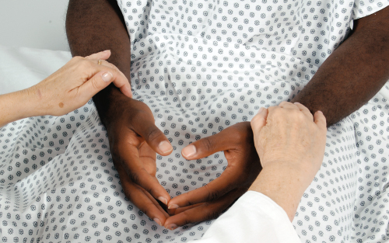
Radial Pulse

Slide 34
Ulnar and Brachial Pulses
It usually is not necessary to palpate ulnar pulses
If indicated, palpate along medial side of inner forearm, although ulnar pulses often are not palpable in normal person
Palpate the brachial pulses: their force should be equal bilaterally
Check epitrochlear lymph node in depression above and behind medial condyle of humerus
Do this by “shaking hands” with person and reaching your other hand under person’s elbow to groove between biceps and triceps muscles, above medial epicondyle
This node is not palpable normally

Slide 35
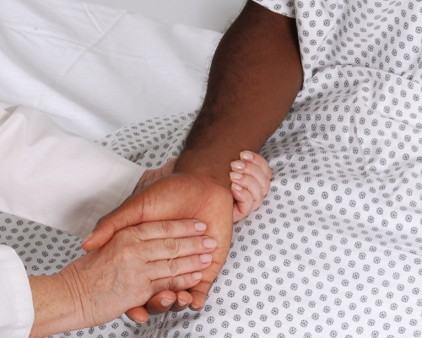
Ulnar Pulse

Slide 36
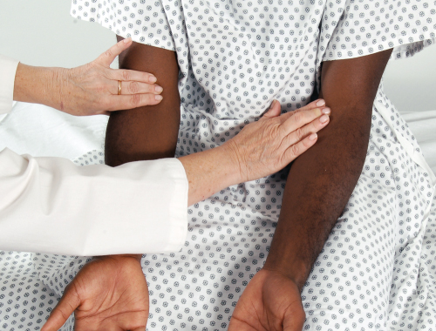
Brachial Pulse

Slide 37
Modified Allen Test
Used to evaluate collateral circulation prior to cannulating radial artery
Firmly occlude both ulnar and radial arteries of one hand while person makes a fist several times; this causes hand to blanch
Ask person to open hand without hyperextending it; then release pressure on ulnar artery while maintaining pressure on radial artery
Adequate circulation is suggested by a return to hand’s normal color in approximately 2 to 5 seconds
Although test is simple and useful, it is relatively crude and subject to error

Slide 38
Inspect and Palpate the Legs
Uncover the legs while keeping genitalia draped
If lower legs look asymmetric, measure leg at widest point, taking care to measure other leg in exactly same place, same number of centimeters down from patella or other landmark
In presence of skin discoloration, skin ulcers, or gangrene, note size and exact location
Palpate for temperature along legs down to feet, comparing symmetric spots
Or you may sharply dorsiflex foot toward tibia

Slide 39
Femoral Arteries
Locate femoral arteries just below inguinal ligament halfway between pubis and anterior superior iliac spines
To help expose femoral area, particularly in obese people, ask person to bend his or her knees to side in a froglike position
Press firmly and then slowly release, noting pulse tap under your fingertips
If this pulse is weak or diminished, auscultate site for a bruit

Slide 40
Femoral Pulse

Slide 41
Popliteal Pulse I
With leg extended but relaxed, anchor your thumbs on knee, and curl your fingers around into popliteal fossa
Press your fingers forward hard to compress artery against bone (lower edge of femur or upper edge of tibia); often it is just lateral to the medial tendon
If you have difficulty, turn person prone and lift up lower leg; let leg relax against your arm and press in deeply with your two thumbs
Often normal popliteal pulse is impossible to palpate

Slide 42
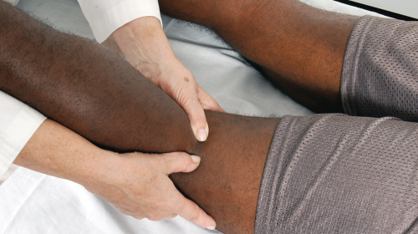
Popliteal Pulse II

Slide 43
Posterior Tibial and Dorsalis Pedis Pulses
For posterior tibial pulse, curve your fingers around medial malleolus
Feel the tapping right behind it in groove between malleolus and Achilles tendon
Dorsalis pedis pulse requires a very light touch
Normally it is just lateral to and parallel with extensor tendon of big toe
Do not mistake pulse in your own fingertips for person’s
In adults over 45 years, occasionally either dorsalis pedis or posterior tibial pulse may be hard to find, but not both on the same foot

Slide 44
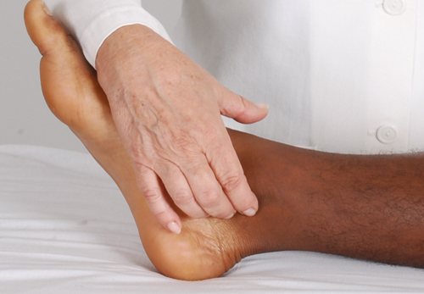
Posterior Tibial Pulse

Slide 45
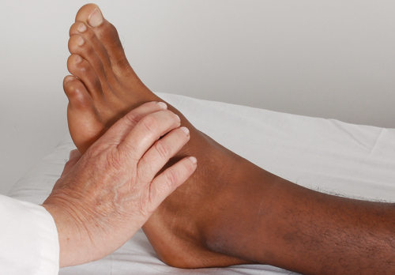
Dorsalis Pedis Pulse

Slide 46
Pretibial Edema and Pitting Edema Scale
Check for pretibial edema
Firmly depress skin over tibia or medial malleolus for 5 seconds and release
Normally your finger should leave no indentation, although a pit commonly is seen if person has been standing all day or during pregnancy
If pitting edema is present, grade it on following scale:
1+ Mild pitting, slight indentation, no perceptible swelling
2+ Moderate pitting, indentation subsides rapidly
3+ Deep pitting, indentation remains, leg looks swollen
4+ Very deep pitting, indentation lasts long time, leg very swollen

Slide 47
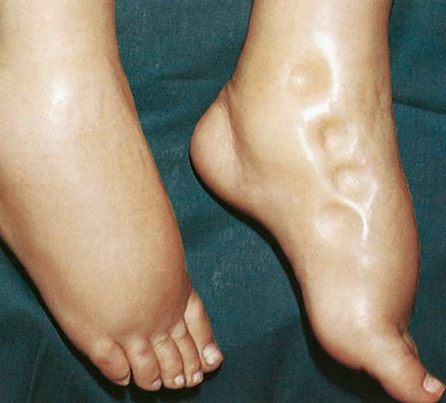
Pitting Edema
From Bloom A, Watkins PH, Ireland J: Color atlas of diabetes, ed 2, St. Louis, 1992, Mosby.

Slide 48
Pitting Edema Scale Classification
Scale is subjective and qualitative
The amount of pressure used is arbitrary, as is judgment of depth and rate of pitting
Clinicians need a standard quantified scale to ensure consistent clinical measurements and management
Many classify the edema by measuring the depth of the pitting in centimeter
Some measure with a millimeter scale, others by an increase in weight; still others try to quantify rate of time pitting remains after release of pressure
Check with your institution to determine a consistently used scale

Slide 49
Standing Assessment
Ask the person to stand so that you can assess venous system
Note any visible, dilated, and tortuous veins
If present, varicose veins cause pain, swelling, fatigue, and cramping

Slide 50
Color Changes I
If you suspect an arterial deficit, raise legs about 30 cm (12 in.) off table and ask person to wag feet for 30 seconds to drain off venous blood
Skin color now reflects only contribution of arterial blood
Light-skinned person’s feet normally will look a little pale but still should be pink
Dark-skinned person’s feet are more difficult to evaluate, but soles should reveal extreme color change
Now have person sit up with legs over side of table
Compare color of both feet, and note time it takes for color to return to feet; normally this is 10 seconds or less

Slide 51
Color Changes II
Note also time it takes for superficial veins around feet to fill
Normal time is about 15 seconds
This test is unreliable if person has concomitant venous disease with incompetent valves
Test lower legs for strength
Test lower legs for sensation

Slide 52
Doppler Ultrasonic Probe
Use this device to detect a weak peripheral pulse, to measure low blood pressure or blood pressure in lower extremity
Doppler probe magnifies pulsatile sounds from heart and blood vessels
Position person supine, with legs externally rotated so you can reach medial ankles easily
Place drop of coupling gel on end of handheld transducer
Place transducer over pulse site, swiveled at a 90-degree angle; apply very light pressure; locate pulse site by the swishing, whooshing sound

Slide 53
Ankle-Brachial Index (ABI)
Use Doppler stethoscope
Highly specific, noninvasive, and readily available way to determine extent of peripheral vascular disease
Specific criteria for procedure with patient lying flat and heels fully supported along with correct choice of cuff size
No smoking within 2 hours with 5- to 10-minute rest period prior to measurement
Two measurements taken and then the average is used as the recorded pressure
Formula calculation required

Slide 54
Question
The nurse is assessing the ankle-brachial index (ABI) of a patient with peripheral arterial disease (PAD). The nurse would be suspect of an ABI of:
1.1.
1.0.
–1.1.
0.5.
Notes:
Correct answer is 4. An ABI of less than 0.5 indicates moderate PAD. The lower the number, the higher the risk for myocardial infarction and cerebrovascular accident.
Answers 1 and 2 are incorrect because the ABI is normally between 1.0 and 1.2, because the pressure in the ankles is usually slightly higher than the pressure in the arms.
Answer 3 is incorrect because a negative number is mathematically impossible.

Slide 55
Wells Score for Deep Vein Thrombosis (DVT)
Combination of assessment findings categorized into low, moderate, or high probability of DVT
Scoring system developed as assessment findings for DVT is often unreliable because DVT often occurs with other comorbidities
Clinical model includes 10 categories focusing on malignancy, mobility limitations, swelling, non-varicose veins, previous history of DVT, and alternative medical diagnosis at least as likely as DVT
Score of 0 or less indicates a low probability, 1 or 2 indicates moderate probability, and 3 points or higher indicates high probability

Slide 56
Question
The nurse is assessing a patient’s risk for developing a deep vein thrombosis (DVT). The patient considered at the highest risk is a 60-year-old patient who:
has been on bed rest for 3 days.
has been receiving physical therapy for left knee replacement.
has calf and thigh measurements that have less than an inch of variation on both legs.
was admitted to the hospital with asthma exacerbation.
Notes:
The correct answer is 1. Bed rest and inactivity increase a patient’s risk of DVT.
Answer 2 is incorrect because although this patient would be considered at risk, knee replacement patients are not the highest risk.
Answer 3 is incorrect because this would be a normal assessment of calf and thigh for DVT.
Answer 4 is incorrect because this patient would not be at high risk for DVT.

Slide 57
Developmental Competence: Infants and Children
Pulse force should be normal and symmetric in both upper and lower extremities
Palpable lymph nodes occur often in healthy infants and children
Small, firm (shotty), mobile, and nontender
Vaccinations can produce local lymphadenopathy
Note characteristics of any palpable lymph nodes and whether they are local or generalized

Slide 58
Developmental Competence: Pregnant Woman
Expect diffuse bilateral pitting edema in the lower extremities, especially at the end of the day and into the third trimester
Nearly 80% of pregnant women have some peripheral edema
Varicose veins are often seen in the third trimester

Slide 59
Developmental Competence: Aging Adult
DP and PT pulses may become more difficult to find
Trophic changes associated with arterial insufficiency may be seen
Thin, shiny skin
Thick, ridged nails
Loss of hair on lower legs

Slide 60
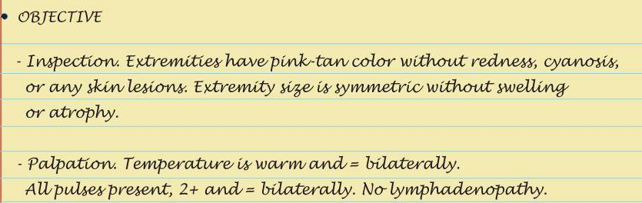
Sample Charting: Subjective and Objective

Slide 61
Sample Charting: Assessment

Slide 62
Abnormal Findings: Variations in Arterial Pulse
Weak, “thready” pulse, 1+
Full, bounding pulse, 3+
Water-Hammer (Corrigan’s) pulse, 3+ (collapses suddenly)
Pulsus bigeminus
Pulsus alternans
Pulsus paradoxus
Pulsus bisferiens

Slide 63
Abnormal Findings: Peripheral Vascular Disease
Arms
Raynaud phenomenon
Lymphedema
Legs
Arterial-ischemic ulcer
Venous (stasis) ulcer
Superficial varicose veins
Deep vein thrombophlebitis
Aneurysms
Occlusions

Slide 64
Summary Checklist: Peripheral Vascular System and Lymphatic System
Inspect arms for color, size, or any lesions
Palpate pulses: radial and brachial
Check epitrochlear node
Inspect legs for color, size, any lesions, or trophic skin changes
Palpate temperature of feet and legs
Palpate inguinal nodes
Palpate pulses: femoral, popliteal, posterior tibial, and dorsalis pedis

Slide 65
Case Study
A patient presents with shiny trophic changes on lower extremities bilaterally. No complaints of pain, temperature of skin slightly cool to touch and sparse hair growth bilaterally
The physician calls into the nurses station and asks the primary nurse for an updated report. How would the nurse respond to the physician’s question?
Notes:
The physician calls into the nurses station and asks the primary nurse for an updated report. How would the nurse respond to the physician’s question?
See Chapter 20: Peripheral Vascular System and Lymphatic System
Based on the provided assessment data, the patient is having signs and symptoms of vascular insufficiency. The skin is slightly cool to touch, sparse hair growth and trophic changes which may indicate arterial insufficiency. Although the patient is not reporting any pain, alterations in sensory function may have already occurred based on recorded observations. The patient should be assessed further for vascular compromise. The nurse should perform sensory testing with a 5.07 mono filament to detect neuropathy and perform a Homan’s test to assess for presence of thrombophlebitis to rule out DVT.

Slide 66
Case Study (Cont.)
The physician asks the nurse if the patient has any signs/symptoms related to a possible thrombophlebitis. What observations would the nurse provide that would provide the physician with the information requested?
Notes:
See Chapter 12: Peripheral Vascular System and Lymphatic System
From textbook:
Signs and symptoms relative to a thrombophlebitis would include:
S: Sudden onset of intense, sharp, deep muscle pain.
O: Increased warmth; swelling; redness; dependent cyanosis is mild or may be absent; tender to palpation
As the patient is not experiencing any of these symptoms, the nurse would respond with a negative assessment with regard to these criteria.

Slide 67
Case Study (Cont.)
What observations would help the nurse to confirm that this was a chronic presentation versus an acute presentation of venous insufficiency?
Notes:
See sections in Chapter 20: Peripheral Vascular System and Lymphatic System
The nurse would assess the following categories: location, character, onset and duration, aggravating and relieving factors, and associated symptoms
Chronic presentations would involve the calf/lower leg, present with aching, tiredness and feeling of fullness. Onset and duration would present as chronic pain that would increase by the end of the day. Aggravating factors would be prolonged standing or sitting. Relieving factors would be elevation of extremity, lying down or walking. Associated symptoms would be edema, varicosities and weeping ulcers of the ankles.
Acute presentations would involve the calf and present with an intense, sharp, deep type of muscle pain that is tender to the touch. Onset and duration would be sudden (within one hour). Aggravating factors would be pain increasing with dorsiflexion of the foot. Due to the acute presentation, relieving factors would require a therapeutic intervention. Associated symptoms would involve a red, swollen extremity.

Slide 68
Case Study (Cont.)
What health promotion measures would help the patient to maintain adequate foot care?
Notes:
See Promoting a Healthy Lifestyle Foot Care in Chapter 20: Peripheral Vascular System & Lymphatic System
From Textbook:
Checking your feet every day.
If you are unable to see the bottoms of your feet, use a mirror or ask someone to help you.
Dry feet carefully after a shower or bath. Examine each foot for red spots or sensitive areas, discoloration of skin or nails, ingrown nails, pain, cuts, swelling, or blisters.
Keep toenails trimmed, straight across, and filed at the edges with an emery board or nail file.
Nail polish… do’s and don’ts.
Chipped nail polish may support the growth of larger numbers of organisms on nails. This is especially important for those already at risk for infection.
Do not use nail polish to cover up discolored nails. Nail polish locks out moisture and keeps the nail bed from being able to ‘breathe’.
Keeping blood flowing to your feet.
Walking is a great way to exercise your feet or try foot exercises such as:
Sitting down and rotating your ankles in one direction, then the other, or try writing the alphabet from A to Z!
In bare feet curl your toes and spread them out.
When an individual is not able to walk, putting the feet up when sitting or lying down, stretching, wiggling toes, or having a gentle foot massage or warm foot bath is a great alternative.
Wearing shoes that fit and are comfortable.
The best time to measure feet is toward the end of the day, when feet tend to be the largest.
Individuals often have one foot that is larger than the other. They should fit their shoes to the larger foot.
Select shoes that are shaped like one’s feet. The ball of the foot should fit comfortably into the widest part of the shoe. Toes should not be crowded.
For women, low-heeled shoes are safer and less damaging than high-heeled shoes.
Keeping skin soft and smooth.
Use mild soap.
Be careful about adding oils to bath water. They can make your feet and the bathtub both very slippery.
A thin coat of skin lotion over the tops and bottoms of one’s feet help to keep skin soft and smooth.

