Slide 1
Introduction to Web Programming
Lecture 5: Introduction to CSS (Part 1)
Natheer Gharaibeh

Slide 2
What we have addressed so far ..
•
What is HTML5?
•
HTML elements, like?
•
HTML forms
•
HTML5 new layout elements

Slide 3
Outlines of today’s lecture
•
What is CSS?
•
CSS syntax
•
How to use CSS

Slide 4
Introduction to CSS
HTML5 was designed to specify the content and structure of a document and was NEVER intended to contain tags for formatting a document.
<h1>This is a heading</h1>
<p>This is a paragraph.</p>
Though HTML5 has some attributes that control presentation, it’s better not to mix presentation with content.
  When tags like <font>, and color attributes were added to the HTML 3.2
specification, it started a nightmare for web developers.
  Development of large web sites, where fonts and color information were added to every single page, became a long and expensive process.
To solve this problem, the World Wide Web Consortium (W3C) created CSS.

Slide 5
Introduction to CSS (Cont.)
CSS stands for Cascading Style Sheets
We use CSS to specify the presentation of elements on a web page (e.g., fonts, spacing, sizes, colors, positioning) separately from the document’s structure and content (section headers, body text, links, etc.).

Slide 6
http://www.w3schools.com/css/demo_default.htm

Slide 7

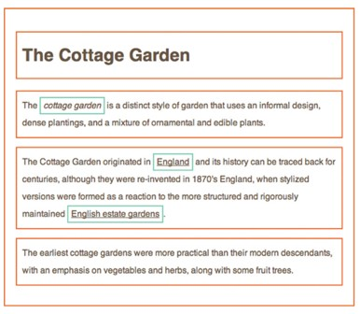
The CSS Box Model
•The key to understanding how CSS works is to imagine that there is an invisible box around every HTML element.
• CSS allows you to create rules that control the way that each
individual box (and the contents of that box) is presented.

Slide 8
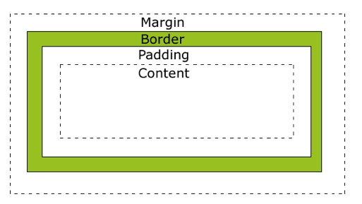
The CSS Box Model (Cont.)
The CSS box model is essentially a box that wraps around HTML elements, and it consists of: margins, borders, padding, and the actual content.
The box model allows us to add a border around elements, and to define space between elements.

Slide 9
The CSS Box Model (Cont.)
Explanation of the different parts:
Content - The content of the box, where text and images appear
Padding - Clears an area around the content. The padding is transparent
Border - A border that goes around the padding and content
Margin - Clears an area outside the

Slide 10


From Head first HTML and CSS, by Robson, E., & Freeman, E., 2012, O'Reilly Media, Inc
Each statement in CSS consists of a location (like bedroom), a property in that location (like drapes or carpet), and a style to apply to that property
(like the color blue, or 1 inch tiles).

Slide 11
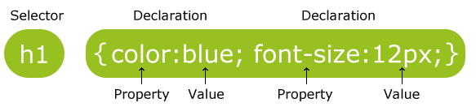
CSS Syntax
Each CSS consists of a list of rules or rule sets.
A CSS rule set consists of a selector and a declaration block:
The selector points to the HTML element you want to style.
The declaration block contains one or more declarations separated by semicolons.
Each declaration includes a property name and a value, separated by a colon.
A CSS declaration always ends with a semicolon, and declaration groups are surrounded by curly braces.
To make the CSS code more readable, you can put one declaration on each line.

Slide 12
CSS Selectors
•A CSS selector is the part of CSS rule set which
allows you to select the content you want to style.
CSS selectors are used to "find" (or select) HTML elements based on their id, class, type, attribute, and more.

Slide 13
The element Selector
•The element/element type/type selector selects elements based on the element name/type.
•Example: You can select all <p> elements on a page like this: (all <p> elements will be center-aligned, with a red text color)
p {
text-align: center; color: red;
}

Slide 14
The id Selector
•The id selector uses the id attribute of an HTML element to select a specific element.
•An id should be unique within a page, so the id selector is used if you want to select a single, unique element.
•To select an element with a specific id, write a hash character, followed by the id of the element.
Example: The style rule below will be applied to the HTML element with id="para1":
#para1 {
text-align: center; color: red;
}

Slide 15
The class Selector
•The class selector selects elements with a specific class attribute.
•To select elements with a specific class, write a period character, followed by the
name of the class:
•In the example below, all HTML elements with class="center" will be center-aligned:
.center {
text-align: center; color: red;
}
•You can also specify that only specific HTML elements should be affected by a class.
•In the example below, all <p> elements with class="center" will be center-aligned: p.center {
text-align: center; color: red;
}

Slide 16
Universal Selector
Applies to all HTML elements in the document
The universal selector is declared using an asterisk
* {
color: green; font-size: 20px;
}

Slide 17
Grouping Selectors
If you have elements with
the same style definitions, like this:
h1 {
text-align: center; color: red;
}
h2 {
text-align: center; color: red;
}
p {
text-align: center; color: red;
}
•You can group the selectors, to minimize the code.
•To group selectors, separate each selector with a comma.
•In the example below we have grouped the selectors from the code above:
h1, h2, p {
text-align: center; color: red;
}
17

Slide 18
CSS Comments
•Comments are used to explain your code, and may help you when you edit the source code at a later date. Comments are ignored by browsers.
•A CSS comment starts with /* and ends with */. Comments can also span multiple lines:
p {
color: red;
/* This is a single-line comment */ text-align: center;
}
/* This is
a multi-line comment */

Slide 19
Three Ways of Inserting Style Sheets
There are three ways of inserting a style sheet:
Internal style sheet
External style sheet
Inline style

Slide 20
Internal Style Sheet
•You define internal styles in the head section of an HTML page, inside the <style> tag, like this:
<head>
<style>
body {
background-color: linen;
}
h1 {
color: maroon; margin-left: 40px;
}
</style>
</head>

Slide 21
External Style Sheet
•
You can create a CSS file to contain the style rule sets.
•
The <link> element can be used in the HTML document to tell the browser where to find the CSS file used to style the page.
•
<link> should use three attributes: href
This specifies the path to the CSS file (which is often placed in a folder called css or styles).
•
type
This attribute specifies the type of document being linked to. The value should be text/css.
rel
This specifies the relationship between the HTML page and the file it is linked to. The value should be stylesheet when linking to a CSS file.

Slide 22
External Style Sheet (Cont.)
Each page must include a link to the style sheet with the <link> tag. The <link> tag goes inside the head section:
<head>
<link rel="stylesheet" type="text/css" href="mystyle.css">
</head>
An example of a style sheet file called "myStyle.css", is shown below:
body {
background-color: lightblue;
}
h1 {
color: navy; margin-left: 20px;
}

Slide 23
Inline Style
An inline style loses many of the advantages of a style sheet (by mixing content with presentation). Use this method sparingly!
To use inline styles, add the style attribute to the relevant tag. The style attribute can contain any CSS property. The example shows how to change the color and the left margin of a h1 element:
<h1 style="color:blue;margin-left:30px;">This is a heading.</h1>

Slide 24
Demo!

Slide 25
Why Use External Style Sheets?
When building a website there are several advantages to placing your CSS rules in a separate style sheet.
All of your web pages can share the same style sheet. This is achieved by using the
<link> element on each HTML page of your site to link to the same CSS document.
This means that the same code does not need to be repeated in every page (which results in less code and smaller HTML pages).
Therefore, once the user has downloaded the CSS stylesheet, the rest of the site will
load faster.
If you want to make a change to how your site appears, you only need to edit the one CSS file and all of your pages will be updated.
It is generally considered good practice to have the content of the site separated from the rules that determine how it appears.

Slide 26
When to Use Internal?
•If you have a single document with a unique style.
•If you are just creating a single page, you might decide to put the rules in the same file to keep everything in one place. (However, many authors would consider it better practice to keep the CSS in a separate file.)
•If you have one page which requires a few extra rules (that are not used by the rest of the site), you might consider using CSS in the same page. (Again, most authors consider it better practice to keep all CSS rules in a separate file.)

Slide 27
References
www.w3schools.com
Robson, E., & Freeman, E. (2012). Head first HTML and CSS. O'Reilly Media, Inc.
Lazaris, L. (2013). Jump Start CSS. Sitepoint.
Duckett, J. (2011). HTML and CSS: Design and Build Websites. John Wiley & Sons.
Deitel & Deitel (2011). Internet and World Wide Web How to Program, 5th Edition, Harvey & Paul Deitel & Associates.

