Slide 1
Introduction to Web Programming
Lecture 8: Introduction to JavaScript
Natheer Gharaibeh

Slide 2
Outlines of today’s lecture
•
Introduction to JavaScript
•
How to use it
•
JavaScript variables and operators

Slide 3
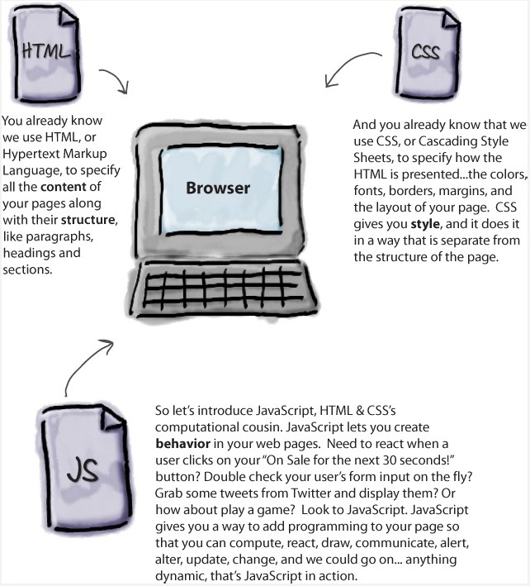
From Head first HTML and CSS, by Robson, E., & Fr³eeman, E., 2012, O'Reilly Media, Inc

Slide 4
Introduction
•With HTML & CSS what you’re doing is largely declarative—for instance, you’re declaring, say, that some text is a paragraph or that all elements in the “sale” class should be colored red.
•With JavaScript you’re adding behavior/interactivity to the page, and to do that you need to describe computation. You need to be able to describe things like, “compute the user’s score by summing up all the correct answers” or “do this action ten times” or even “go off and get my latest tweet, and put it in this page.”
•JavaScript is usually embedded directly into HTML pages
•JavaScript is an interpreted language (means that scripts execute without compilation)

Slide 5
What is JavaScript?
JavaScript is one of the programming languages of the Web.
The overwhelming majority of modern websites use JavaScript.
All modern web browsers include JavaScript interpreters.
•JavaScript is part of the triad of technologies that all Web developers must learn: HTML to specify the content of web pages, CSS to specify the presentation of web pages, and JavaScript to specify the behavior of web pages.

Slide 6
Are Java and JavaScript the Same?
NO!
Java and JavaScript are two completely different languages in both concept and design!
•Java (developed by Sun Microsystems) is a powerful and much more complex programming language - in the same category as C and C++.

Slide 7
What JS can do?!
• JavaScript Can Change HTML Content
One of many HTML methods is document.getElementById().
Try it Yourself »
•JavaScript Can Change HTML Attributes
This example changes an HTML image, by changing the src attribute of an <img> tag:
Try it Yourself »
• JavaScript Can Change HTML Styles (CSS)
Changing the style of an HTML element, is a variant of changing an HTML attribute:
Try it Yourself »
•JavaScript Can Validate Data
JavaScript is often used to validate input
Try it Yourself »

Slide 8
JavaScript Program
•A computer program is a list of "instructions" to be "executed" by the computer.
•In a programming language, these program instructions are called statements.
•JavaScript statements are separated by semicolon.

Slide 9
JavaScript Statement
•JavaScript is a sequence of statements to be executed by the browser.
•Unlike HTML, JavaScript is case sensitive therefore watch your capitalization closely when you write JavaScript statements
•This JavaScript statement tells the browser to write to the web page:
document.write("Hello !!”);
•The semicolon is optional (according to the JavaScript standard [Using semicolons makes it possible to write multiple statements on one line].

Slide 10
How to insert JavaScript
Inside <head> and/or <body>
•The HTML <script> tag is used to insert a JavaScript into an HTML page.
•You can place any number of scripts in an HTML document.
•Scripts can be placed in the <body>, or in the <head> section of an HTML page, or in both.
•Keeping all code in one place, is always a good habit.
Example
<html>
<body>
<h1>My First Web Page</h1>
<script type="text/javascript">
// ... some JavaScript code ... document.write("Hello," +" today is "+Date());
</script>
</body>
</html>

Slide 11
How to insert JavaScript (Cont.)
•Scripts can also be placed in external files.
•External scripts are practical when the same code is used in many different web pages.
•JavaScript files have the file extension .js.
•To use an external script, put the name of the script file in the src (source) attribute of the <script> tag:
•Example
<!DOCTYPE html>
<html>
<body>
<script src="myScript.js"></script>
</body>
</html>

Slide 12
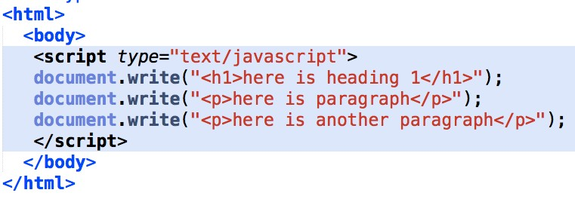
Example

Slide 13
From Head first HTML and CSS, by Robson, E., & Freeman,1E3., 2012, O'Reilly Media, Inc

Slide 14
JavaScript Comments
•Single line comments start with //.
•Multi line comments start with /* and end with */.
Example
<script type="text/javascript">
/*
The code below will write
one heading and two paragraphs
*/
document.write("<h1>This is a heading</h1>"); document.write("<p>This is a paragraph.</p>"); document.write("<p>This is another paragraph.</p>”);
</script>

Slide 15
JavaScript Variables
•In a programming language, variables are used to store data values.
•JavaScript uses the var keyword to define variables. var x;
•An equal sign is used to assign values to variables. var x=5;
•Rules for JavaScript variable names:
•Variable names are case sensitive (y and Y are two different variables)
•Variable names must begin with a letter, an underscore (_) or a dollar sign ($).
•Subsequent characters can be letters, digits, underscores, or dollar signs

Slide 16
Local and Global Variables
Local JavaScript Variables
•A variable declared within a JavaScript function becomes LOCAL and can only be accessed within that function. (the variable has local scope).
•Local variables are destroyed when you exit the function.
Global JavaScript Variables
•Variables declared outside a function become GLOBAL, and all scripts and functions on the web page can access it.
•Global variables are destroyed when you close the page.

Slide 17
Local and Global Example
<html>
<head>
<script type="text/javascript"> function displaymessage()
{
var x=3; //local variable
alert("Local x = " + x + " , Global y="+y);
}
</script>
</head>
<body>
<script type="text/javascript"> var y=5; //global variable alert(" Global y = " + y);
</script>
<form>
<input type="button" value="Click me! " onclick="displaymessage()" />
</form>
</body>
</html>

Slide 18
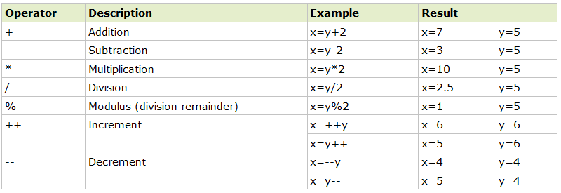
JavaScript Arithmetic Operators
Given that y=5, the table below explains the arithmetic operators:

Slide 19
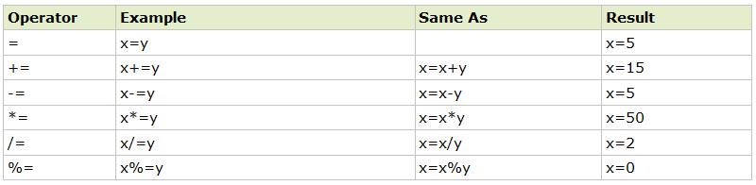
JavaScript Assignment Operators
•Assignment operators are used to assign values to JavaScript variables.
•Given that x=10 and y=5, the table below explains the assignment operators:

Slide 20
The + Operator
The + operator can also be used to add string variables or text values together.
txt1="What a very"; txt2="nice day"; txt3=txt1+txt2; txt4=txt1+" "+txt2;
After the execution of the statements above, the variable txt3 contains "What a verynice day".
After the execution of the statements above, the variable txt4 contains: "What a very nice day"

Slide 21
Adding Strings and Numbers
If you add a number and a string, the result will be a string!
Example
<html>
<body>
<script type="text/javascript"> var x=5+5;
document.write(x + "<br />" ); x="5"+"5";
document.write(x + "<br />" ); x=5+"5";
document.write(x + "<br />" ); x="5"+5;
document.write(x + "<br />" );
</script>
</body>
</html>

Slide 22
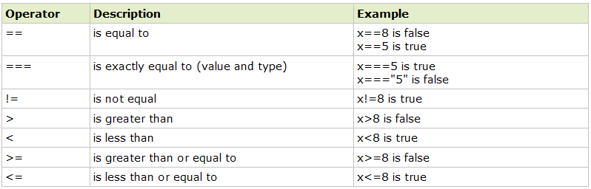
Comparison Operators
•Comparison operators are used in logical statements to determine equality or difference between variables or values.
•Given that x=5, the table below explains the comparison operators:

Slide 23
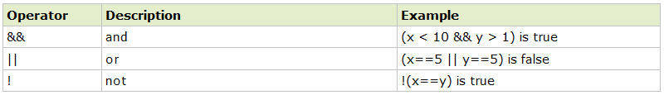
Logical Operators
Given that x=6 and y=3, the table below explains the logical operators:
Conditional Operator
JavaScript also contains a conditional operator that assigns a value to a variable based on some condition.
Syntax
variablename=(condition)?value1:value2;

Slide 24
References
Robson, E., & Freeman, E. (2012). Head first HTML and CSS. O'Reilly Media, Inc.
www.w3schools.com
Duckett, J. (2011). HTML and CSS: Design and Build Websites. John Wiley & Sons.
Deitel & Deitel (2011). Internet and World Wide Web How to Program, 5th Edition, Harvey & Paul Deitel & Associates.

