Slide 1
Introduction to Web Programming
Lecture 2: Introduction to HTML5: PART (2)
Images, hyperlinks, lists and tables
Natheer Gharaibeh

Slide 2
Outlines of today’s lecture
•
Element attributes
•
HTML elements–images
•
HTML elements–hyperlinks
•
HTML elements–lists
•
HTML elements–tables

Slide 3
But first … what we addressed last week
•
What is HTML?
•
Why do we use it?
•
What is the general structure of HTML documents?
•
What elements did we cover?

Slide 4
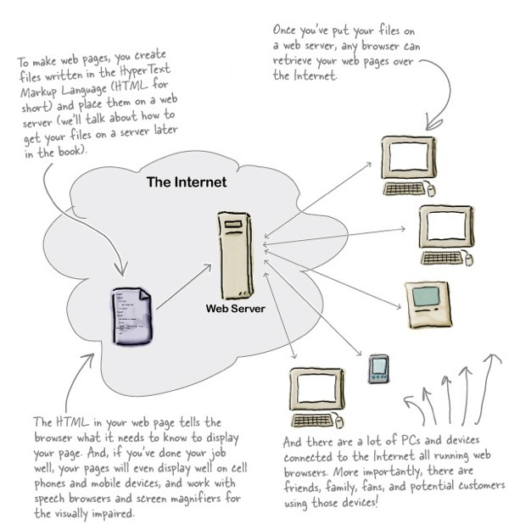
Let’s look at the big picture again!
From Head first HTML and CSS, by Robson, E., & F₄reeman, E., 2012, O'Reilly Media, Inc

Slide 5
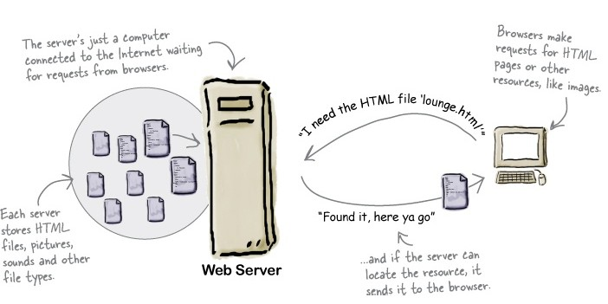
What does the web server do?
From Head first HTML and CSS, by Robson, E., & Freeman, E., 2012, O'Reilly Media, Inc

Slide 6
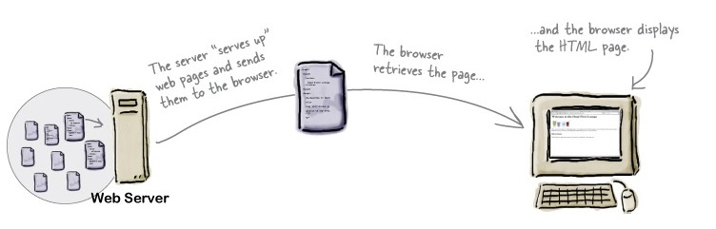
What does the browser do?
From Head first HTML and CSS, by Robson, E., & Freeman, E., 2012, O'Reilly Media, Inc

Slide 7
HTML Attributes
•
HTML elements can have attributes
Attributes provide additional information about an element
•
Attributes are always specified in the start tag
•
Attributes come in name/value pairs like: name=“value”
•
Always use lowercase and quote your attribute values

Slide 8
Examples
The lang Attribute
•
The lang attribute specifies the language of the element's content
•
Syntax: <element lang=“language_code”>
•
Language code reference
•
The document language can be declared in the <html> tag
•
Example: <html lang=“en-US">
•
Declaring a language is important for accessibility applications (such as screen readers) and
search engines–it helps search engines in filtering results based on the user’s linguistic preferences.
The title Attribute
•
Specifies extra information about an element
•
The information is most often shown as a tooltip text when the mouse moves over the element
•
Example: <p title=“this is a paragraph title">

Slide 9
What if?!
•
Are quotations necessary in attribute values?
•
Omitting quotes might produce errors! So always use them. Example?
•
Single or double quotes?
•
It depends on the value of the attribute.
Example?

Slide 10
HTML Elements–Images
We’ve shown how to mark up documents that contain only text, but web pages may also contain images, animations, graphics, audios and even videos.
img element is used to include an image in the document.
HTML Images Syntax
•
In HTML, images are defined with the <img> tag.
•
The <img> tag is empty, it contains attributes only, and does not have a closing tag.

Slide 11
Image Attributes
•
The src attribute
•
•
Tells the browser where it can find the image file
It is good practice to create a folder for all of the images the site uses
•
The alt attribute
•
•
Specifies an alternate text for the image, if it cannot be displayed
The value of the alt attribute should describe the image in words, hence it is useful for accessibility applications
•
Image Size - Width and Height
•
You can use the attributes width and height to specify the size of an image
The values are specified in pixels
Images often take longer to load than the HTML code that makes up the rest of the page. It is, therefore, a good idea to specify the size of the image so that the browser can render the rest of the text on the page while leaving the right amount of space for the image that is still loading
•
•

Slide 12
Image Demo!

Slide 13
HTML5: FIGURE AND FIGURE CAPTION
Images often come with captions. HTML5 has introduced a new <figure> element to contain images and their caption <figcaption> so that the two are associated
<!doctype html>
<html>
<body>
<figure>
<img ….. />
<figcaption>
figure caption goes here.
You can have more than one image inside the <figure> element as long as they all share the same caption
</figcaption>
</figure>
</body>
</html>

Slide 14
HTML Elements–Hyperlinks
A hyperlink references or links to other resources, such as HTML documents, sections within documents, images…etc
Can be a text, or an image that you can click on, and jump to another document
Web browsers typically underline text hyperlinks and color them blue by default
In HTML, links are defined with the <a> tag
Link Syntax: <a href="url">link text</a>
  The href attribute specifies the destination of a link
  The link text is the visible part and it does not have to be text. It can be an HTML image or any other HTML element

Slide 15
HTML Hyperlinks–the target attribute
The target attribute specifies where to open the linked document
To open the linked document in a new window or tab: target=“_blank“
Example:
<a href="http://www.w3schools.com/" target="_blank">Visit W3Schools!</a>
To open the linked document in the full body of the window or tab: target=“_top"
Example:
<a href="http://www.w3schools.com/" target="_top" >Visit W3Schools!</a>

Slide 16
HTML Links–the id attribute
HTML bookmarks are used to allow readers to jump to specific parts of a Web page.
The id attribute can be used to create bookmarks inside HTML documents.
Bookmarks are not displayed in any special way. They are invisible to the reader.
Example
Add an id attribute to any html element:
<h1 id="tips">Useful Tips Section</h1>
Then create a link to the bookmark (Useful Tips Section)from the same page:
<a href="#tips">Visit the Useful Tips Section</a>
Or, create a link to the bookmark (Useful Tips Section) from another page:
<a href="http://www.w3schools.com/html_links.htm#tips">Visit the Useful Tips Section</a>

Slide 17

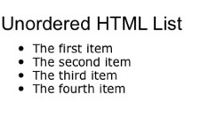

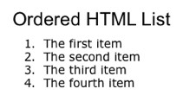

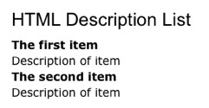
HTML Elements–Lists
•
HTML offers three types of lists:
•
Unordered lists
•
Ordered lists
•
Description lists

Slide 18
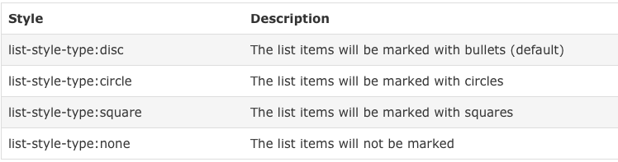
Unordered Lists
An unordered list starts with the <ul> tag
Each list item starts with the <li> tag
The list items will be marked with bullets which are small black circles (default)
Style attribute might be added to the <ul> tag to define how the list items will be marked

Slide 19
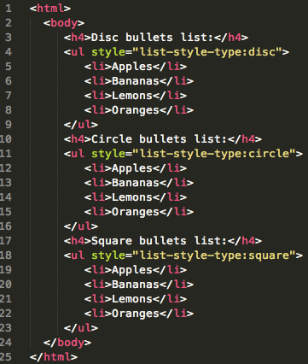

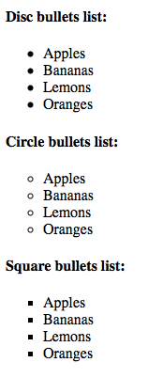
Example–Different Styles of Unordered List

Slide 20
Ordered Lists
An ordered list starts with the <ol> tag
Each list item starts with the <li> tag
The list items will be marked with numbers (default)
A type attribute can be added to an ordered list, to define the type of the marker

Slide 21
Example– Different Styles of Ordered List

Slide 22

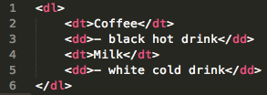

Description/Definition Lists
A description/definition list, is a list of terms, with a description of each term
The <dl> tag defines a description list
The <dt> tag defines the definition term, and the <dd> tag defines the data (description)
• Example:
Tip: Inside a list item you can put text, line breaks, images, links, other lists, etc.

Slide 23
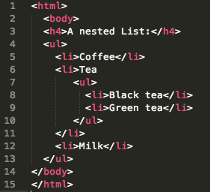

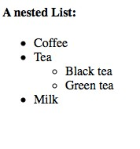
Example–Nested List

Slide 24

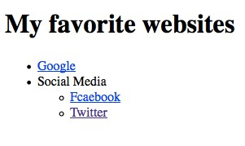
HyperLinks and Lists Demo!

Slide 25
HTML Elements–Tables
Tables are defined with the <table> tag
A table is divided into rows (with the <tr> tag), and each row is divided into data cells (with the <td> tag). td stands for "table data," and holds the content of a data cell. A
<td> tag can contain text, links, images, lists, forms, other tables, etc
If you do not specify a border attribute, the table will be displayed without borders

Slide 26
Table Tags
Tag | Description
<table> | Defines a table
<th> | Defines a table header
<tr> | Defines a table row
<td> | Defines a table cell
<caption> | Define a table caption

Slide 27
References
www.w3schools.com
Robson, E., & Freeman, E. (2012). Head first HTML and CSS. O'Reilly Media, Inc.
Duckett, J. (2011). HTML and CSS: Design and Build Websites. John Wiley & Sons.
Deitel & Deitel (2011). Internet and World Wide Web How to Program, 5th Edition, Harvey & Paul Deitel & Associates.

