Slide 1
Introduction to Web Programming
Lecture 4: Introduction to HTML5: PART (4)
Natheer Gharaibeh

Slide 2
Outlines of today’s lecture
•
HTML quotations, citations and abbreviations
•
HTML <address>
•
HTML comments
•
HTML iframes
•
Block and inline elements

Slide 3

HTML Quotations
There are two elements commonly used for marking up quotations:
1. <q>
used for shorter quotes that sit within a paragraph.
browsers are supposed to put quotes around the <q> element, however Internet Explorer does not — therefore many people avoid using the <q> element.
Example
<p>WWF's goal is to: <q>Build a future where people live in harmony with nature.</q></p>

Slide 4

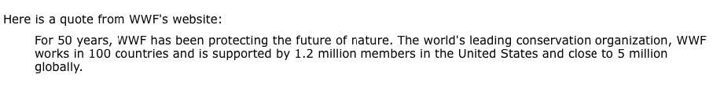
HTML Quotations (Cont.)
2.<blockquote>
•used for longer quotes that take up an entire paragraph.
•browsers tend to indent the contents of the <blockquote> element.
Example
<p>Here is a quote from WWF's website:</p>
<blockquote cite="http://www.worldwildlife.org/who/index.html"> For 50 years, WWF has been protecting the future of nature.
The world's leading conservation organization, WWF works in 100 countries and is supported by
1.2 million members in the United States and close to 5 million globally.
</blockquote>

Slide 5
HTML Quotations (Cont.)
Both elements may use the cite attribute to indicate where the quote is from. Its value should be a URL that will have more information about the source of the quotation
Example
<p>Here is a quote from WWF's website:</p>
<blockquote cite="http://www.worldwildlife.org/who/index.html"> For 50 years, WWF has been protecting the future of nature.
The world's leading conservation organization, WWF works in 100 countries and is supported by
1.2 million members in the United States and close to 5 million globally.
</blockquote>

Slide 6
Abbreviations & Acronyms
•The HTML <abbr> element defines an abbreviation or an acronym.
•A title attribute on the opening tag is used to specify the full term.
•Marking abbreviations can give useful information to browsers, translation systems and search-engines.
Example
<p>The <abbr title="World Health Organization">WHO</abbr> was founded in 1948.</p>

Slide 7
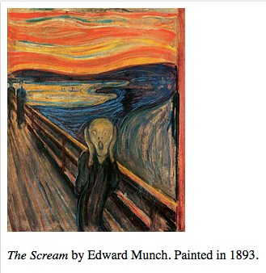
HTML Citations
The HTML <cite> element defines the title of a work.
Browsers usually displays <cite> elements in italic.
Example
<p><cite>The Scream</cite> by Edward Munch. Painted in 1893.</p>

Slide 8
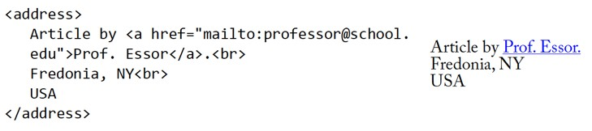
HTML <address> for Contact Information
The HTML <address> element defines contact information (author/owner) of a document or article.
•
•
The <address> element is usually displayed in italic. Most browsers will add a line break before and after the element.
•
Example:

Slide 9

HTML Computer Code Elements
<code>Deﬁnes programming code
The <code> element does not preserve extra whitespace and line-breaks.
To ﬁx this, you can put the <code> element inside a <pre> element.
<kbd>Deﬁnes keyboard input
Example: <kbd>File | Open…</kbd>
<samp>Deﬁnes computer output
Example:
<samp>
demo.example.com login: Apr 12 09:10:17
Linux 2.6.10-grsec+gg3+e+Ps6b+nfs+gr0501+++p3+c4a+gr2b-reslog-v6.189
</samp>

Slide 10
HTML Computer Code Elements (Cont.)
<var> - Deﬁnes a variable
- The variable could be a variable in a mathematical expression or a variable in programming context.
Example:
Einstein wrote: <var>E</var> = <var>m</var><var>c</var><sup>2</ sup>.

Slide 11
HTML Comments
You can add comments to your HTML source by using the following syntax:
<!-- Write your comments here -->
Comments are also great for debugging HTML, because you can comment out HTML lines of code, one at a time, to search for errors
Example
<!-- Do not display this at the moment
<img border="0" src="pic_mountain.jpg" alt=“Mountain" />
-->

Slide 12
HTML iframes
An iframe is used to display a web page within a web page.
Example: http://www.w3schools.com/html/html_iframe.asp
The syntax for adding an iframe is:
<iframe src="URL"></iframe>
The src attribute specifies the URL (web address) of the iframe page.
An iframe can be used as the target frame for a link.
  The target attribute of the link must refer to the name attribute of the iframe:
Example:
<iframe src="demo_iframe.htm" name="iframe_a"></iframe>
<p><a href="http://www.w3schools.com" target="iframe_a">W3Schools.com</a></p>

Slide 13
Let’s go back to the target
attribute in <a> element
Syntax
<a target="_blank|_self|_parent|_top|framename"> Attribute Values:
_blank: Opens the linked document in a new window or tab
_self: Opens the linked document in the same frame as it was clicked (this is default)
_parent: Opens the linked document in the parent frame
_top: Opens the linked document in the full body of the window framename: Opens the linked document in a named frame

Slide 14

HTML Block Elements
•Most HTML elements are defined as block level elements or inline elements.
•Block level elements normally start (and end) with a new line, when displayed in a browser and takes up the full width available (stretches out to the left and right as far as it can)..
Examples: <h1>, <p>, <ul>, <table>

Slide 15

HTML Inline Elements
•Inline elements are normally displayed without line breaks.
Examples: <b>, <td>, <a>,
<img>, <span>
<span> element can be used to style parts of the text
Example:
•

Slide 16
Grouping Text & Elements in a Block
The <div> element allows you to group a set of elements together in one block-level box.
For example, you might create a <div> element to contain all of the elements for the header of your site (the logo and the navigation).
In a browser, the contents of the <div> element will start on a new line, but other than this it will make no difference to the presentation of the page.
Using an id or class attribute on the <div> element, however, means that you can create CSS style rules to indicate how much space the <div> element should occupy on the screen and change the appearance of all the elements contained within it.

Slide 17
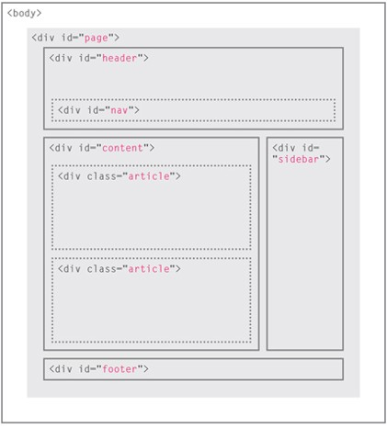
Traditional HTML Layouts
For a long time, web page authors used <div> elements to group together related elements on the page.
Authors used class or id attributes to indicate the role of the
<div> element in the structure of the page.
On the right you can see a layout that is quite common.
At the top of the page is the header, containing a logo and the primary navigation.
Under this are one or more articles or posts. Sometimes these are summaries that link to individual posts.
There is a side bar on the right-hand side.
When coding a site like this, developers would usually put these main sections of the page inside <div> elements and use the class or id attributes to indicate the purpose of that part of the page.

Slide 18
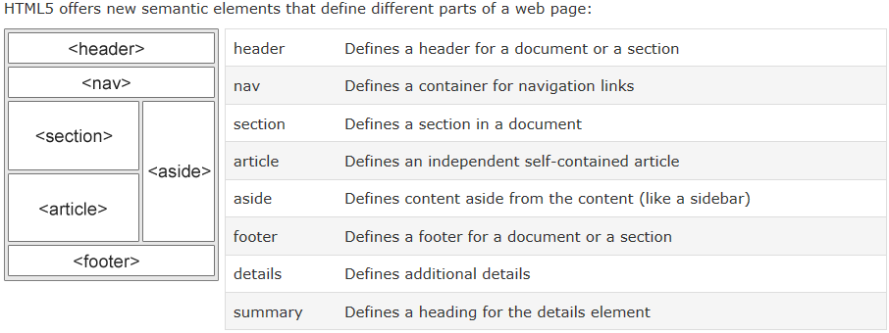
New HTML5 Layout Elements
•HTML5 introduces a new set of elements that allow you to divide up the parts of a page.
•The names of these elements indicate the kind of content you will find in them.

Slide 19
References
www.w3schools.com
Duckett, J. (2011). HTML and CSS: Design and Build Websites. John Wiley & Sons.
Deitel & Deitel (2011). Internet and World Wide Web How to Program, 5th Edition, Harvey & Paul Deitel & Associates.

