Slide 2
Objectives
Describe a website, common webpage characteristics, and web servers
Explain the role IP addresses, domain names, and URLs play in locating webpages
Connect to the Internet or a network
Start a browser and view webpages
Visit webpages using browser shortcuts

Slide 3
Objectives
Save online information for later use
Change browser options
Discuss the risks and safeguards related to using the web

Slide 4
Websites, Webpages, and Web Servers
Websites
Number of pages varies depending on site’s purpose and type of content and services it provides
Home page is the primary webpage at a website
A web portal, or simply a portal, is a special type of website that offers access to a vast range of content and services

Slide 5
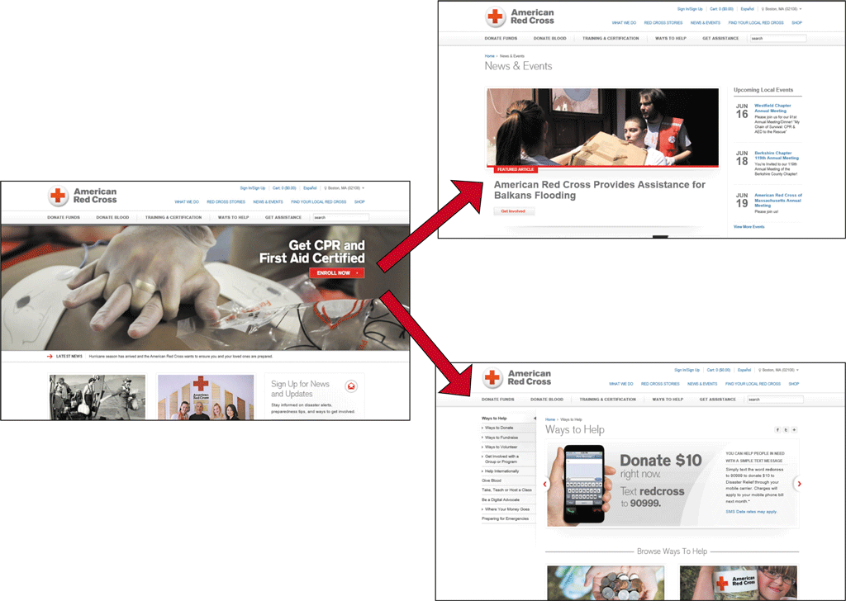
Websites, Webpages, and Web Servers

Slide 6
Websites, Webpages, and Web Servers
Webpages
Designed to attract visitors and hold their attention
Common characteristics
Logo and/or name
Images and media
Links
Advertisements
Search tool
Connectivity links or icons
Copyright statement
Link to a privacy and security policy statement

Slide 7
Websites, Webpages, and Web Servers

Slide 8
Websites, Webpages, and Web Servers
Web Servers
Browser is a client that requests services from a web server
Server “serves up” or provides the requested resources or services
Web browsing is example of client/server computing

Slide 9
Websites, Webpages, and Web Servers
Web Servers (continued)
Single web server can host multiple websites
Larger websites may be stored across multiple web servers

Slide 10
Domain Names, IP Addresses, and URLs
IP Address
A unique number that identifies each computer or device connected to the Internet
Static IP addresses seldom change
Dynamic IP addresses are temporary
2 Versions
IPv4: 4 numbers (0-255) separated by a dot.
Example: 69.32.133.11
IPv6: 8 hexadecimal numbers (0- 65,535) separated by a colon
Example: 3ffe:1900:4545:3:200:f8ff:fe21:67cf

Slide 11
Domain Names, IP Addresses, and URLs

Slide 12
Domain Names, IP Addresses, and URLs
Domain Names
A text alias for one or more IP addresses
cengage.com is domain name for 69.32.133.11
Domain Name System (DNS) uses name servers to translate domain name to numeric IP address
Managed by ICANN (The Internet Corporation for Assigned Names and Numbers)
TLD (.com, .edu, .gov, .biz, and so forth)
ccTLD (.us, .uk, .ca, and so forth)

Slide 13
Domain Names, IP Addresses, and URLs

Slide 14
Domain Names, IP Addresses, and URLs
Uniform Resource Locators (URLs)
A unique web address
http:// protocol
host
domain name
path
webpage name

Slide 15
Connecting to the Internet
Check to be sure you are connected
Smartphone – check for connection
Mobile device – access Settings menu or folder to enable Wi-Fi
Laptop or desktop – go to settings or Control Panel to enable Wi-Fi

Slide 16
Browsers
Software or app used to access and view webpages
Popular browsers for personal computers in homes and businesses
Google Chrome
Mozilla Firefox
Microsoft Windows Internet Explorer
Apple Safari
Opera

Slide 17
Browsers

Slide 18
Browsers
Internet Explorer 11 features
Home page
Display area
Back and Forward buttons
Address bar
Home button
‘View favorites, and history’ button
Tools button
Tabs for each open webpage

Slide 19
Browsers

Slide 20
Browsers
Internet Explorer 11 features (continued)
New tab button
Scroll bar
Command bar – optional, customizable toolbar

Slide 21
Opening Your Browser and Loading a Webpage
Double-click the browser icon on the desktop, click the browser icon on the taskbar, or tap the browser icon on the home screen of your mobile device
Tap or click the Address box on the Address bar
Enter www.cengage.com as the URL
Press the ENTER key or tap or click the appropriate browser button to open the Cengage home page

Slide 22
Opening Your Browser and Loading a Webpage

Slide 23
Using a Search Box to Find Information
Enter Discovering the Internet in the Search Products text box
Press the ENTER key or tap or click the appropriate button to begin the search
Tap or click the link for this text to open the webpage

Slide 24
Using a Search Box to Find Information

Slide 25
Viewing a Webpage
Tap or click the Cengage Learning logo to return to the home page or enter cengage.com in the Address bar, and then tap or click the appropriate button
Drag the scroll box on the vertical scroll bar down, or swipe your finger upward if using a touch screen, to view the content at the bottom of the webpage, and then drag or swipe downward to view the top of the webpage

Slide 26
Viewing a Webpage

Slide 27
Browsers
Navigating Recently Viewed Webpages
Use the Back, Forward, Stop, Refresh, and Home Buttons
Back and Forward buttons – revisit recently viewed webpages
Stop and Refresh buttons – stops opening a page or opens an updated copy of the current page
Home – displays the home page(s)

Slide 28
Navigating Through Recently Viewed Pages
Type weather.com in the Address box
Press the ENTER key or tap or click the necessary button to open the weather.com webpage
Tap or click any link to open a new webpage
Click the Back button to return to The Weather Channel home page
Tap or click the Forward button, if available, to return to the webpage you were viewing before you clicked the Back button

Slide 29
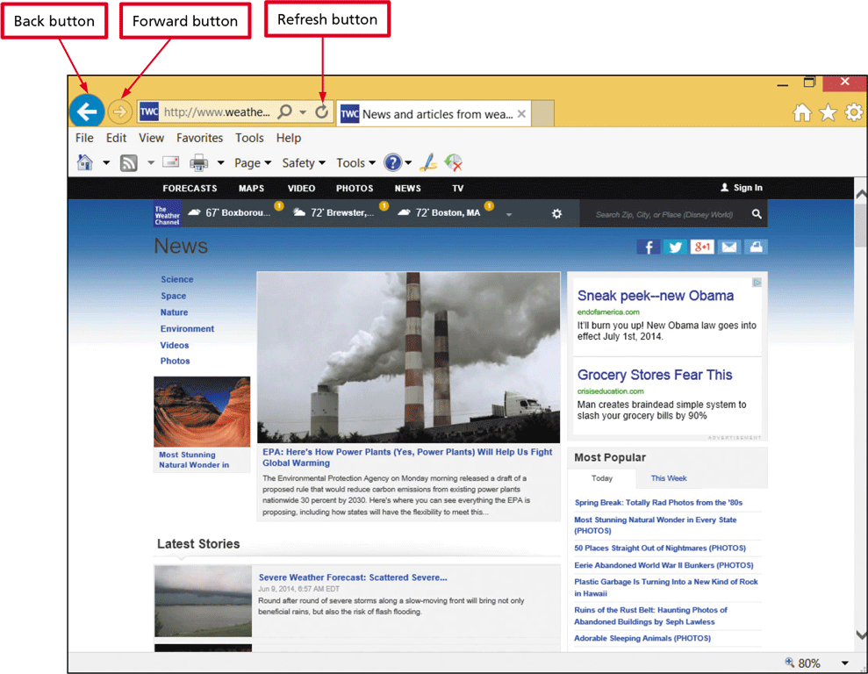
Navigating Through Recently Viewed Pages
Tap or click the Refresh button or menu command, or swipe at the top of the mobile browser window to access the refreshed webpage

Slide 30
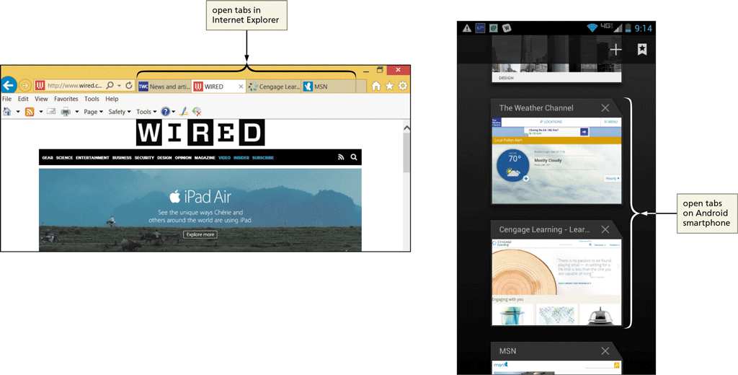
Browsers
Using Tabbed Browsing
Allows you to open multiple webpages in a single browser window

Slide 31
Browsers
Using Tabbed Browsing (continued)
Each page can be opened in its own tab
On mobile devices, view open tabs using a menu command
New tab button displays a blank tab on which you can enter a URL
Tapping or clicking a tab brings the webpage and tab from the background to the foreground
Click the New Tab button to open a blank tab then enter URL in the Address box to open a webpage in the new tab

Slide 32
Opening and Closing Multiple Webpage Tabs
Tap or click the Internet Explorer to open Internet Explorer
Tap or click the New Tab button on the tab row to open a new tab page
Type espn.com in the Address bar
Press the ENTER key or tap or click the appropriate button to open the home page in the new tab

Slide 33
Opening and Closing Multiple Webpage Tabs
Tap or click the New tab button on the tab row to open a new tab
Enter nfl.com in the Address box
Tap or click the necessary button to open the NFL.com home page
Tap or click the Close Tab button on the NFL News webpage tab to close the webpage
Tap or click the New tab button on the tab row to open a new tab
Tap or click the ‘Reopen closed tabs’ button on the New tab page, if available, to see a list of closed tabs

Slide 34
Opening and Closing Multiple Webpage Tabs
Tap or click the NFL News link to reopen the webpage in a new tab
Close the browser and close all tabs, if asked
Start the browser
Tap or click the New tab button on the tab row to open a new tab page if necessary
Tap or click the ‘Reopen last session’ button if available to reopen the tabs that were open when you closed the browser

Slide 35
Opening and Closing Multiple Webpage Tabs

Slide 36
Switching Between Open Webpages Using a Mobile Browser
Locate the Tabs button, which likely will appear in the upper-right corner of the mobile browser window
Tap or click the Tabs button to display open tabs
Swipe up or down, or use a scroll bar if available, to view all open tabs
Tap or click a tab to display it in the foreground

Slide 37
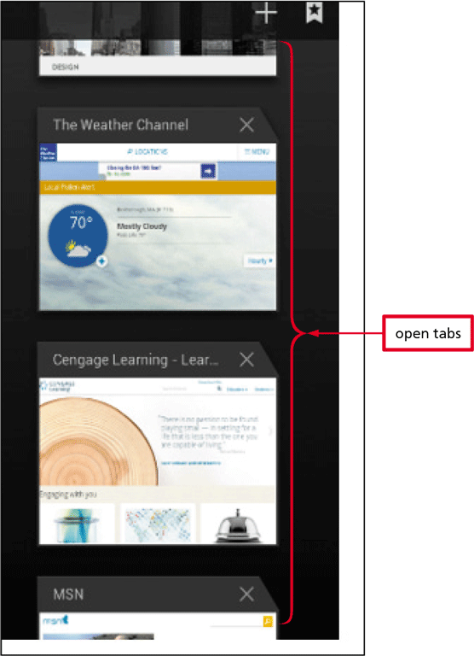
Switching Between Open Webpages Using a Mobile Browser

Slide 38
Using Browser Shortcuts to Visit Webpages
Most browsers provide shortcuts for accessing webpage content and revisiting webpages, including:
Favorites
History
Accelerators
Address bar drop-down list
Suggested websites

Slide 39
Using Browser Shortcuts to Visit Webpages
Favorites
A favorite, or bookmark, is a browser shortcut to a frequently viewed webpage
Once created, you can tap or click the Favorites or Bookmark button to revisit the webpage

Slide 40
Creating a Subfolder and Adding a Favorite or Bookmark
Start the browser
Type dell.com in the Address bar
Press the ENTER key or tap or click the necessary button to open the Dell home page
Tap or click the Favorites or Bookmarks button, if available, to open the Favorites or Bookmarks pane
If necessary, navigate to view your list of favorites and subfolders
Tap or click the ‘Add to favorites’ button, the Add Bookmark button, or other similar command to display the Add a Favorite dialog box

Slide 41
Creating a Subfolder and Adding a Favorite or Bookmark
Type Textbook links as the favorite name
Tap or click the New folder button, if available, to display the Create a Folder dialog box
Type Discovering the Internet as the folder name
Tap or click the Create button or Save button to create the new Discovering the Internet folder
Tap or click the Add button or other appropriate button to add the favorite to the new Discovering the Internet folder

Slide 42
Creating a Subfolder and Adding a Favorite or Bookmark
Tap or click the New tab button to display a new page
Tap or click the Favorites button or Bookmarks button, and then tap or click the Favorites tab, if necessary to display the Favorites pane
Tap or click the Discovering the Internet folder to view its contents
Tap or click the Discovering the Internet favorite link, and then tap or click the Textbook link to open the Dell home page in the current tab

Slide 43
Creating a Subfolder and Adding a Favorite or Bookmark

Slide 44
Using Bookmarks or Favorites on a Mobile Device
Open the Dell home page
Open the browser’s menu to view options for the website
Tap or click Bookmarks or other similar command
Tap or click the Other folder link to open a new folder
In the Label text box, type Textbook links as the Favorite name
Choose where to add the bookmark, if possible
Enter Discovering the Internet as the folder name

Slide 45
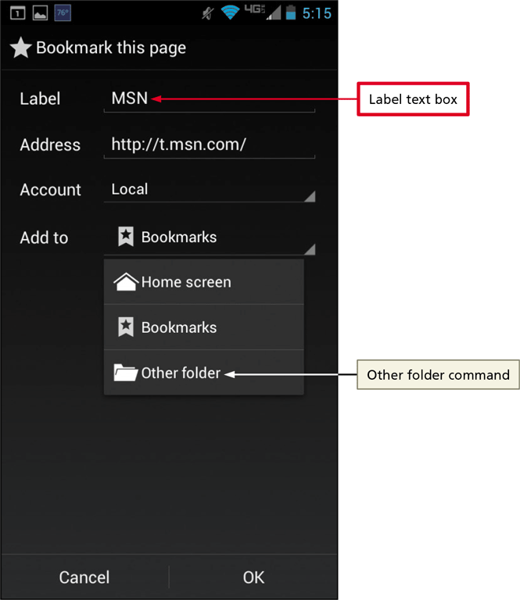
Using Bookmarks or Favorites on a Mobile Device
Tap or click the Create or Save button to create the new Discovering the Internet folder
Tap or click the Save or Add button or other appropriate button to add the favorite to the new Discovering the Internet folder

Slide 46
Deleting a Favorites Subfolder and Its Contents
Tap or click the Favorites button or Bookmarks button, or open your browser and open the browser menu if you are using a mobile device
Display your list of favorites and subfolders
Tap or click the ‘Discovering the Internet’ folder to select it
Right-click if necessary, then tap or click Delete or a similar command
Tap or click the Yes button, if necessary, to confirm the deletion
Close the browser

Slide 47
Deleting a Favorites Subfolder and Its Contents

Slide 48
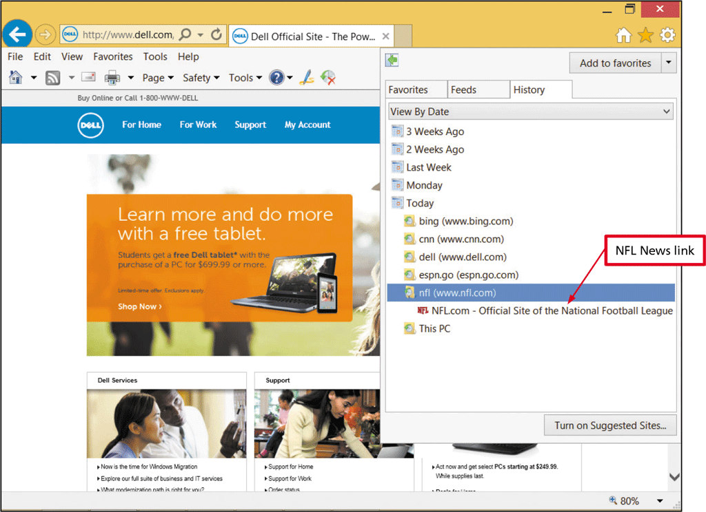
Revisiting a Webpage Using the History List
Tap or click the Favorites button, Customize button, or other option
Tap or click the History tab or History menu option to view the History list
Tap or click the Today icon, if necessary, to expand the list of webpages visited today

Slide 49
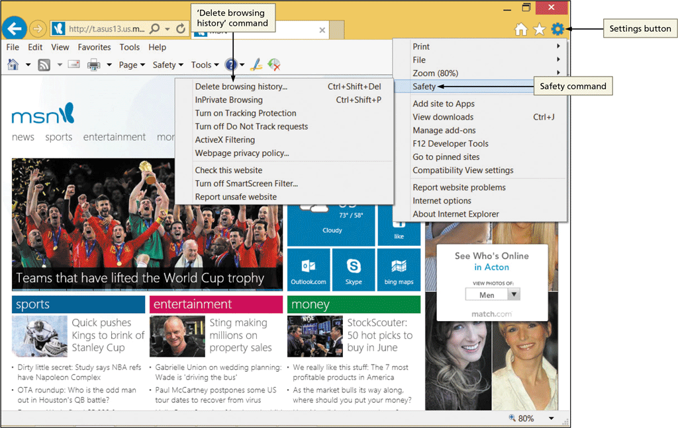
Using Browser Shortcuts to Visit Webpages
Clear the Browser History
Clear the browser history to protect your privacy

Slide 50
Using Browser Shortcuts to Visit Webpages
Add-Ons
Allow you to access web content or take some action based on selected webpage text
Also called accelerators or extensions

Slide 51
Using Browser Shortcuts to Visit Webpages
Suggested Websites
The AutoComplete feature looks at the first few characters you type in the Address box and then suggests websites and search keywords based on the stored URLs
The Address bar dropdown list organizes suggestions by:
AutoComplete suggestions
History of webpages previously visited
Suggested search topics

Slide 52
Using Browser Shortcuts to Visit Webpages

Slide 53
Creating a Website Shortcut on the Desktop
Navigate to www.msn.com if necessary
If necessary, minimize browser window so that you can see the desktop
Tap or click the MSN icon in the Address bar or select the URL in the Address bar
Drag the icon or suggested URL to the desktop to create a shortcut

Slide 54
Creating a Website Shortcut on the Desktop

Slide 55
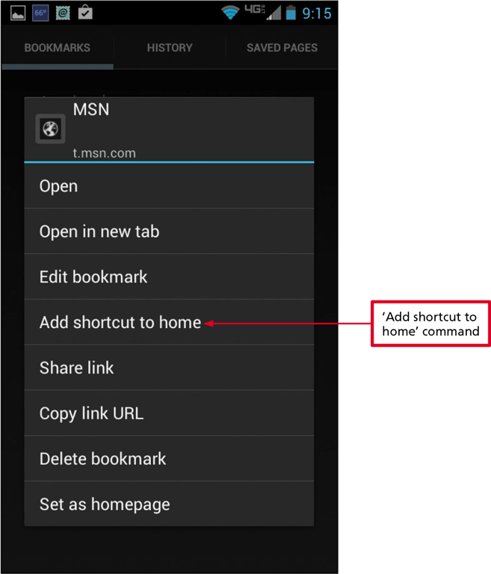
Creating a Website Shortcut on a Mobile Device’s Home Screen
Tap and hold the URL in the Address bar to select it
Drag selected URL to the home screen to create a shortcut
Close the browser

Slide 56
Saving Online Information
Printing a Webpage
Preview the webpage
Change paper size, margins, and orientation, header and footer content
Print a printer-friendly format

Slide 57
Saving Online Information

Slide 58
Saving Online Information
Saving a Webpage
Webpage, complete (HTML files and all related files)
Archive file of webpage
HTML file only
Text file
Sharing a Webpage
‘Send page by email command’ in browser
Email or Text icon at website
Share via social media and content sharing websites

Slide 59
Saving Online Information

Slide 60
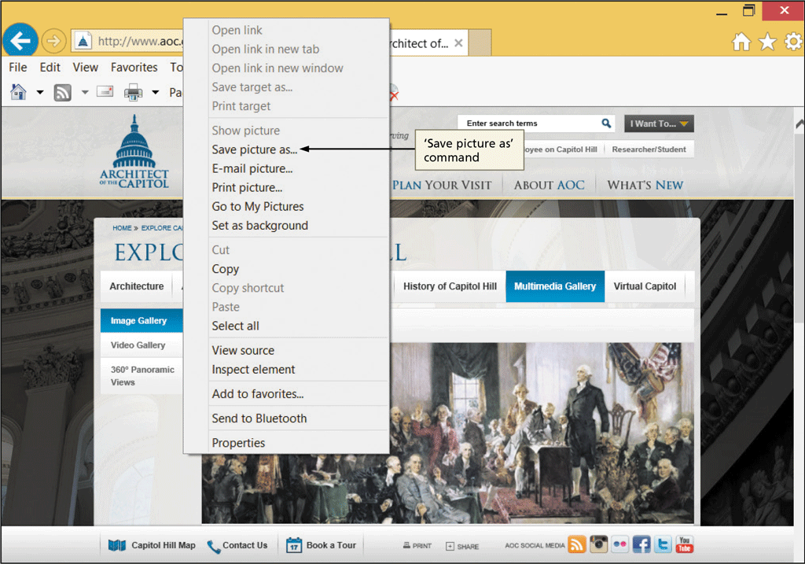
Saving Online Information
Saving a Webpage Image
Ownership and copyright considerations
Typically can right-click image to display menu

Slide 61
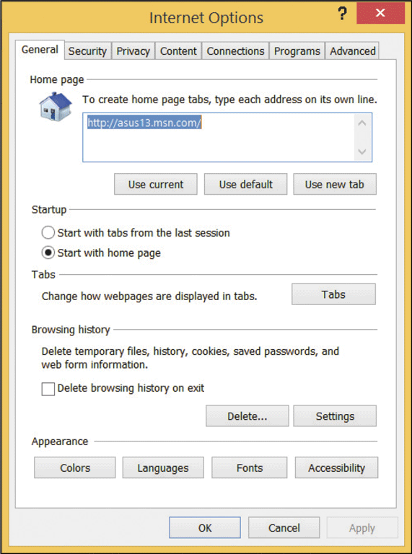
Changing Browser Options
Show or hide commands
Change display by zooming
On some computers and devices, you can change the browser’s home page and select options for displaying browser history

Slide 62
Adding a Browser Home Page
Type weather.com in the Address bar and press the ENTER key
Tap or click the Home button arrow on the Command bar to display the Home button menu
Tap or click ‘Add or change home page’ to display the Add or Change Home Page dialog box
Tap or click the ‘Add this webpage to your home page tabs’ option button to add the current webpage as a home page tab

Slide 63
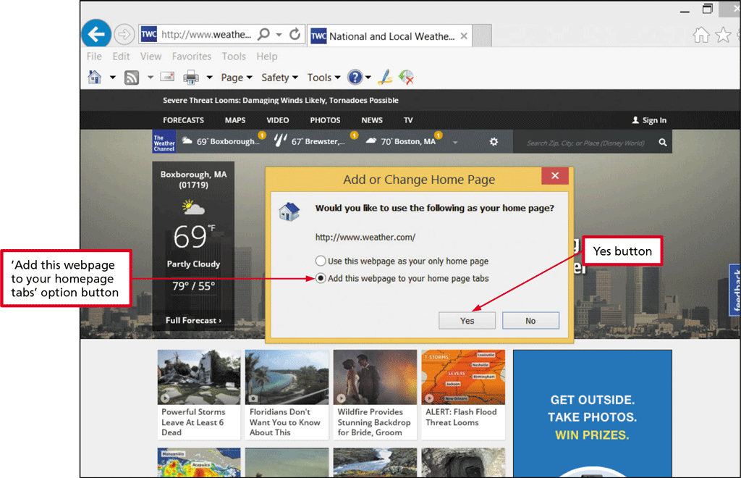
Adding a Browser Home Page
Tap or click the Yes button to add the webpage to your home page tabs

Slide 64
Changing Browser Options
Zooming a Webpage
Most browsers for laptops of desktops have a command on the right side of the status bar or address bar to change display options
On mobile devices that are touch-screen enabled, pinch or stretch the screen to adjust the zoom
Helpful for users with vision problems

Slide 65
Changing Browser Options

Slide 66
Changing Browser Options
Setting Other Browser Options
Changing browser’s home page(s)
Adding, deleting, organizing, and setting preferences for add-ons and plug-ins
Changing or restoring browser defaults
Managing browser history
Changing how webpage tabs appear
Modifying the settings for temporary Internet files (such as cookies
Establishing security and privacy controls
Deleting temporary Internet files
Changing settings that affect browser’s overall appearance

Slide 67
Using the Web: Risks and Safeguards
Protecting Your Computer from Hackers
A hacker is an individual who uses his or her technology skills to access a network and the computers on that network without authorization
A firewall is hardware and/or software that protects a computer or network from unauthorized access by hackers
Operating system might provide a firewall
Use password protection
Many routers and other network devices include firewalls

Slide 68
Using the Web: Risks and Safeguards

Slide 69
Using the Web: Risks and Safeguards
Virus Protection
A virus is a small, potentially damaging computer program or app
Most browsers include filters and virus detection
Can be spread to other computers through:
Sending/receiving e-mail message, text message, or file attachment
Downloading software and apps
Install virus protection software to protect against infection and update it automatically

Slide 70
Using the Web: Risks and Safeguards
Shopping Safely Online
Use reputable online vendors
Pay with a credit card over a secure connection
Never send your credit card number or other personal information as an email or text message
Filtering Web Content
Web is a largely unregulated and unprotected environment
Tracking Protection Lists (TPLs)
Use web content filters (Internet filters)

Slide 71
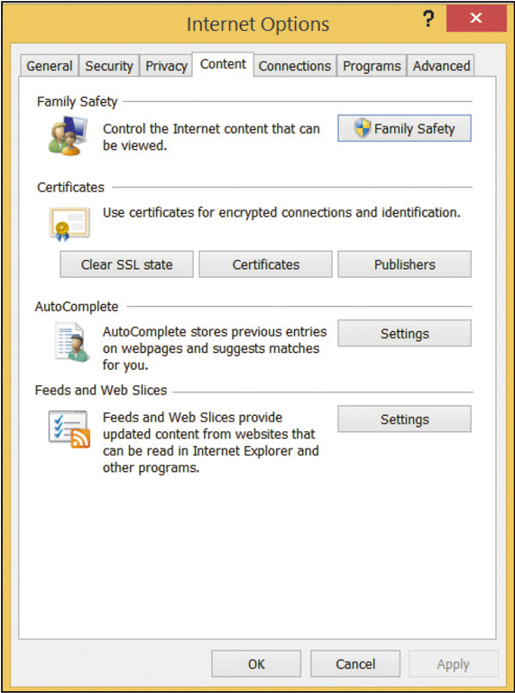
Using the Web: Risks and Safeguards

Slide 72
Using the Web: Risks and Safeguards
Protecting against Malicious Websites
A malicious website is a website designed to look like a legitimate site, but is owned by hackers or online thieves
Used by thieves to:
Collect personal information, such as name and password
Distribute malicious software
Most browsers have built-in filters for detecting malicious websites

Slide 73
Using the Web: Risks and Safeguards
Keeping Your Personal Information Private
Information privacy refers to the right of individuals and companies to deny or restrict the collection and use of personal information.
Entities that might be collecting and using your private information:
Employers
Internet Service Providers
Government agencies
Privacy Advocates

Slide 74
Using the Web: Risks and Safeguards
Keeping Your Personal Information Private (continued)
Privacy Advocates – dedicated to informing government agencies and consumers about privacy issues and maintaining information about privacy issues at their websites
Business websites
Cookies – Small text file stored on a computer of device
Spyware – technology that accesses your computer system to gather information without your knowledge and approval
Adware – form of spyware that gathers information then uses it to deliver targeted web advertising

Slide 75
Chapter Summary
Describe a website, common webpage characteristics, and web servers
Explain the role IP addresses, domain names, and URLs play in locating webpages
Connect to the Internet or a network
Start a browser and view webpages
Visit webpages using browser shortcuts

Slide 76
Chapter Summary
Save online information for later use
Change browser options
Discuss the risks and safeguards related to using the web

