Slide 2
Objectives
Describe and give examples of different types of portals and their target audiences
Identify and use online news, sports, weather, and traffic resources
Discuss streaming media, watch video clips, and listen to Internet radio
Use online research and reference tools
Explore health, entertainment, hobby, and other special-interest websites

Slide 3
Objectives
Use online tools for managing personal finances
Describe online educational resources
Describe the consumer marketplace and online auctions
Identify types of online games
Share files over the Internet

Slide 4
Portals
Consumer Portals
General consumer portals offer visitors a broad range of content
Search tools
Current news, weather, sports
Links to reference tools and shopping
Some offer email, file sharing, and social media
Personal portals (or horizontal portals)
Consumer portals that visitors can customize to meet specific needs
My Yahoo! and My MSN

Slide 5
Portals

Slide 6
Portals
Vertical, Hyperlocal, and Industry Portals
Vertical portals (vortals) provide a web gateway for visitors with more specific interests
USA.gov
SuzySaid
National Resource Directory
MSN Latino
Export.gov
Huffington Post
Hyperlocal portals are specific to a certain geographic location and provide content about that area, written for and by local citizens
Industry portals target viewers interested in a specific industry
Farms.com (agriculture industry)
Business.gov (small business)

Slide 7
Portals
Vertical, Hyperlocal, and Industry Portals (continued)
Industry portals target viewers interested in a specific industry
Farms.com (agribusiness)
Web Host Industry Review (web hosting industry)
MFG.com (manufacturing industry)
COMMREX (commercial real estate industry exchange)
Billboard (entertainment industry)
BusinessUSA (small business)

Slide 8
Exploring Portals
Run a browser and enter address in Address bar.
Press the enter key or tap or click the necessary button to open the webpage.
Scroll the webpage and review its content.
Tap or click the links of your choice to review at least two subsidiary pages at the website.

Slide 9
Portals
Developing Portals
Businesses create portals for a variety of reasons
Portal software enables
Customization
Controlled access
Multisystem integration
Goal of portal development is to create a single webpage or website that can present content from multiple sources and contributors in a uniform design

Slide 10
Developing Portals

Slide 11
Portals
Corporate Portals
A corporate portal, or enterprise information portal (EIP) provides access to a company's business information, work with others using email or other internal collaboration tools, or conduct business transactions
Most are private and password-protected

Slide 12
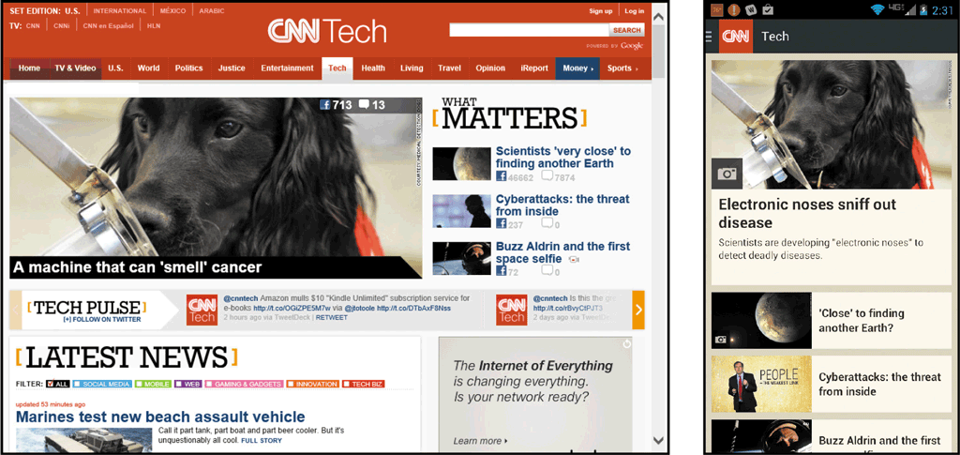
News, Sports, Weather, and Traffic Resources
Users supplement traditional print and broadcast news media sources with websites they access from computers and mobile devices

Slide 13
News, Sports, Weather, and Traffic Resources
Most major newspapers also publish online editions
Television and radio networks publish websites and provide apps
National Public Radio (NPR)
NBC
CBC
BBC
CNN
FOX News

Slide 14
News, Sports, Weather, and Traffic Resources
Sports
Kooora
ESPN
FOX Sports
Sports Illustrated
Weather
Arabia Weather
Weather Channel
AccuWeather.com
Traffic reports
Google Maps
NAVTEQ

Slide 15
News, Sports, Weather, and Traffic Resources
Characteristics of News-Oriented Websites
Availability – access from almost anywhere, at anytime
Authority – legitimate news websites follow practices to ensure integrity
Immediacy – breaking news, sports scores, or weather and traffic updates
Interactivity – interact with editorial staff and react or respond to articles
Customizability – each viewer can customize based on location and interests
Connectivity –users can share news and articles by posting or sending links using social media, text, or email

Slide 16
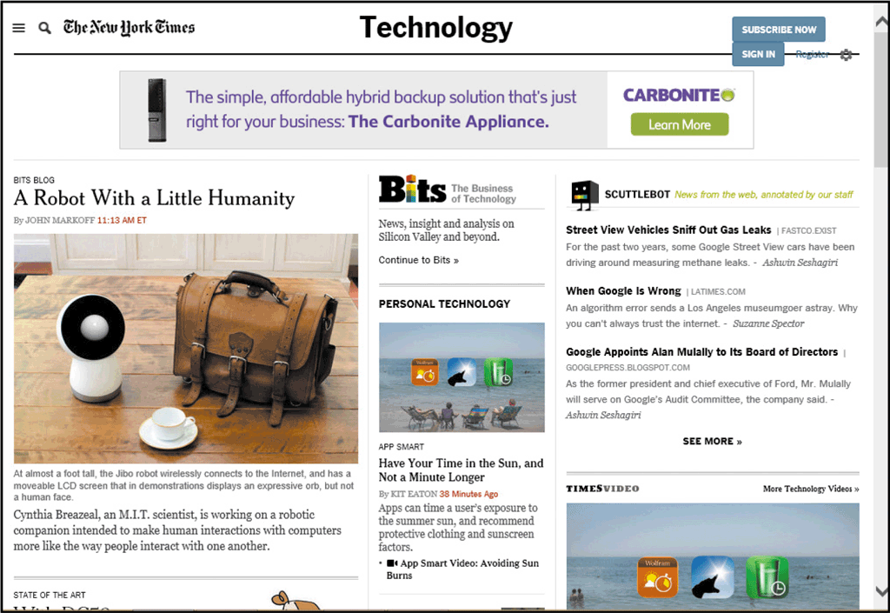
Exploring News and Traffic Websites
Start a browser and enter the web address in the Address bar.
Press the enter key or tap or click the necessary button to display the webpage.
Scroll the webpage to review its contents and links.

Slide 17
News, Sports, Weather, and Traffic Resources
Streaming Media
Streaming media is audio and video that you can view in a browser without downloading
Advantage of streaming media is that you do not use storage space to store the media
Computer or device must have a sound card, speakers, and a media player

Slide 18
Research and Reference Tools
Numerous websites that provide access to specialized information collections
Online encyclopedias
Dictionaries
Reference desks
Trip planners

Slide 19
Research and Reference Tools

Slide 20
Exploring an Online Encyclopedia
Start a browser and enter the web address in the Address bar
Press the enter key or tap or click the necessary button to open the home page
Enter search text in the Search box and then tap or click Search button to find links
Scroll through search results to see suggested links

Slide 21
Research and Reference Tools

Slide 22
Research and Reference Tools
Online Dictionaries
Merriam-Webster Online
OneLook Dictionary Search
Cambridge Dictionaries Online
Thesaurus.com
NetLingo
Law.com

Slide 23
Research and Reference Tools

Slide 24
Research and Reference Tools
Online Reference Desks
An online reference desk is a collection of links to online sources
Internet Public Library
refdesk.com
LibrarySpot.com
iTools

Slide 25
Research and Reference Tools
User-Generated Content
User-generated research tools can use GPS or a user-entered ZIP code to access user reviews and ratings of restaurants and other services
Yelp
OpenTable
Urbanspoon

Slide 26
Research and Reference Tools
Online Route Planners
FreeTrip
MapQuest
Google Maps
Yahoo! Maps
Expedia Maps

Slide 27
Personal Finance Resources
Banking, Bill Presentment, and Bill Payment Services
Complete traditional paper-based banking activities online quickly and easily
Check your bank balance or view paid items
Brick-and-mortar businesses are physical locations
Brick-and-click businesses allow customers to conduct business or complete transactions at a physical location as well as online

Slide 28
Personal Finance Resources
Banking, Bill Presentment, and Bill Payment Services (continued)
Online banking allows you to:
View real-time account balances and recent transactions
View a history of account activity
Deposit checks
Search for individual transactions
Pay your bills
Transfer funds between accounts
Download transactions into personal financial management software, such as Quicken
Issue a stop payment on a check
Order checks
Report a lost or stolen ATM card and request a replacement
Change personal information, such as your address, telephone number, and e-mail address

Slide 29
Personal Finance Resources
Banking, Bill Presentment, and Bill Payment Services (continued)
A bill payment service allows you to log on to a website and pay your bills
More and more companies use bill presentment, the process of sending bills (e-bills) electronically, instead of mailing statements
E-bills can reduce a company’s billing costs
E-bills are more environmentally friendly

Slide 30
Personal Finance Resources
Banking, Bill Presentment, and Bill Payment Services (continued)
Some companies allow their customers to log on to the company’s website and pay their bills electronically
Utilities
Credit card companies
Third-party payment service, such as PayPal

Slide 31
Personal Finance Resources
Financial Calculators, Insurance, and Credit Sites
Use online financial calculators to estimate loan or mortgage payments, plan for a major purchase, or plan for retirement
Conveniently shop online for competing insurance rates
Learn more about how to effectively handle credit and shop for the best credit card offers online

Slide 32
Personal Finance Resources

Slide 33
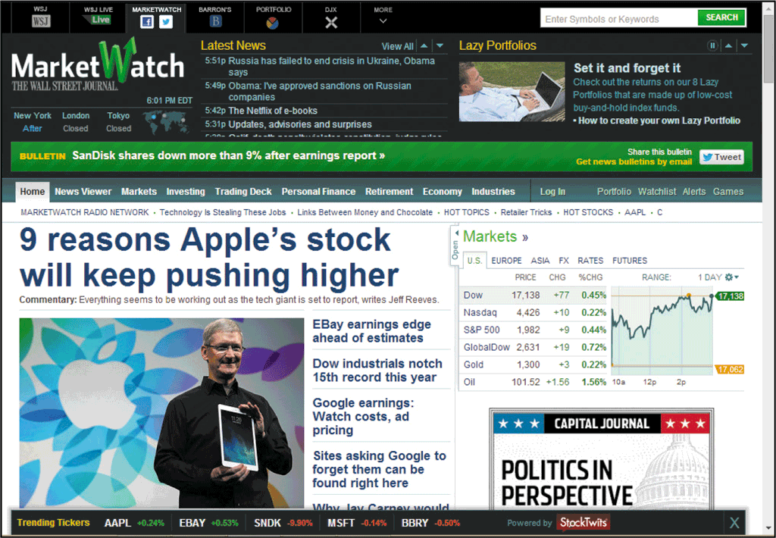
Personal Finance Resources
Investing Online
The availability of quick access to online investment information and the proliferation of investment-oriented websites empower people to handle or receive advice on their own stock portfolios and other investments
MarketWatch
Hoover's
CNNMoney
Morningstar
MSN Money
The Motley Fool
Online brokers

Slide 34
Special Interest Websites
Health, Diet, and Fitness Information
Restricted-calorie meal plans
Grocery shopping lists
Exercise plans, complete with text and graphic instructions
Daily food and exercise diaries
Databases of food items with nutrition information used to select foods for daily food consumption diaries
Support discussion groups

Slide 35
Special Interest Websites

Slide 36
Entertainment, Hobby, and Other Special-Interest Sites
Learn to make gazpacho at VegWeb.com
Exchange family history with distant cousins at FamilySearch.org
Review résumé writing tips and post your résumé at Monster.com
Check out colleges, universities, graduate schools, and financial aid choices at Peterson’s
Enjoy movie reviews at Rotten Tomatoes
Discover the beauty of Native American art by touring online exhibits at the National Museum of the American Indian

Slide 37
Entertainment, Hobby, and Other Special-Interest Sites
Food and Cooking
Emeril’s
Epicurious
Vegetarian Times

Slide 38
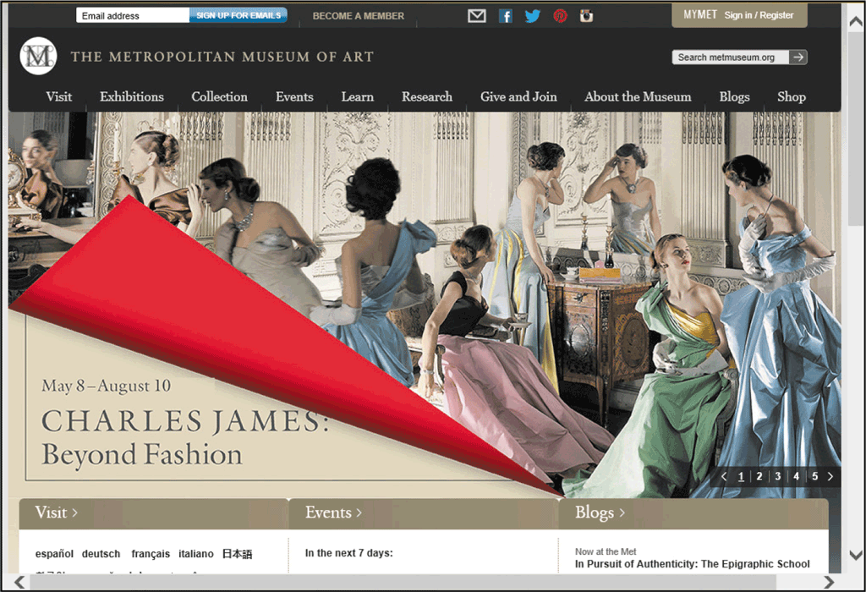
Entertainment, Hobby, and Other Special-Interest Sites
Museums
American Museum of Natural History National Library of Australia
Colonial Williamsburg Museum
African American Museum

Slide 39
Entertainment, Hobby, and Other Special-Interest Sites
Genealogy

Slide 40
Entertainment, Hobby, and Other Special-Interest Sites
Seniors

Slide 41
Entertainment, Hobby, and Other Special-Interest Sites
Parents and Families

Slide 42
Education Tools
Web-based learning (online learning or distance learning) is the delivery of educational material over the Internet to users
K-12 schools
Adult continuing education at colleges and universities
Employee training
Personal enrichment

Slide 43
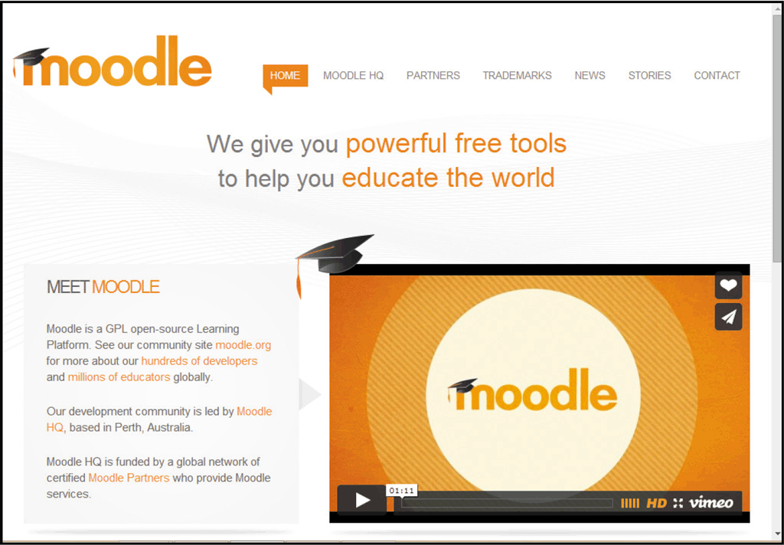
Education Tools
K-12 and University Students
Enhances curriculum for rural schools
Enables students to control timing, location, and learning pace
Offers additional opportunities for working adults who cannot always attend traditional classes

Slide 44
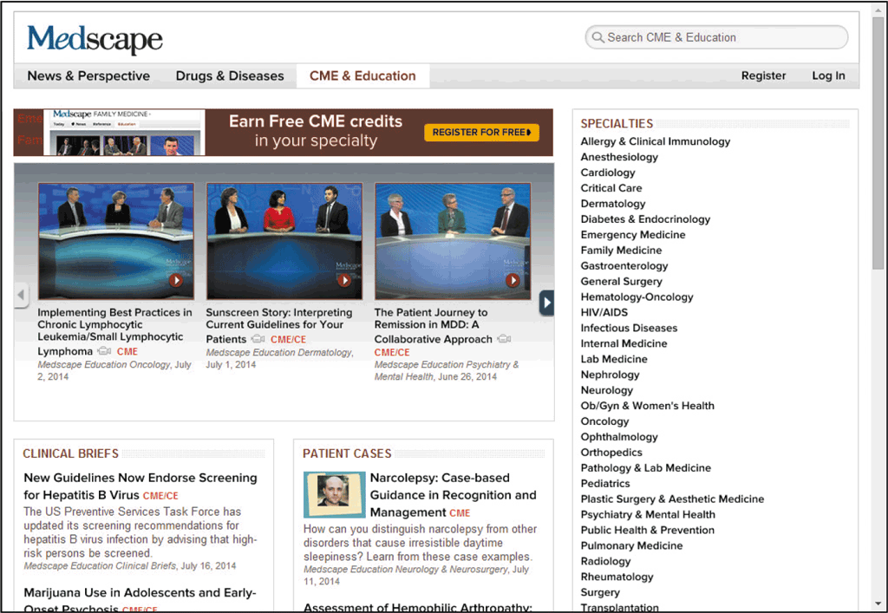
Education Tools
Online Employee Training and Professional Development
Provides an economical way to train employees
Allows busy professionals to fulfill their professional education requirements
IT professionals can use online content to prepare for certifications

Slide 45
Education Tools
Adult Continuing Education Websites
Provide learning opportunities for personal growth, lifestyle enrichment, and professional advancement opportunities
Many colleges and universities offer a variety of credit and noncredit courses online
Fees range from free to around $100
Massive open online courses (MOOCs) are offered for free online, but do not count for educational credit

Slide 46
Education Tools

Slide 47
Shopping Websites
You can purchase, sell, auction, and bid on almost any type of item or service online
Benefits for online stores include:
Not renting a storefront
Not creating in-store displays
Not having to decide what hours to run the business
Shoppers can compare products and prices online without visiting one or more stores

Slide 48
Shopping Websites
The Online Consumer Marketspace
The term marketspace distinguishes the virtual location where e-business is conducted from the physical marketplaces in which business takes place
Online retailers may offer discounts, free shipping, and other incentives
Consumers can compare features and prices online, then buy from a brick-and-mortar location

Slide 49
Shopping Sites
The Online Consumer Marketspace (continued)
At auction websites, sellers can set a reserve price, which is the lowest price at which a seller will sell an item
The amount you are willing to pay is a bid
Advantages of buying items at online auction are the variety of items and the opportunity to get products at lower prices

Slide 50
Shopping Sites

Slide 51
Online Gaming Websites
Attract a wide group of participants around the world
Sites that offer games include Yahoo! Games, MSN Games, PBSKids, and webkinz
Massively multiplayer online games (MMOGs) have thousands of players around the world who assume personas and play
In a virtual world, players assume a persona that lives in an alternate virtual existence

Slide 52
Download and File-Sharing Sites
Downloading paid content, such as music files, software, stock photos, and so forth, is one of the most popular Internet activities
Freeware and shareware, including games or utilities, can be downloaded from a number of websites
Transferring files between Internet-connected computers is widely used and convenient activity

Slide 53
Download and File-Sharing Sites

Slide 54
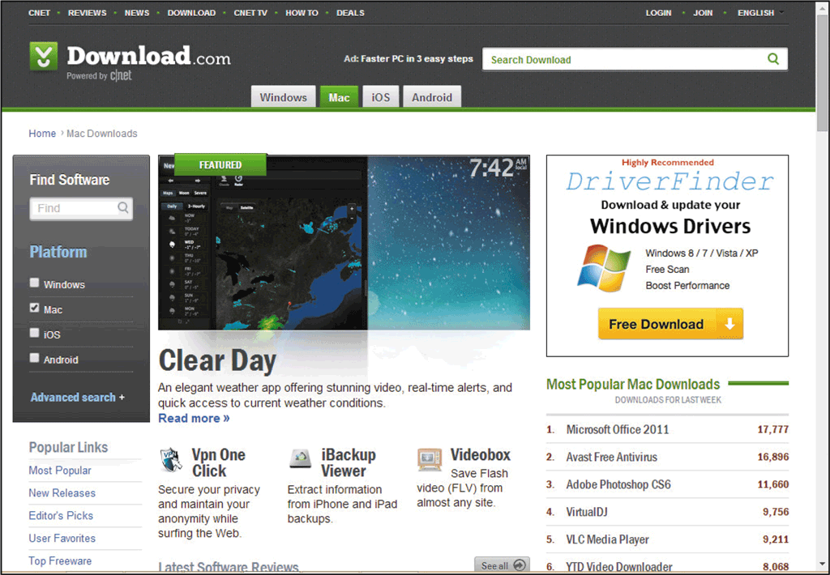
Download and File-Sharing Sites
Download Websites
Freeware is software that the author allows you to download and use without charge, but requires that you follow copyright laws and restrictions
Shareware is software that you can download and try out but are expected to pay for if you decide to use on a permanent basis

Slide 55
Download and File-Sharing Sites
File Transfer Protocol (FTP)
Users can download and upload files located on a remote computer, called an FTP website
Anonymous FTP websites are public FTP websites that do not require a unique username
Private FTP sites restrict access by requiring a unique username and password
Files can be downloaded or uploaded using an FTP client program, a browser, or your file management program

Slide 56
Download and File-Sharing Sites

Slide 57
Download and File-Sharing Sites
P2P File-Sharing Networks
A peer-to-peer (P2P) file-sharing network allows files to be transferred between individual personal computers located on the same local area network or between individual computers connected to the Internet
Music and movie industries are working to stop piracy of copyrighted material over P2P file-sharing networks
P2P sharing of copyrighted material accounts for job loss and revenue; also, potential litigation
Commercial applications of P2P file-sharing include sharing product information and training materials

Slide 58
Chapter Summary
Describe and give examples of different types of portals and their target audiences
Identify and use online news, weather, and traffic resources
Discuss streaming media, watch video clips, and listen to Internet radio
Utilize online research and reference tools
Explore health, entertainment, hobby, and other special-interest websites

Slide 59
Chapter Summary
Use online tools for managing personal finances
Describe online educational resources
Describe the consumer marketplace and online auctions
Identify types of online games
Share files over the Internet

