Slide 2
Objectives
Discuss basic networking technologies
Describe the infrastructure of the Internet, including network service providers, the TCP/IP stack, IP addresses, and the Domain Name System (DNS)
Discuss GPS and identify wireless location-based services

Slide 3
Objectives
Explain the convergence of the Internet with telephony and conferencing
Discuss internal and external network security threats, transactional risks, and virtual private networks

Slide 4
Networking Basics
A network connects two or more computers, printers, or other devices together with cables or wireless media allowing users to share
Data
Peripheral devices
Software and apps
Other network resources (such as an Internet connection)

Slide 5
Networking Basics
Local, Metropolitan, and Wide Area Networks
Modern networks can be categorized by the physical area they cover
Local area network (LAN) - home, office, building, or several buildings
Metropolitan area network (MAN) – region
Wide area network (WAN) - across the country or around the world
Local Area Networks
Local area networks are configured in one of two basic structures
Peer-to-peer
Client/server

Slide 6
Networking Basics
Local Area Networks (continued)
Peer-to-peer LAN
10 or fewer personal computers connected
One or more of the computers may also have a printer, scanner, or external storage device
Each node must have built-in networking capabilities or a network interface card (NIC)
Each node may be connected to a single cable or may be connected at a common connection point using a hub
Users can access files stored on any computer and any peripheral device connected to a computer on the network
Simple to configure and inexpensive to use

Slide 7
Networking Basics

Slide 8
Networking Basics
Local Area Networks (continued)
Client/server network consists of multiple personal computers and devices or workstations (clients), one or more servers, and other devices such as printers
Uses a network operating system to manage data, printer access, communications, Internet connections, security, and network administration
Examples include Microsoft Windows Server, OS X Server, Novell NetWare, Cisco IOS, UNIX, and Linux

Slide 9
Networking Basics
Local Area Networks (continued)
Advantages over a peer-to-peer network
Supports shared data storage
Provides network maintenance tools
Promotes more efficient data backups
Disadvantages compared to a peer-to-peer network
More expensive
More difficult to configure
Requires more technical expertise to manage

Slide 10
Networking Basics

Slide 11
Networking Basics
Metropolitan Area Networks (MANs)
Connects clients and servers in a region that is larger than a single office or building
Multiple buildings across a city or multiple educational, research, or government facilities across a state
Generally are owned by a consortium of users of a single network provider that sells high-speed network services to multiple users

Slide 12
Networking Basics
Wide Area Networks (WANs)
Cover a very wide geographical area
Can be a single network or multiple connected LANs located across the country or around the world
Most WANs are private, corporately owned networks
The Internet is the world’s largest public WAN

Slide 13
Networking Basics
Network Topologies, Access Methods, and Transmission Media
Physical topology is the arrangement of a network’s computers, printers
Access method is how data is transmitted from node to node across the network
Transmission media – are the physical or wireless communication media used to carry transmissions
These three characteristics define the throughput, which is the amount of data that can travel node to node in a specified amount of time

Slide 14
Networking Basics
Network Topologies, Access Methods, and Transmission Media (continued)
Three basic LAN physical topologies
Bus
Ring
Star
Today, many LANs use a hybrid physical topology that combines some elements of these three topologies

Slide 15
Networking Basics
Network Topologies, Access Methods, and Transmission Media (continued)
Access Methods
Sometimes called logical topology
Ethernet – a node attempting to transmit data first must determine whether or not another node is sending a transmission
Token ring – passes tokens, small packets of data, clockwise in a circle from node to node
Transmission Media
Cellular transmissions travel wirelessly over land cells using transceivers, or cell sites; cellular networks can transfer voice and data over a large, almost limitless area

Slide 16
Networking Basics

Slide 17
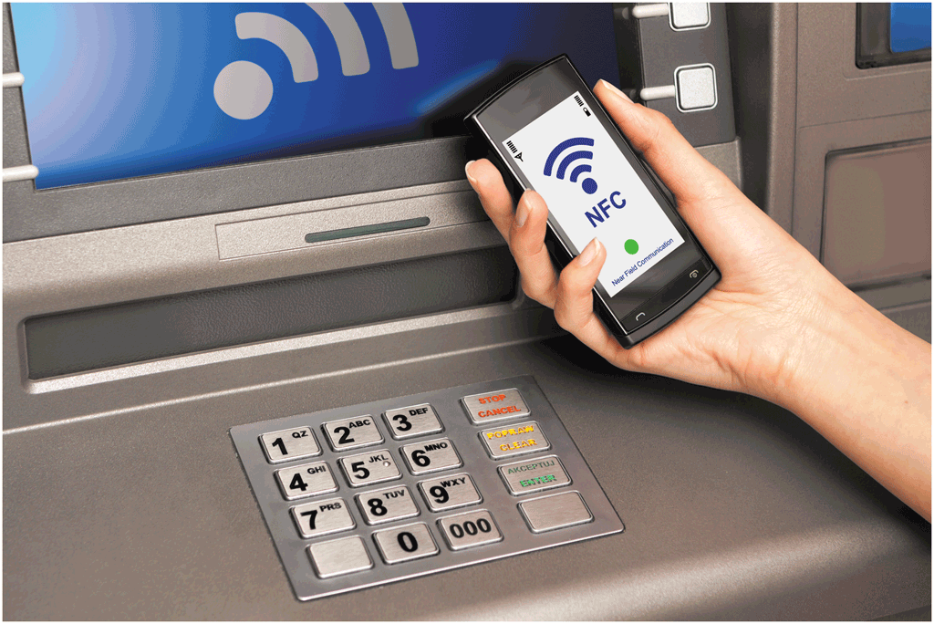
Networking Basics
Network Topologies, Access Methods, and Transmission Media (continued)
Transmission Media (continued)
Infrared (IR) transmissions use infrared light-wave signals as short range transmission medium; require line-of-sight transmissions
Near field communication (NFC) transmissions use radio waves to connect devices that are touching or nearby (generally within 10 centimeters)

Slide 18
Networking Basics
Network Topologies, Access Methods, and Transmission Media (continued)
Transmission Media (continued)
Radio frequency (RF) transmissions use broadcast radio waves to transmit data over short distances; some wireless devices use transceiver, a single component and receives transmissions
Bluetooth is a short-range RF technology
Designed for wireless personal area networks (WPANs), which have a range of approximately 33 feet (10 meters)
To enable two Bluetooth devices to work together, pair them

Slide 19
Networking Basics
Network Topologies, Access Methods, and Transmission Media (continued)
Transmission Media (continued)
A Wi-Fi network, or wireless LAN (WLAN) uses a wireless medium — such as radio frequency transmissions — to connect computers and mobile devices, printers, and other devices
Physical transmission media
Coaxial cable (pronounced KO-ax); although was the choice for many early networks, not used in most modern networks because it does not transmit data as fast as other media
Twisted-pair cable commonly used as a LAN transmission medium
Fiber-optic cable commonly used as a MAN or WAN transmission medium

Slide 20
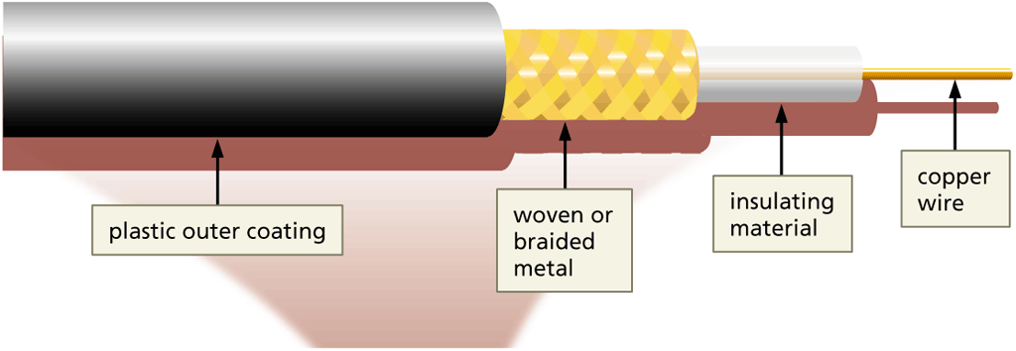
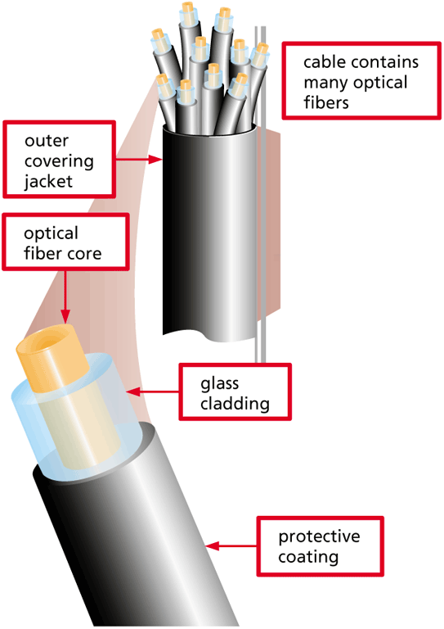
Networking Basics

Slide 21
Networking Basics
Connectivity Hardware and Software
Hardware connectivity devices connect nodes on the same network, connect nodes across multiple networks, and forward packets between nodes
Segments are multiple groups of computers or devices that share a common function
Hubs
Hub – inexpensive hardware device used to connect multiple nodes on the same network
Passive hub – cannot determine how to direct a packet; simply sends same signal to all its connected nodes or segments
Intelligent hub – can perform tasks, such as filtering data or permitting a network administrator to monitor hub traffic

Slide 22
Networking Basics
Connectivity Hardware and Software (continued)
Bridges
Bridge – intelligent connectivity device with one input port and one output port that connects two segments on the same LAN or two separate LANs
Each node on the network has a MAC (Media Access Control Address)
Bridge creates a database of all the MAC addresses for nodes on its segment or LAN
Data Switches
Data switch – intelligent device that also interprets MAC addresses and filters and forwards data packets to network segments
Can be a less-expensive choice than a bridge for networks with a large number of nodes

Slide 23
Networking Basics
Connectivity Hardware and Software (continued)
Routers
Router is an intelligent device with multiple ports; a specialized computers that connect LAN segments, two LANs, or multiple LANs on a WAN
Determines the best route for packets
Fall into three categories: wireless, mobile, or broadband
Use static routing or dynamic routing
Internet routers are complex, fast, expensive devices that send packets from one router to another in a series of hops until they reach their destination network
Use the tracert utility to trace router hops

Slide 24
Using the Tracert Utility to Trace Hops
Press and hold or right-click the Start button on the Windows taskbar.
Tap or click the Run menu command to open the Run dialog box.
Enter cmd in the Open text box in the Run window.
Tap or click the Open button, or press the ENTER key to open the Command Prompt window.
Enter tracert www.cengage.com at the command-line prompt to trace the number of hops between your computer and the destination computer.
Press the ENTER key to view the path from your computer to the Cengage destination server as packets are sent from router to router over the Internet.

Slide 25
Using the Tracert Utility to Trace Hops

Slide 26
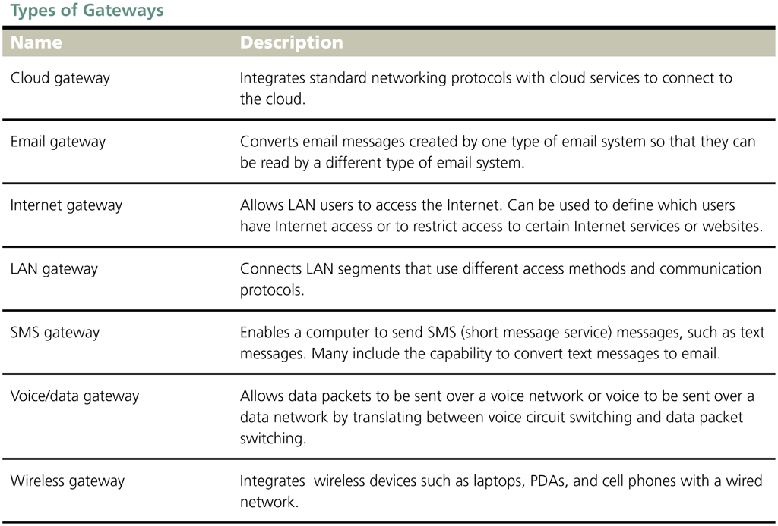
Networking Basics
Connectivity Hardware and Software (continued)
Gateways
A gateway is a hardware or software that runs on a mainframe computer, server, individual workstation or router; connects two or more networks or network segments that use different packet formatting, different communication protocols, and different access methods

Slide 27
Internet Infrastructure
Network Service Providers
Network service providers (NSPs) provide the public and private network infrastructure for the Internet that enables wireless, cellular, and other capabilities
AT&T, Sprint, Verizon, T-Mobile, and others
An Internet exchange point (IXP) is a physical infrastructure that enables ISPs to communicate among their networks, which limits the upstream traffic an ISP must handle
Metropolitan Area Exchange (MAE) – a specific type of high-speed Ethernet connection within a metropolitan area
Peering is the exchange of Internet traffic and router information between NSPs and ISPs at an exchange point

Slide 28
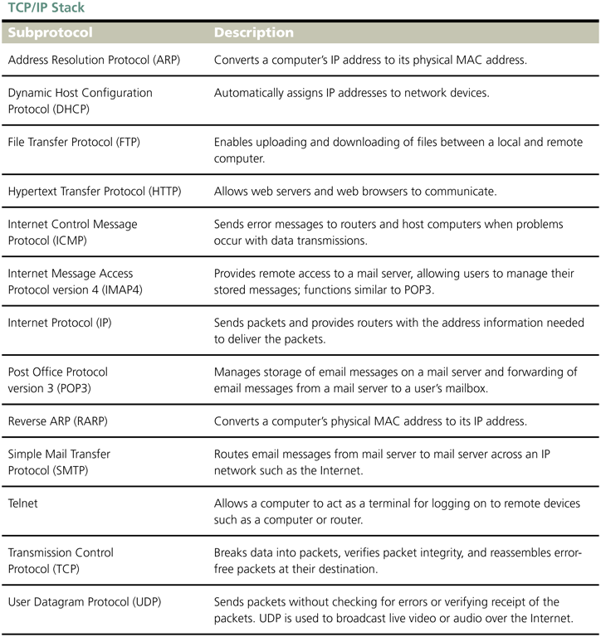
Internet Infrastructure
TCP/IP Stack
TCP/IP stack –set of standard Internet protocols on which communications across the Internet and many private networks rely
TCP, IP, and UDP are core subprotocols required for all TCP/IP transmissions
IP network is another name for a network running TCP/IP

Slide 29
Internet Infrastructure
IP Addresses
In addition to a MAC address, each node on an IP network has a logical address, called an IP address
IP address is the unique address of each node on a network
The current IP standard, IPv6, lengthens IP addresses from 32 bits to 128 bits
Contains eight 8-bit numbers, each of which is called an octet

Slide 30
Internet Infrastructure

Slide 31
Internet Infrastructure
IP Addresses (continued)
Classful routing system used originally
Classless routing system, called Classless Inter-Domain Routing (CIDR) allows network administrators to expand the number of network nodes assigned to an IP address
Used extensively on the Internet
Used in large private networks

Slide 32
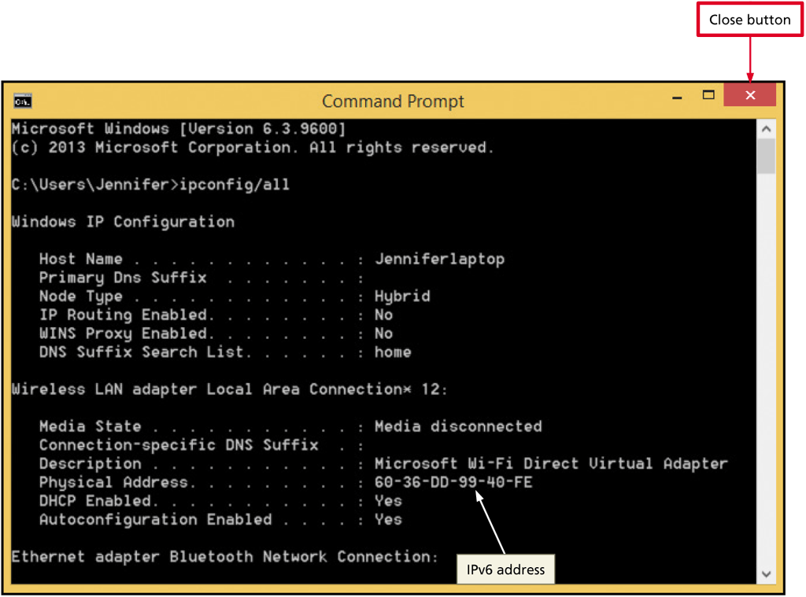
Viewing a Networked Computer’s IP Address
Open the Command Prompt window.
Enter ipconfig /all at the command-line prompt to instruct the operating system to display all IP information about your networked computer.
Press the ENTER key to display your computer’s host name, IP address, and other IP information.

Slide 33
Internet Infrastructure
Domain Name System (DNS)
The DNS is a hierarchy of servers used to translate domain names into IP addresses in a process called resolving the domain name
Twelve different organizations, such as VeriSign, NASA, the University of Maryland, and the University of Southern California, operate the root name servers

Slide 34
Internet Infrastructure
Domain Name System (DNS) (continued)
Authoritative servers contain IP information for the TLD and ccTLD domains and their registrants
Caching servers operated by ISPs and company IT departments contain stored domain name and IP address information
DNS namespace consists of all information in the DNS databases
Process of resolving a domain name begins with local caching server

Slide 35
Internet Infrastructure

Slide 36
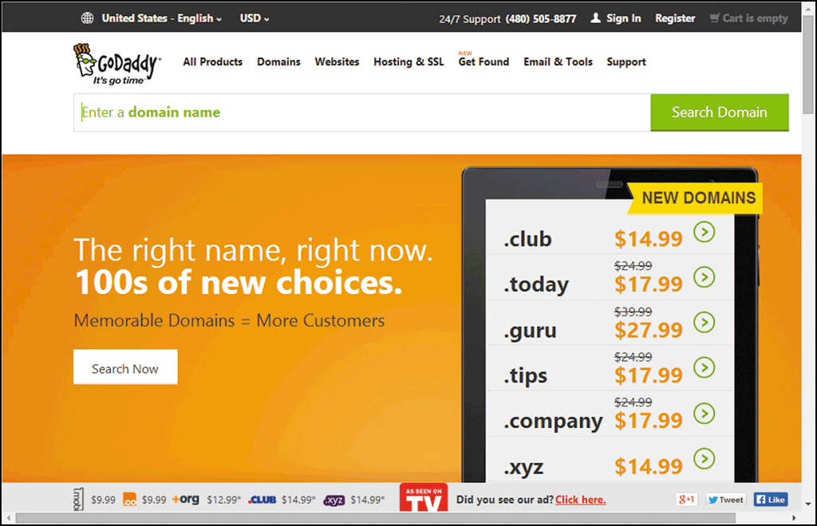
Internet Infrastructure
Domain Name System (DNS) (continued)
Shared Registration System (SRS) is registration system that allows private companies, called accredited registrars, to handle registration of domain names

Slide 37
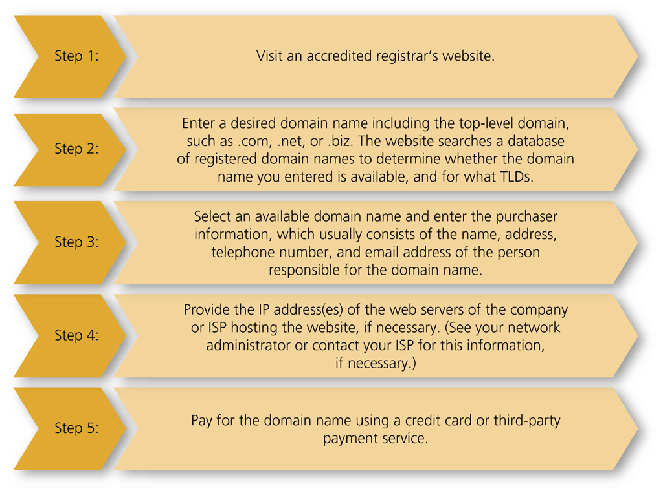
Internet Infrastructure
Domain Name System (DNS) (continued)
Process of registering domain name varies by registrar
If chosen name is taken, reconsider website name

Slide 38
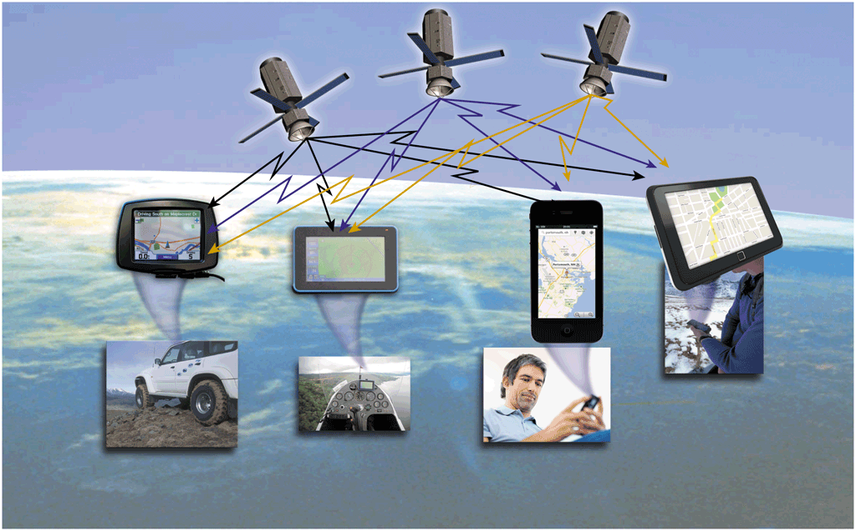
Location-Based Services and GPS
Location-based service (LBS) is a wireless service offered to customers based on their physical location
Example: E9-1-1
Global Positioning System (GPS) satellite network and receivers mounted in automobiles or placed in mobile phones, watches, tablets, or other handheld devices
32 satellites
11,000 miles above earth

Slide 39
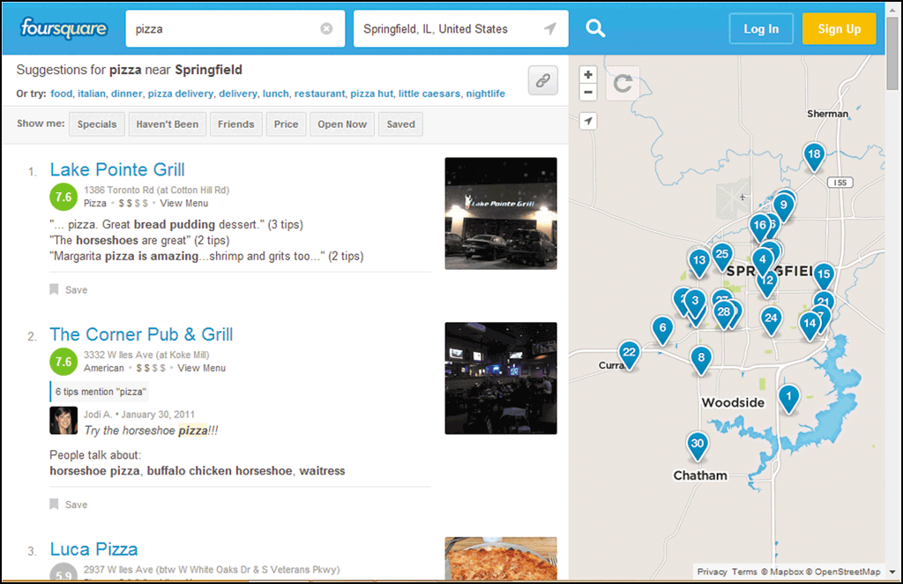
Location-Based Services and GPS
Geosocial networking is a term used to describe the combination of LBS with social networking providers

Slide 40
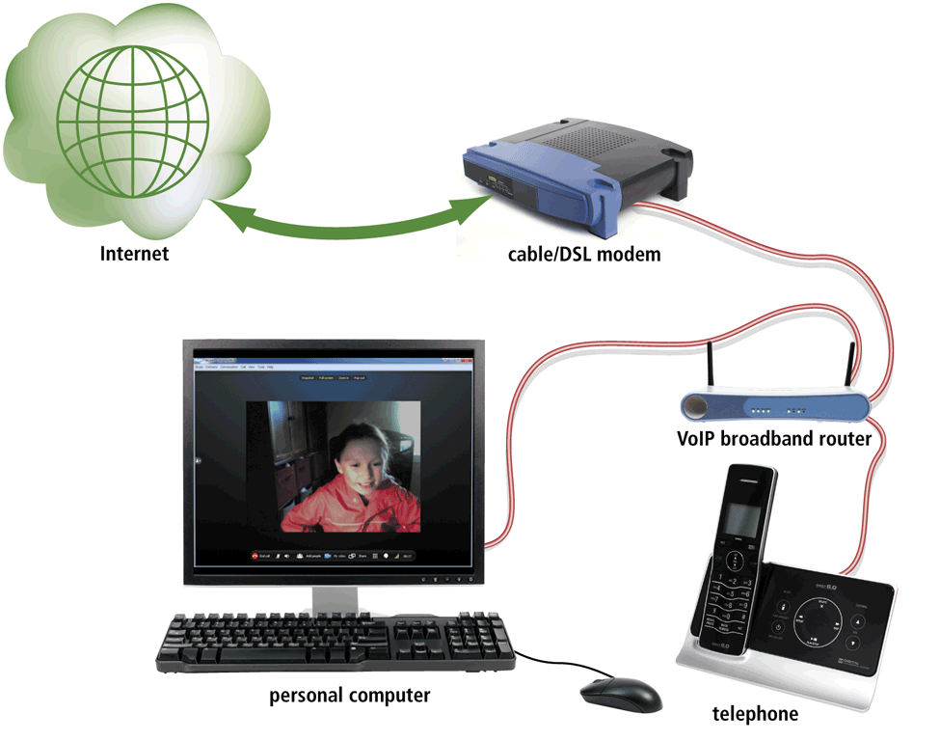
Internet Telephony and Web Conferencing
Internet Telephony
IP telephony or Voice over IP (VoIP)
Uses TCP/IP and packet switching to send voice transmissions over private or public IP network
VoIP providers, such as Vonage, offer telephone services to homes and businesses over broadband Internet connections.
Computer to computer calling using special software, such as Skype

Slide 41
Internet Telephony and Web Conferencing
Virtual Meetings, Conversations, and Web Conferencing
A virtual meeting allows collaboration between participants, such as a group of employees, by allowing invitees to log on to their network and sign in to a meeting in which they communicate with each other as well as view, share, and work collaboratively on files
Video conferencing, an expanded virtual meeting that sometimes includes hundreds or thousands of participants, involves real-time transmission of video and audio between two locations

Slide 42
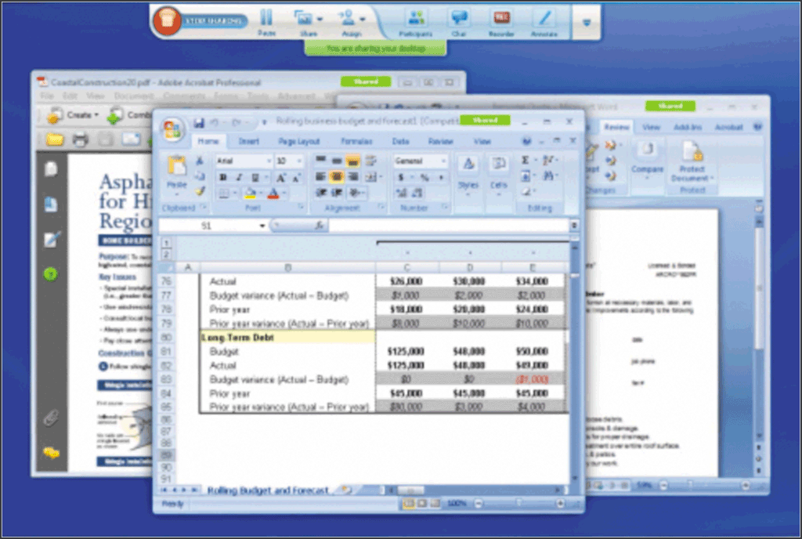
Internet Telephony and Web Conferencing
Virtual Meetings, Conversations, and Web Conferencing
A virtual conversation is a video chat using services such as Google Hangouts or FaceTime
Web conferencing is a virtual meeting conducted using a browser and the web

Slide 43
Network Security Issues and Technologies
Internal Network Security Threats
Security Policies and Procedures
Authorized Network Access
User ID and passwords (something you remember)

Slide 44
Network Security Issues and Technologies
Internal Network Security Threats (continued)
Biometrics – using devices to measure biological data to identify a user (something you are)
Smart card – plastic card the size of a credit card that contains memory chips that can store special access codes or biometric information (something you have)
Wireless Network Security
LAN jacking or war driving
Spoofing
Rogue WLAN
Data Storage, Backup, and Restore
Cloud storage

Slide 45
Network Security Issues and Technologies
Internal Network Security Threats (continued)
Disaster Recovery Planning
Techniques to protect against accidental or deliberate physical damage to network equipment and data
Disaster recovery plan covers how an organization deals with a natural or man-made disaster to ensure the organization’s viability
External Network Security Threats
Unauthorized Network Access
Distributed denial of service (DDoS) attacks
Hackers may break into network to steal account information, such as credit card numbers, user passwords, and other personal information to steal a person’s identity, make unauthorized credit card purchases, or open accounts in a user’s name for illegal purposes

Slide 46
Network Security Issues and Technologies
External Network Security Threats (continued)
Computer Viruses
Worm
Trojan horse
Protect again viruses with virus protection apps
Symantec
McAfee
Swipe codes

Slide 47
Reviewing Current Virus, Worm, and Trojan Horse Threats
Enter symantec.com in browser’s Address bar and then press the ENTER key or tap or click the appropriate button to open the Symantec webpage.
Tap or click the Security Response link to open the webpage.
Tap or click the Threats tab.

Slide 48
Network Security Issues and Technologies
External Network Security Threats (continued)
Web Page Hacking
Hijacking occurs when hackers redirect a URL to an alternate website
Web Application Security Consortium and its sponsored Web Hacking Incidents Database is a good learning resource

Slide 49
Network Security Issues and Technologies
External Network Security Threats (continued)
Firewalls and Proxy Servers
Network firewall is a combination of hardware and software that filters traffic between private networks or between a private network and a public network, such as the Internet
Proxy server is a computer or application that hides an internal IP address from the outside world by substituting its own IP address for a source computer’s IP address before sending outgoing email or webpage requests

Slide 50
Network Security Issues and Technologies

Slide 51
Network Security Issues and Technologies
External Network Security Threats (continued)
Internet Filtering Software
WebSpy
Websense
Security Audits
Network security audit – reviews overall security policies, employee security policy and procedure training, data backup and restore policies and procedures, and the physical security of network equipment and data
Penetration testing – security audit personnel try to hack into network

Slide 52
Network Security Issues and Technologies
Transactional Risks
Authentication, integrity, nonrepudiation, confidentiality
Encryption – translating readable data into unreadable data to prevent unauthorized access or use
Certificate authority (CA) creates encryption keys (public and private) for a fee
Public key encrypts data and is posted by CA to publicly accessible directory
Private key is known only to organization and is used to decrypt incoming data

Slide 53
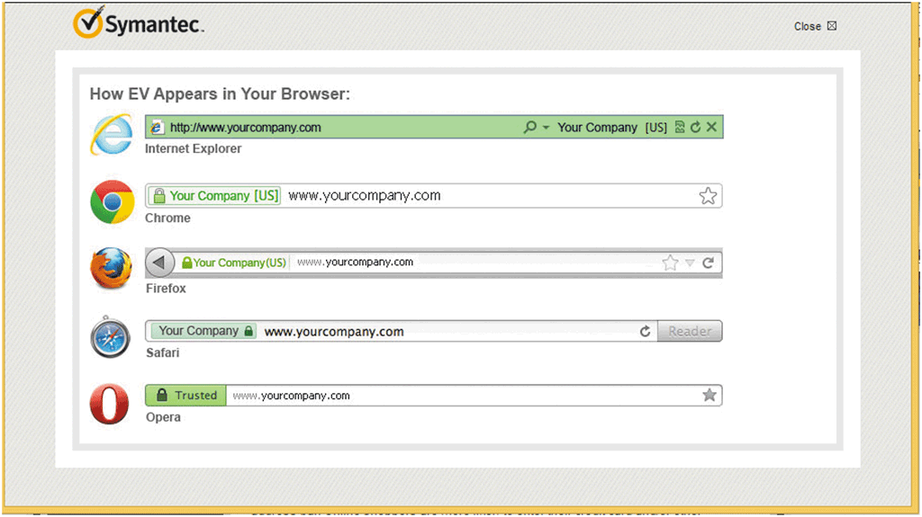
Network Security Issues and Technologies
Transactional Risks (continued)
Digital certificate electronically authenticates organization’s or individual’s identity

Slide 54
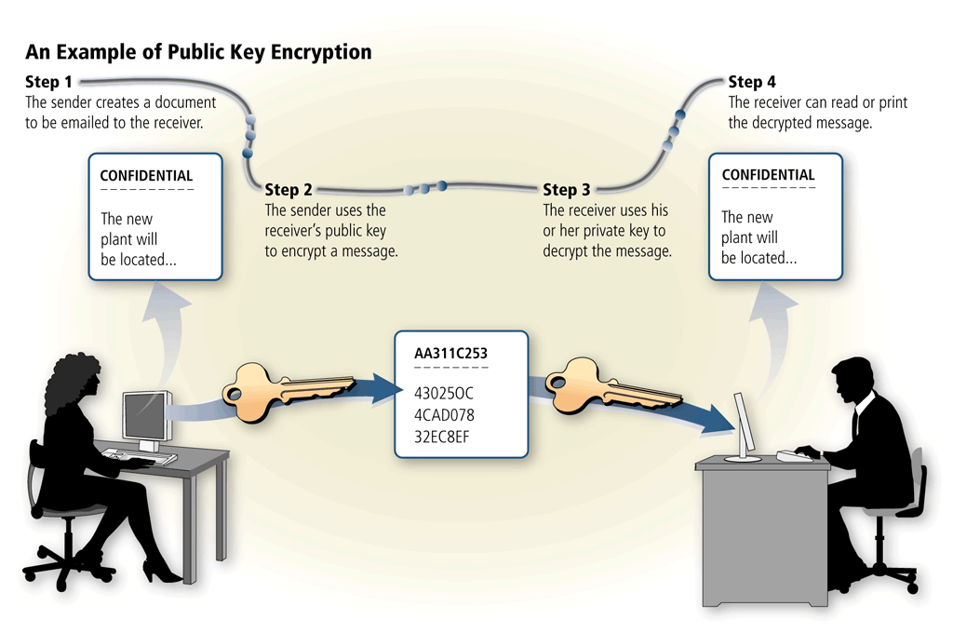
Network Security Issues and Technologies
Transactional Risks (continued)
Public key infrastructure is combination of organizations or individuals sending and receiving encrypted data, their public and private keys, and the CAs that issue the keys and digital certificates.

Slide 55
Virtual Private Networks
A virtual private network uses a large public IP network, such as the Internet, to transmit its data
Tunneling is a process that encapsulates one protocol inside another protocol
At destination network, the IP protocol information is removed and the tunneling protocol transmits the data to its final destination computer
VPNs also use public and private key encryption, digital certificates and special security protocols

Slide 56
Summary
Discuss basic networking technologies
Describe the infrastructure of the Internet, including network service providers, the TCP/IP stack, IP addresses, and the Domain Name System (DNS)
Discuss GPS and identify wireless location-based services

Slide 57
Summary
Explain the convergence of the Internet with telephony and conferencing
Discuss internal and external network security threats, transactional risks, and virtual private networks

