Slide 2
Websites, Webpages, and Web Servers
Websites
Number of pages varies depending on site’s purpose and type of content and services it provides
Home page is the primary webpage at a website
A web portal, or simply a portal, is a special type of website that offers access to a vast range of content and services

Slide 3
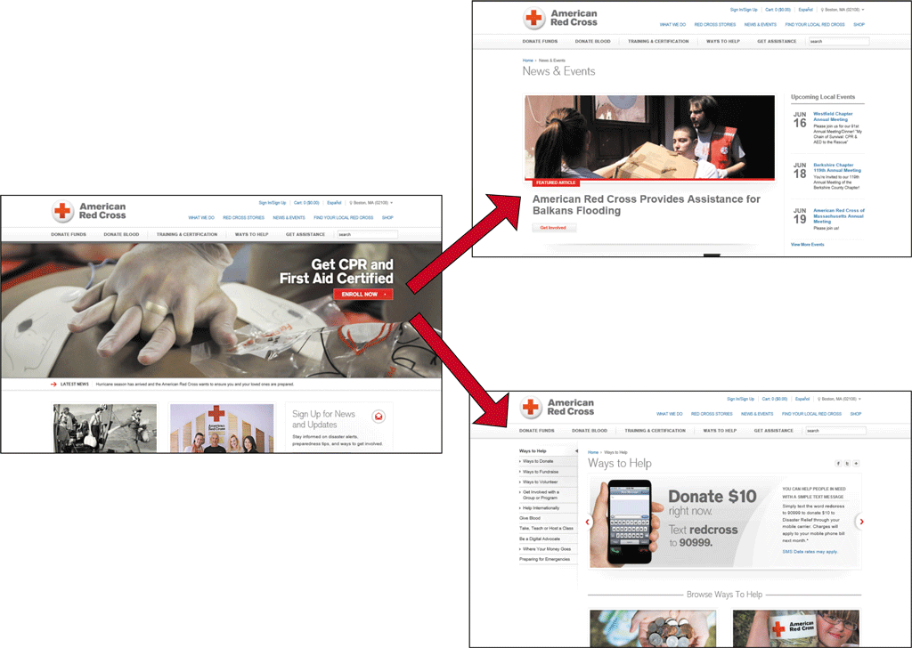
Websites, Webpages, and Web Servers

Slide 4
Websites, Webpages, and Web Servers
Webpages
Designed to attract visitors and hold their attention
Common characteristics
Logo and/or name
Images and media
Links
Advertisements
Search tool
Connectivity links or icons
Copyright statement
Link to a privacy and security policy statement

Slide 5
Websites, Webpages, and Web Servers

Slide 6
Websites, Webpages, and Web Servers
Web Servers
Browser is a client that requests services from a web server
Server “serves up” or provides the requested resources or services
Web browsing is example of client/server computing

Slide 7
Websites, Webpages, and Web Servers
Web Servers (continued)
Single web server can host multiple websites
Larger websites may be stored across multiple web servers

Slide 8
Domain Names, IP Addresses, and URLs
IP Address
A unique number that identifies each computer or device connected to the Internet
Static IP addresses seldom change
Dynamic IP addresses are temporary
2 Versions
IPv4: 4 numbers (0-255) separated by a dot.
Example: 69.32.133.11
IPv6: 8 hexadecimal numbers (0- 65,535) separated by a colon
Example: 3ffe:1900:4545:3:200:f8ff:fe21:67cf

Slide 9
Domain Names, IP Addresses, and URLs

Slide 10
Domain Names, IP Addresses, and URLs
Domain Names
A text alias for one or more IP addresses
cengage.com is domain name for 69.32.133.11
Domain Name System (DNS) uses name servers to translate domain name to numeric IP address
Managed by ICANN (The Internet Corporation for Assigned Names and Numbers)
TLD (.com, .edu, .gov, .biz, and so forth)
ccTLD (.us, .uk, .ca, and so forth)

Slide 11
Domain Names, IP Addresses, and URLs

Slide 12
Domain Names, IP Addresses, and URLs
Uniform Resource Locators (URLs)
A unique web address
http:// protocol
host
domain name
path
webpage name

Slide 13
Connecting to the Internet
Check to be sure you are connected
Smartphone – check for connection
Mobile device – access Settings menu or folder to enable Wi-Fi
Laptop or desktop – go to settings or Control Panel to enable Wi-Fi

Slide 14
Browsers
Software or app used to access and view webpages
Popular browsers for personal computers in homes and businesses
Google Chrome
Mozilla Firefox
Microsoft Windows Internet Explorer
Apple Safari
Opera

Slide 15
Browsers

Slide 16
Browsers
Internet Explorer 11 features
Home page
Display area
Back and Forward buttons
Address bar
Home button
‘View favorites, and history’ button
Tools button
Tabs for each open webpage

Slide 17
Browsers

Slide 18
Browsers
Internet Explorer 11 features (continued)
New tab button
Scroll bar
Command bar – optional, customizable toolbar

Slide 19
Opening Your Browser and Loading a Webpage
Double-click the browser icon on the desktop, click the browser icon on the taskbar, or tap the browser icon on the home screen of your mobile device
Tap or click the Address box on the Address bar
Enter www.cengage.com as the URL
Press the ENTER key or tap or click the appropriate browser button to open the Cengage home page

Slide 20
Opening Your Browser and Loading a Webpage

Slide 21
Using a Search Box to Find Information
Enter Discovering the Internet in the Search Products text box
Press the ENTER key or tap or click the appropriate button to begin the search
Tap or click the link for this text to open the webpage

Slide 22
Using a Search Box to Find Information

Slide 23
Viewing a Webpage
Tap or click the Cengage Learning logo to return to the home page or enter cengage.com in the Address bar, and then tap or click the appropriate button
Drag the scroll box on the vertical scroll bar down, or swipe your finger upward if using a touch screen, to view the content at the bottom of the webpage, and then drag or swipe downward to view the top of the webpage

Slide 24
Viewing a Webpage

Slide 25
Browsers
Navigating Recently Viewed Webpages
Use the Back, Forward, Stop, Refresh, and Home Buttons
Back and Forward buttons – revisit recently viewed webpages
Stop and Refresh buttons – stops opening a page or opens an updated copy of the current page
Home – displays the home page(s)

Slide 26
Navigating Through Recently Viewed Pages
Type weather.com in the Address box
Press the ENTER key or tap or click the necessary button to open the weather.com webpage
Tap or click any link to open a new webpage
Click the Back button to return to The Weather Channel home page
Tap or click the Forward button, if available, to return to the webpage you were viewing before you clicked the Back button

Slide 27
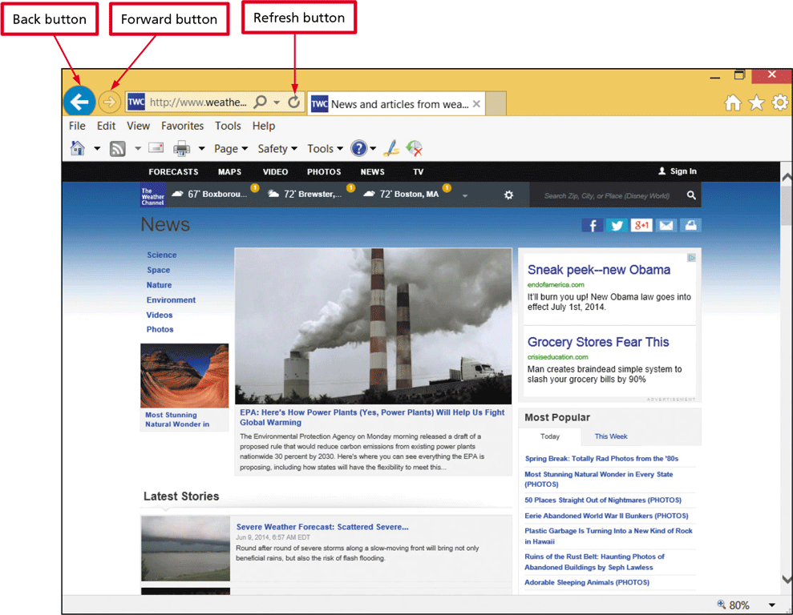
Navigating Through Recently Viewed Pages
Tap or click the Refresh button or menu command, or swipe at the top of the mobile browser window to access the refreshed webpage

Slide 28
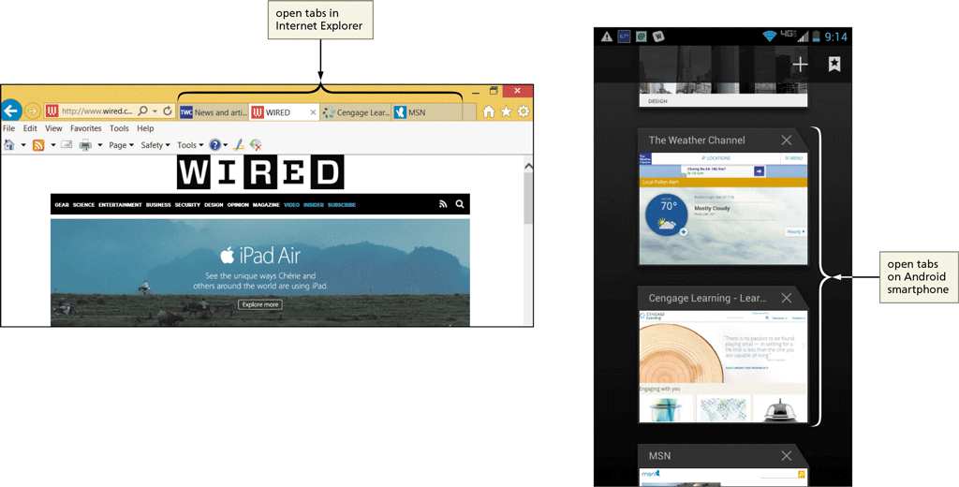
Browsers
Using Tabbed Browsing
Allows you to open multiple webpages in a single browser window

Slide 29
Browsers
Using Tabbed Browsing (continued)
Each page can be opened in its own tab
On mobile devices, view open tabs using a menu command
New tab button displays a blank tab on which you can enter a URL
Tapping or clicking a tab brings the webpage and tab from the background to the foreground
Click the New Tab button to open a blank tab then enter URL in the Address box to open a webpage in the new tab

Slide 30
Opening and Closing Multiple Webpage Tabs
Tap or click the Internet Explorer to open Internet Explorer
Tap or click the New Tab button on the tab row to open a new tab page
Type espn.com in the Address bar
Press the ENTER key or tap or click the appropriate button to open the home page in the new tab

Slide 31
Opening and Closing Multiple Webpage Tabs
Tap or click the New tab button on the tab row to open a new tab
Enter nfl.com in the Address box
Tap or click the necessary button to open the NFL.com home page
Tap or click the Close Tab button on the NFL News webpage tab to close the webpage
Tap or click the New tab button on the tab row to open a new tab
Tap or click the ‘Reopen closed tabs’ button on the New tab page, if available, to see a list of closed tabs

Slide 32
Opening and Closing Multiple Webpage Tabs
Tap or click the NFL News link to reopen the webpage in a new tab
Close the browser and close all tabs, if asked
Start the browser
Tap or click the New tab button on the tab row to open a new tab page if necessary
Tap or click the ‘Reopen last session’ button if available to reopen the tabs that were open when you closed the browser

Slide 33
Opening and Closing Multiple Webpage Tabs

Slide 34
Switching Between Open Webpages Using a Mobile Browser
Locate the Tabs button, which likely will appear in the upper-right corner of the mobile browser window
Tap or click the Tabs button to display open tabs
Swipe up or down, or use a scroll bar if available, to view all open tabs
Tap or click a tab to display it in the foreground

Slide 35
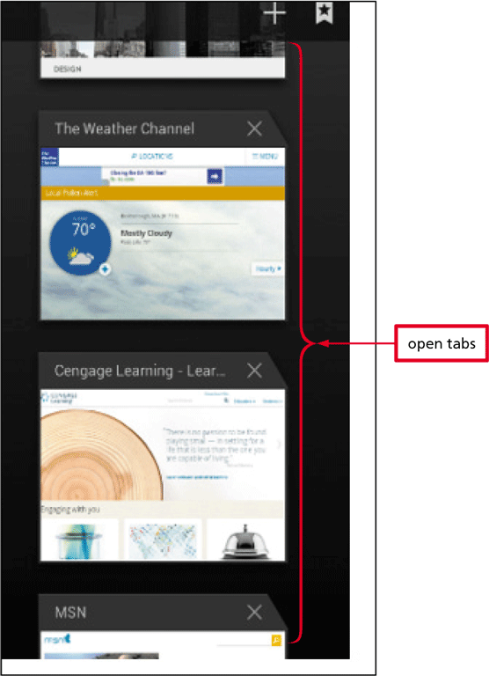
Switching Between Open Webpages Using a Mobile Browser

Slide 36
Creating a Website Shortcut on the Desktop
Navigate to www.msn.com if necessary
If necessary, minimize browser window so that you can see the desktop
Tap or click the MSN icon in the Address bar or select the URL in the Address bar
Drag the icon or suggested URL to the desktop to create a shortcut

Slide 37
Creating a Website Shortcut on the Desktop

Slide 38
Saving Online Information
Printing a Webpage
Preview the webpage
Change paper size, margins, and orientation, header and footer content
Print a printer-friendly format

Slide 39
Saving Online Information

Slide 40
Saving Online Information
Saving a Webpage
Webpage, complete (HTML files and all related files)
Archive file of webpage
HTML file only
Text file
Sharing a Webpage
‘Send page by email command’ in browser
Email or Text icon at website
Share via social media and content sharing websites

Slide 41
Saving Online Information

Slide 42
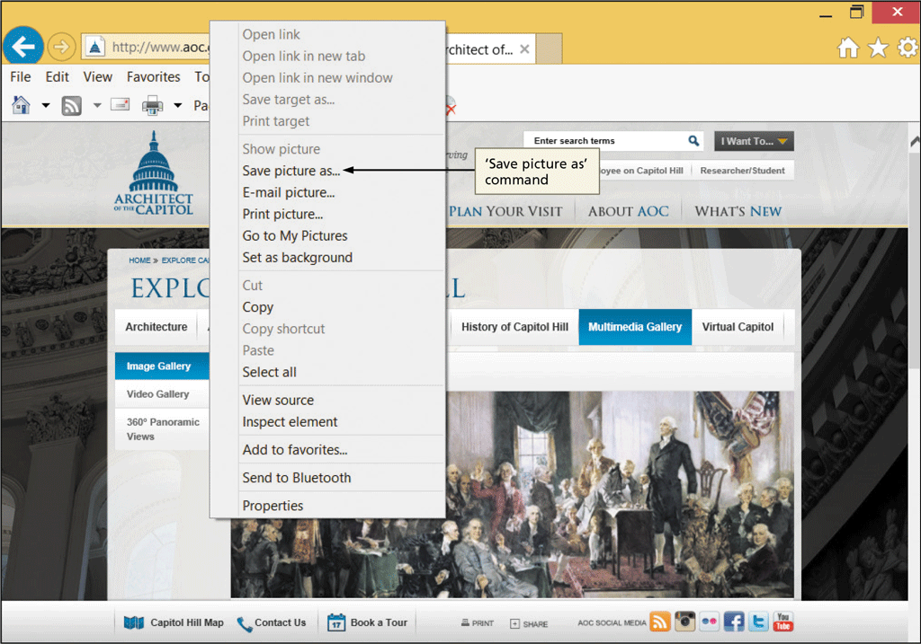
Saving Online Information
Saving a Webpage Image
Ownership and copyright considerations
Typically can right-click image to display menu

Slide 43
Using the Web: Risks and Safeguards
Protecting Your Computer from Hackers
A hacker is an individual who uses his or her technology skills to access a network and the computers on that network without authorization
A firewall is hardware and/or software that protects a computer or network from unauthorized access by hackers
Operating system might provide a firewall
Use password protection
Many routers and other network devices include firewalls

Slide 44
Using the Web: Risks and Safeguards

Slide 45
Using the Web: Risks and Safeguards
Virus Protection
A virus is a small, potentially damaging computer program or app
Most browsers include filters and virus detection
Can be spread to other computers through:
Sending/receiving e-mail message, text message, or file attachment
Downloading software and apps
Install virus protection software to protect against infection and update it automatically

Slide 46
Using the Web: Risks and Safeguards
Shopping Safely Online
Use reputable online vendors
Pay with a credit card over a secure connection
Never send your credit card number or other personal information as an email or text message

Slide 47
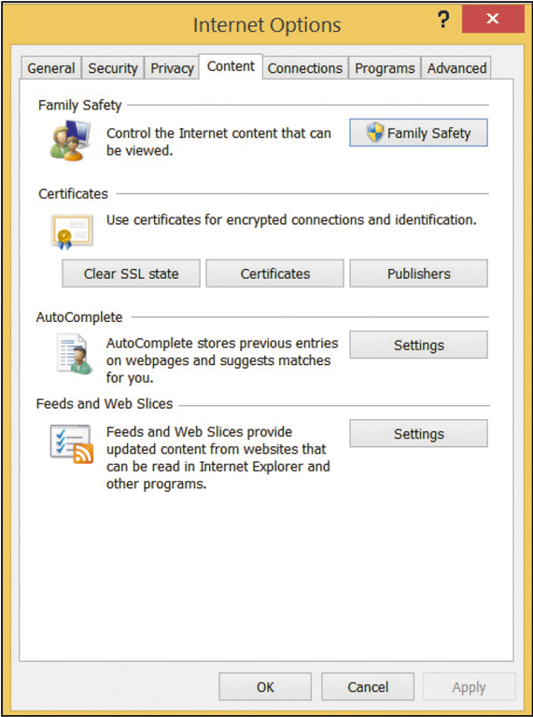
Using the Web: Risks and Safeguards

Slide 48
Using the Web: Risks and Safeguards
Protecting against Malicious Websites
A malicious website is a website designed to look like a legitimate site, but is owned by hackers or online thieves
Used by thieves to:
Collect personal information, such as name and password
Distribute malicious software
Most browsers have built-in filters for detecting malicious websites

Slide 49
Using the Web: Risks and Safeguards
Keeping Your Personal Information Private
Information privacy refers to the right of individuals and companies to deny or restrict the collection and use of personal information.
Entities that might be collecting and using your private information:
Employers
Internet Service Providers
Government agencies
Privacy Advocates

Slide 50
Using the Web: Risks and Safeguards
Keeping Your Personal Information Private (continued)
Privacy Advocates – dedicated to informing government agencies and consumers about privacy issues and maintaining information about privacy issues at their websites
Business websites
Cookies – Small text file stored on a computer of device
Spyware – technology that accesses your computer system to gather information without your knowledge and approval
Adware – form of spyware that gathers information then uses it to deliver targeted web advertising

